Slide 2
To understand when, why and how New Year is celebrated.

Slide 3
New Year’s Eve
New Year’s Eve is celebrated on December 31st, the last day of the calendar year.
People enjoy getting together with family or friends and counting down the hours, minutes and seconds to the start of a brand
new year. You might even be allowed to stay up extra late!
In London, Big Ben chimes to tell us when the new year has arrived, then a huge firework display takes place on the banks of the River Thames.

Slide 4
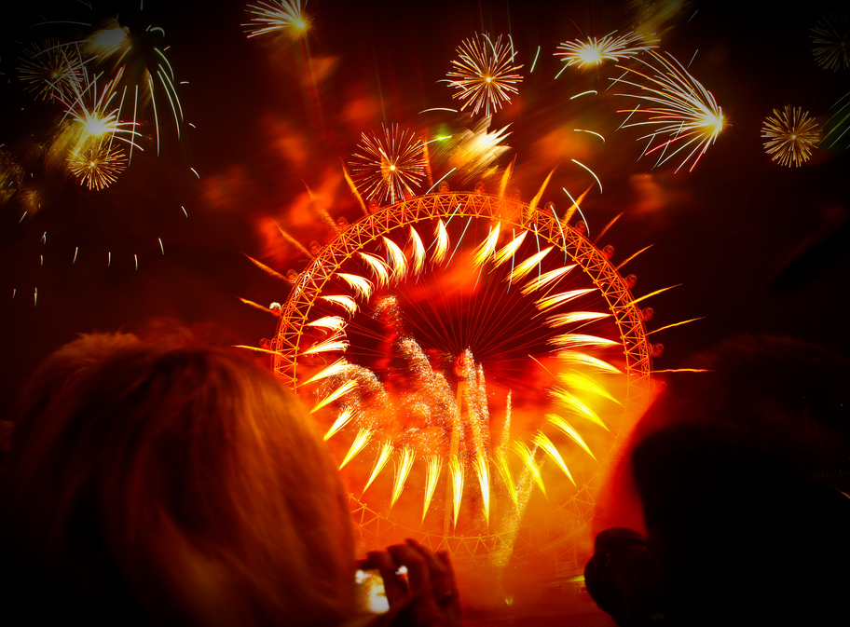
Photos courtesy of Natesh Ramasamy (@ flickr.com) - granted under creative commons licence - attribution

Slide 5
Welcoming a New Year
You might hear people singing ‘Auld Lang Syne’ to welcome in the new year. This is a very old poem written by a famous Scottish poet called Robert Burns. What do you think it is about?
Should auld acquaintance be forgot,
And never brought to mind?
Should auld acquaintance be forgot,
And auld lang syne.
Chorus
For auld lang syne, my jo,
For auld lang syne,
We'll tak a cup o' kindness yet,
For auld lang syne.

Slide 6
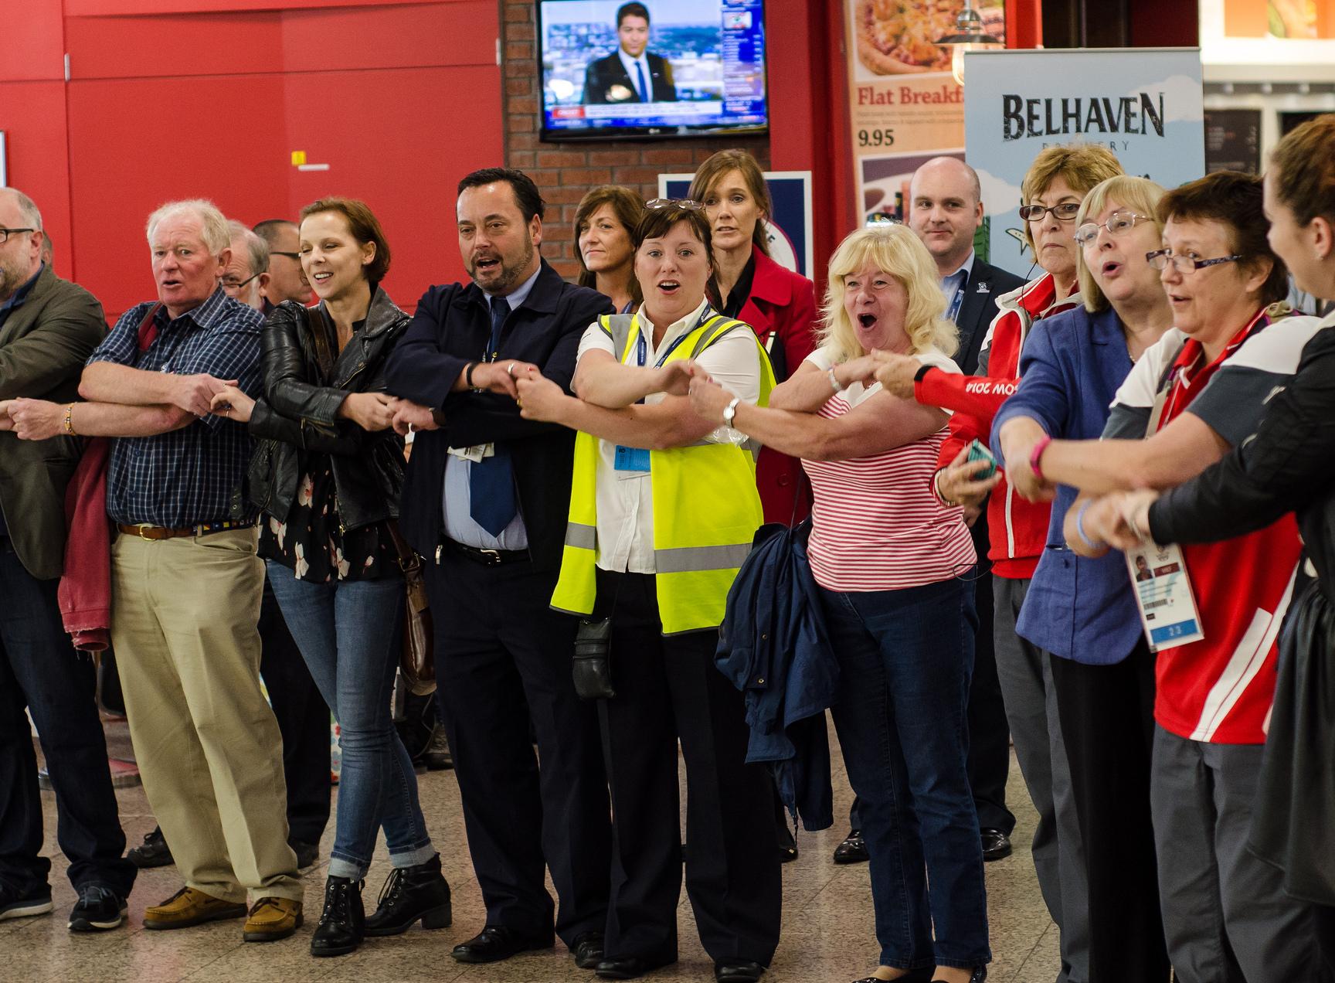
Photos courtesy of Alex Slaven Photography (@ flickr.com) - granted under creative commons licence - attribution

Slide 7
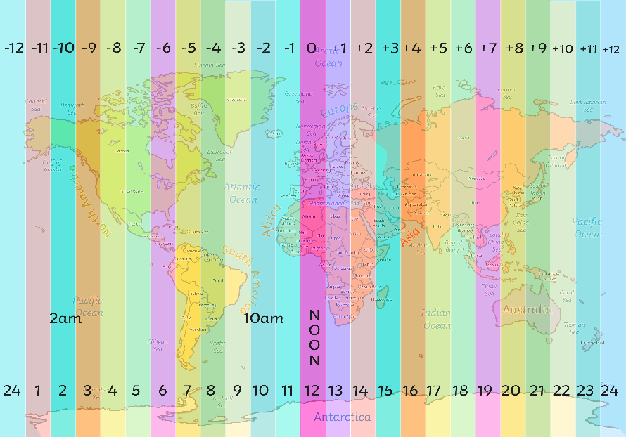
Different Times to Celebrate
Not every place in the world welcomes in the new year at exactly the same time because different places are in different time zones.
Kiritimati, Christmas Island and Kiribati are some of the first places to celebrate with Honolulu, Hawaii being one of the last.

Slide 8
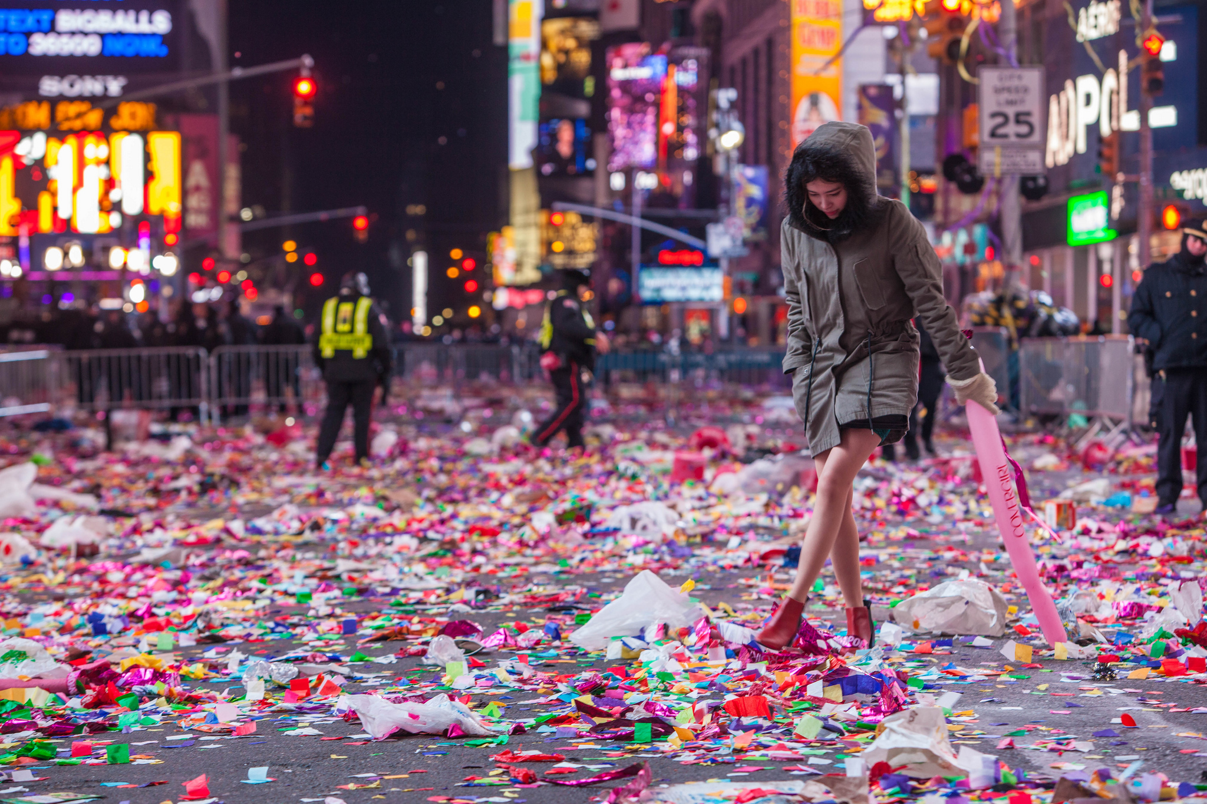
New York
Photos courtesy of Anthony Quintano (@ flickr.com) - granted under creative commons licence - attribution

Slide 9
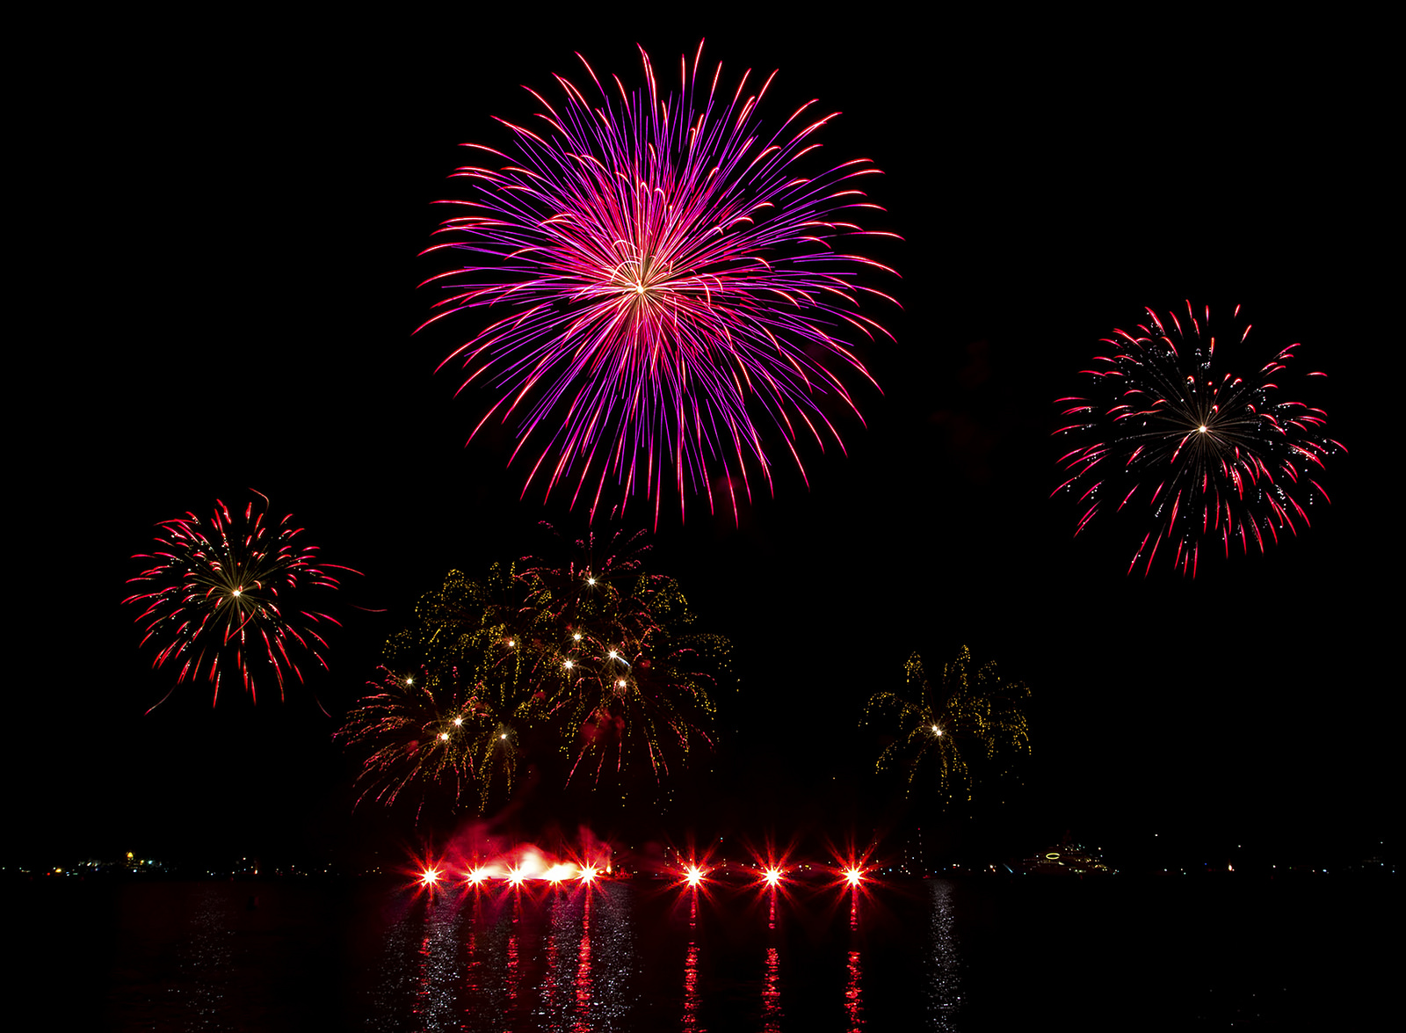
China
Photos courtesy of liquidphotosymail.com (@ flickr.com) - granted under creative commons licence - attribution

Slide 10
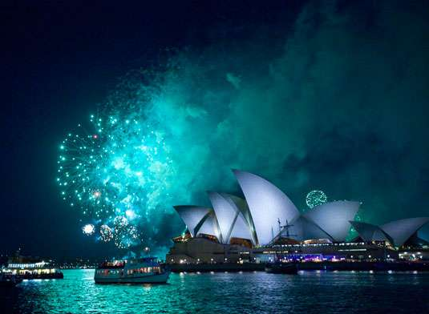
Australia
Photos courtesy of l MandyHallMedia (@ flickr.com) - granted under creative commons licence - attribution

Slide 11
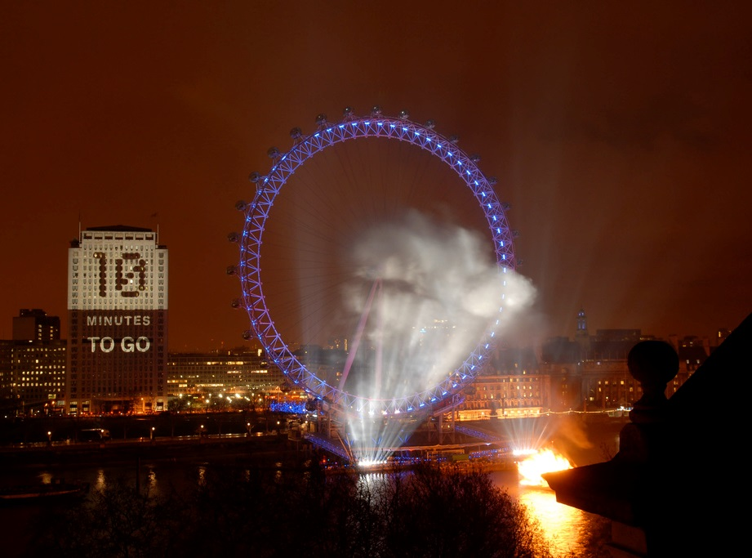
London
Photos courtesy of jtlondon (@ flickr.com) - granted under creative commons licence - attribution

Slide 12
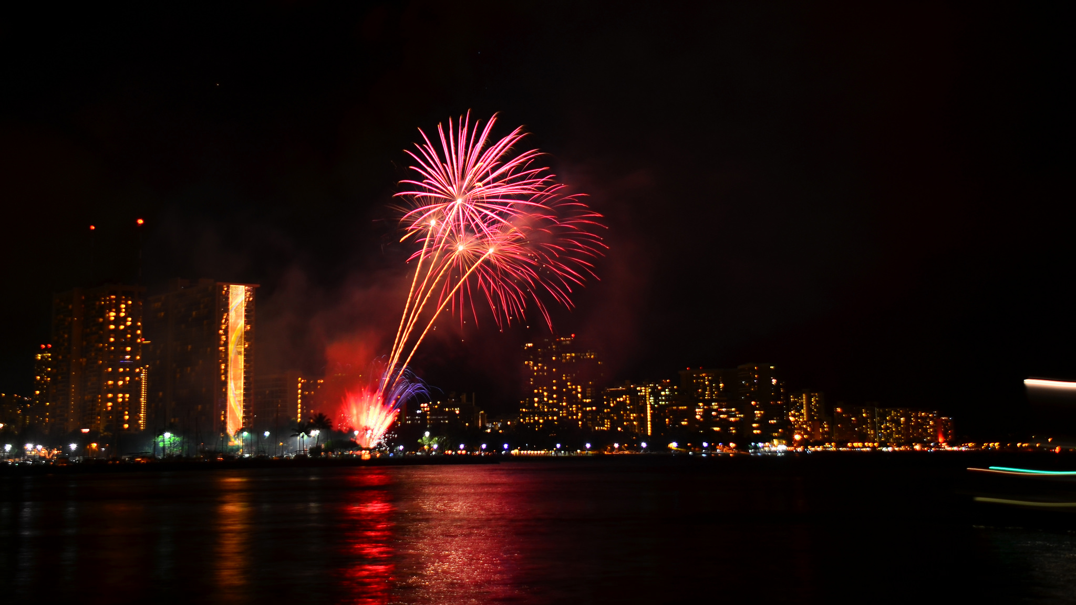
Hawaii
Photos courtesy of Edmund Garman (@ flickr.com) - granted under creative commons licence - attribution

Slide 13
Making a New Year Resolution
New Year’s Day is on January 1st and is often seen as a fresh start.
Many people like to make new year resolutions which are personal goals that they aim to work on throughout the year.
Anyone can make a new year resolution and some make more than one!
Some examples: Getting homework in on time, keeping your bedroom tidy, doing more exercise or eating more healthily.
Have you made any? What are they?

