Slide 1
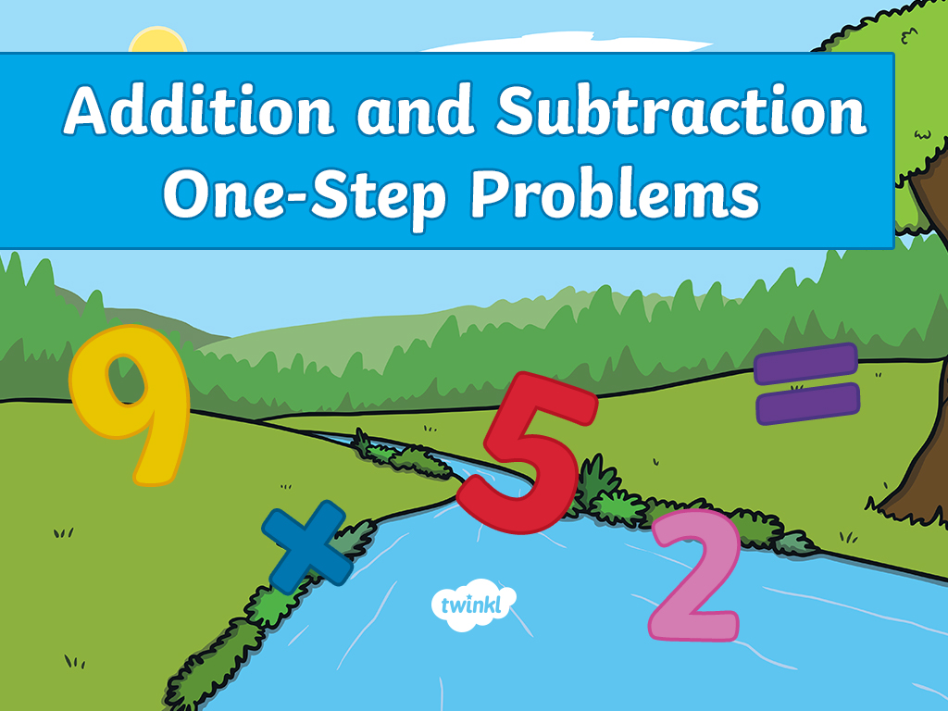

Slide 2
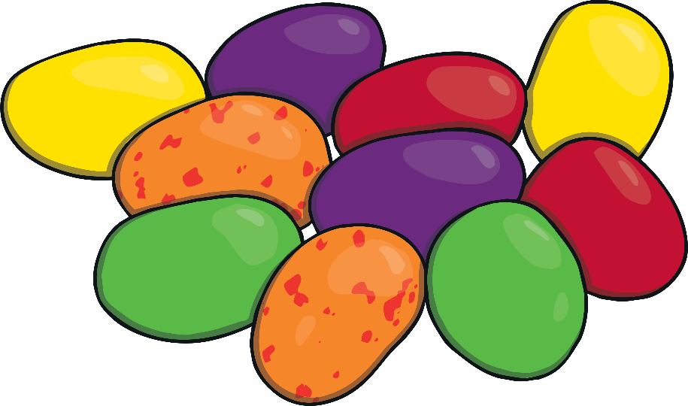
On Christmas Day, Johnny ate 12 sweets. Later that day, he ate 7 more sweets.
How many did he eat altogether?
19 sweets
Click here for answer!

Slide 3
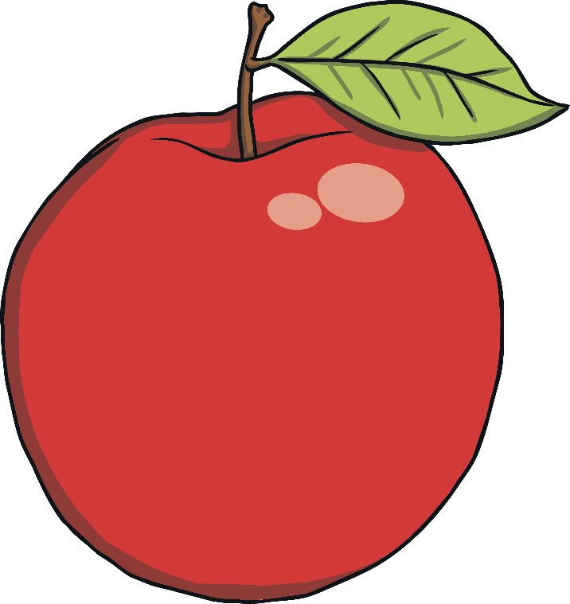
There were 9 apples on a tree. There were 21 apples on another tree.
How many apples were there on the two trees in total?
30 apples
Click here for answer!

Slide 4

Aoife had 35 crayons. She lost 15 of them. How many crayons does Aoife have now?
20 crayons
Click here for answer!

Slide 5
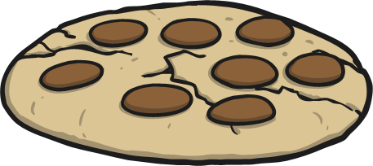
Ben baked 40 cookies for the school bake sale. Tara baked 22 cookies. How many cookies did they make altogether?
62 cookies
Click here for answer!

Slide 6
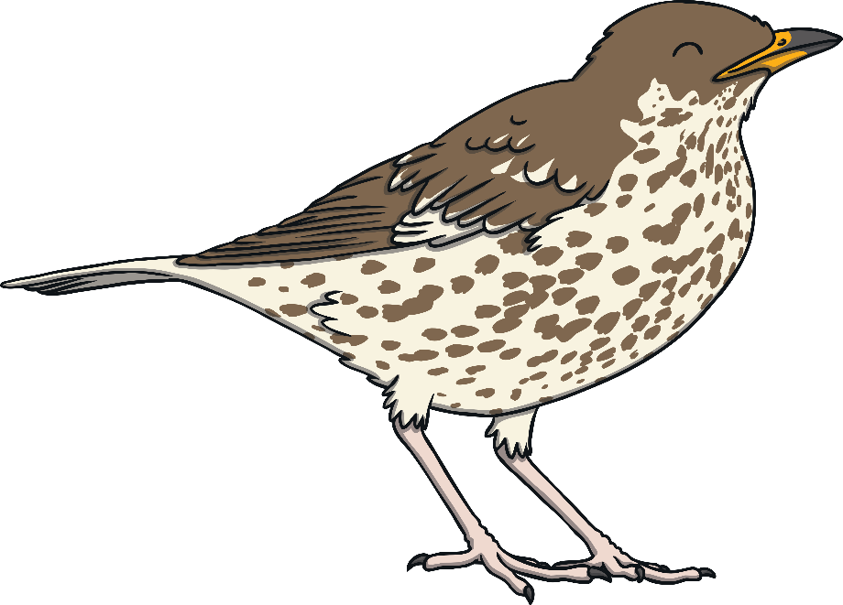
There are 27 birds in a field. Some more fly into the field. Now, there are 58 birds in the field.
How many more birds are there now?
31 birds
Click here for answer!

Slide 7


