Slide 2
click on a shape

Slide 3

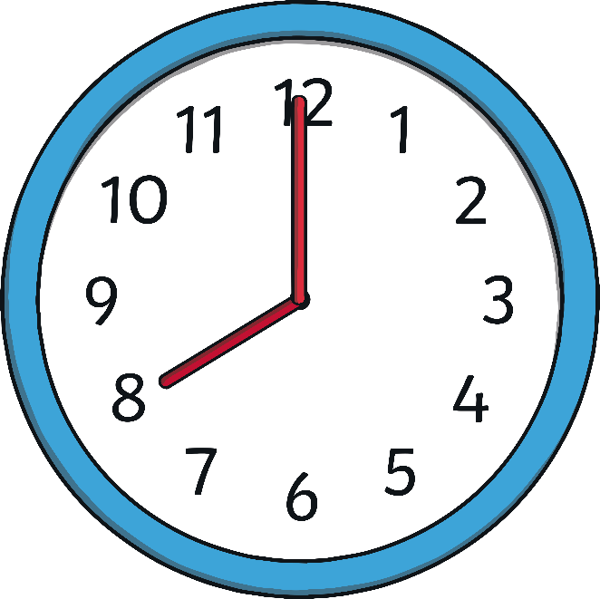
circle
disks
clock
back

Slide 4

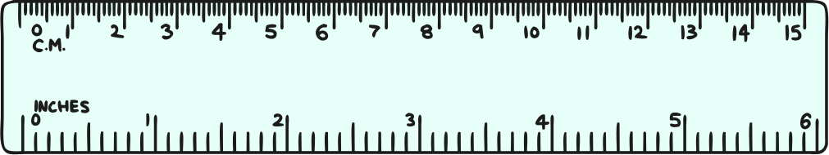
rectangle
rulers
envelopes
back

Slide 5
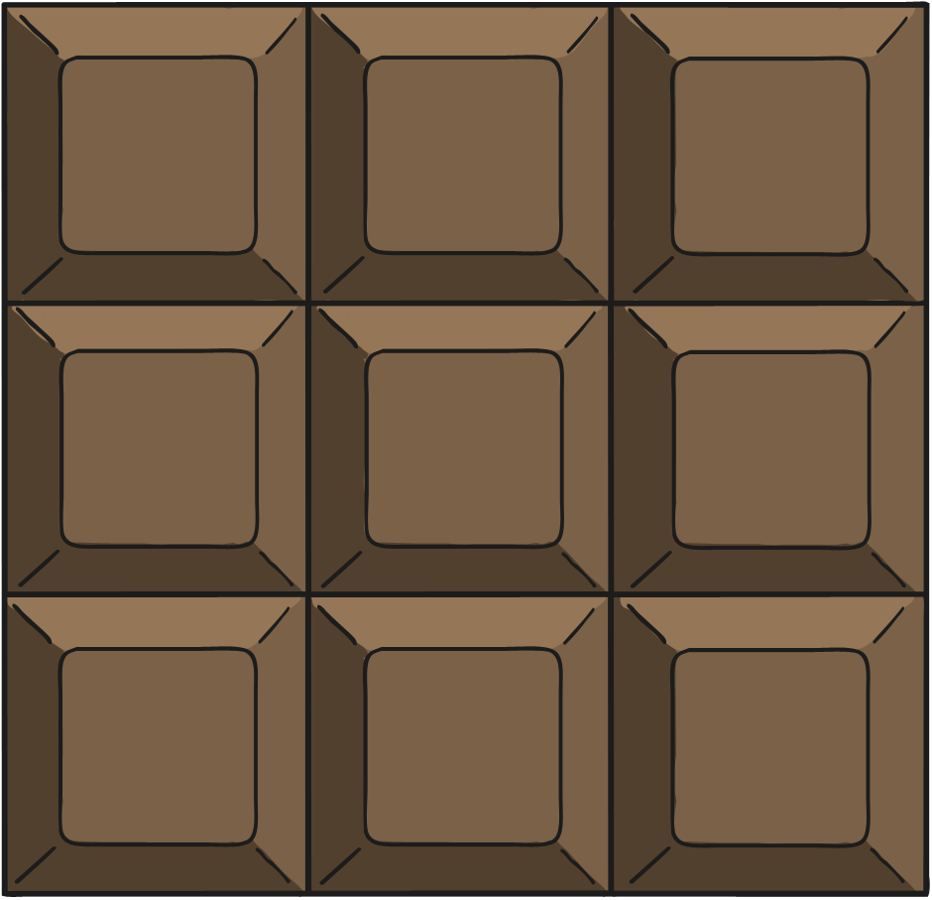

square
chocolate
windows
back

Slide 6

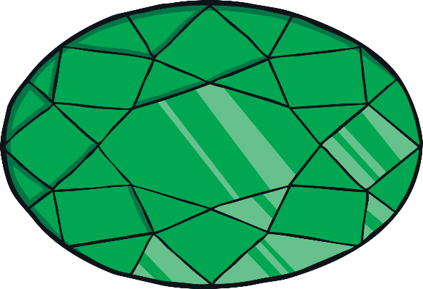
oval
jewel
mirror
back

Slide 7
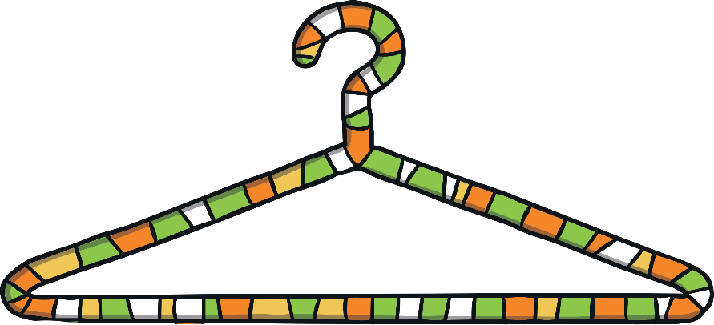
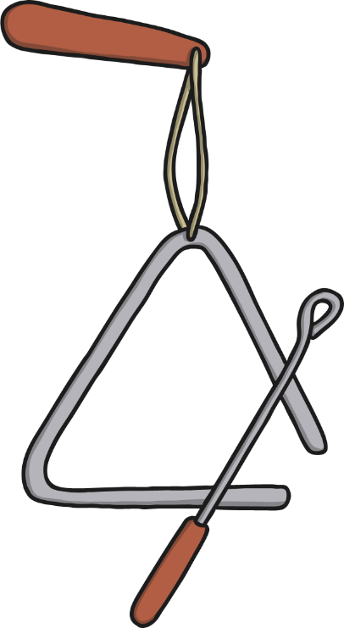
triangle
coat hanger
triangle
back

