Slide 1


History
World War II
Year One
History | UKS2| World War II | Rationing | Lesson 3

Slide 2
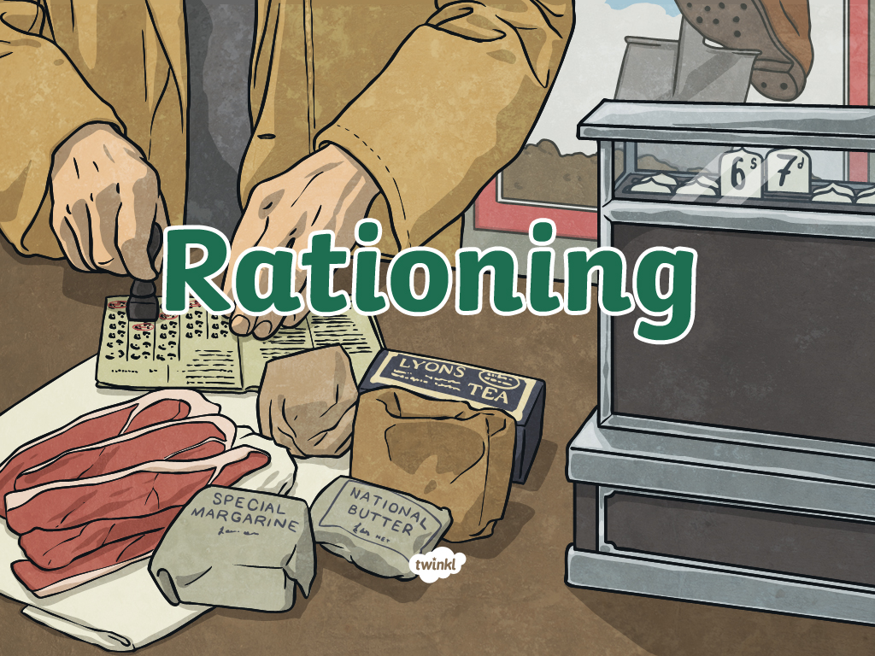

Slide 3
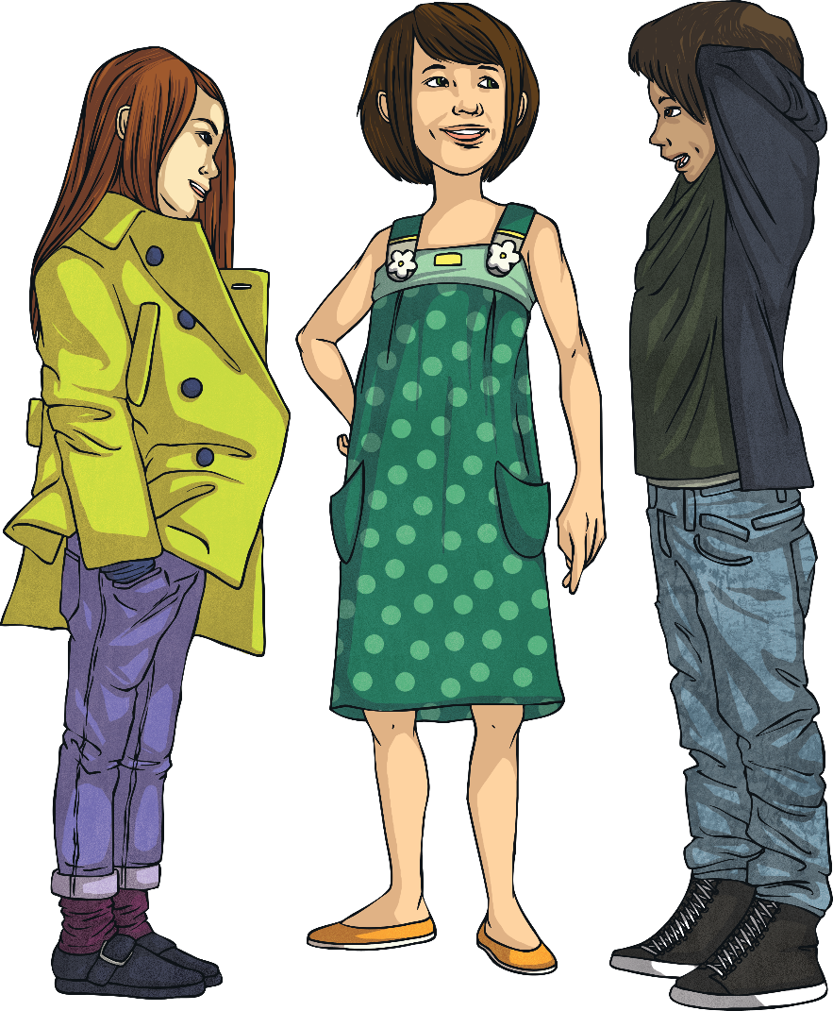
Food, Food, Food
At the start of the war, Britain began to ration food. To ration something means
to allow each person to only have a fixed amount of it.
Discuss the following questions with
the other members of your group:
Why do you think it was necessary to ration food?
What foods do you think
were rationed?
How do you think the rationing of food was organised?
How do you think everyday lives changed as a result of rationing?

Slide 4
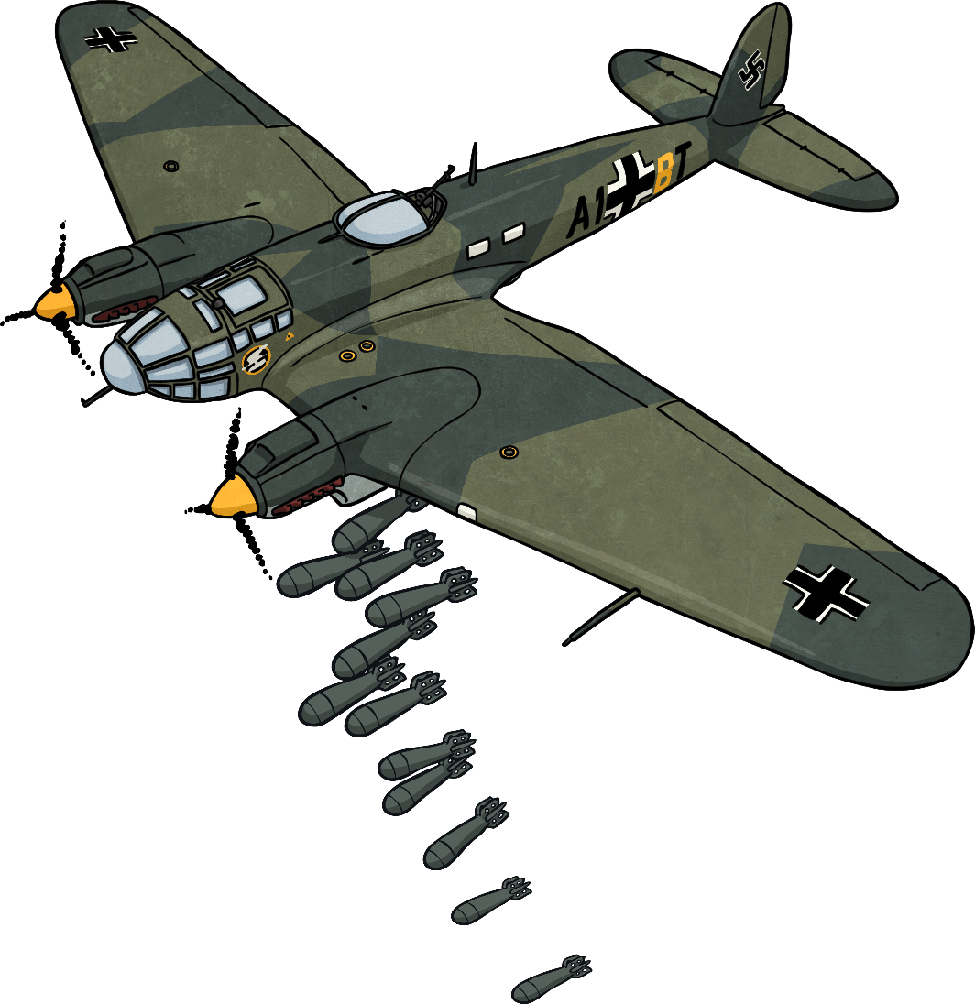
Food, Food, Food
At the start of the war, Britain
was importing more than
two-thirds of its food from
overseas. When supply ships
coming into the country were
targeted by German bombers
and the possibility of invasion or
isolation became a reality, it became
necessary for Britain to conserve as
much food as possible. People needed to
become more creative with the supplies
they had and began to grow more of their
own food.
The rationing of food began in January
1940 and lasted until 1954, which was
actually nine years after the war had ended.
Why do you think rationing continued
after the war?

Slide 5
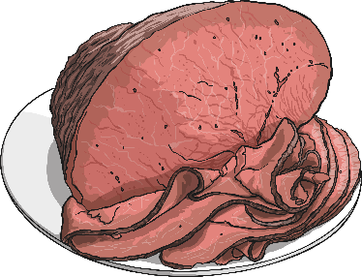
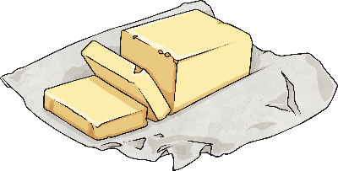
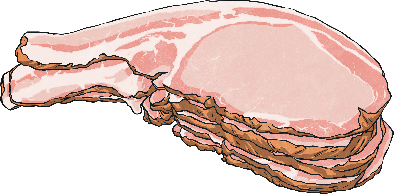
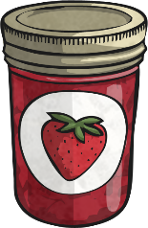

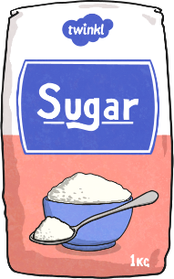
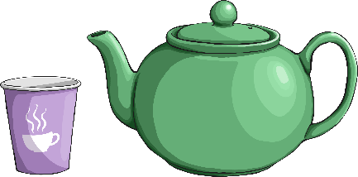
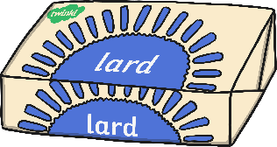
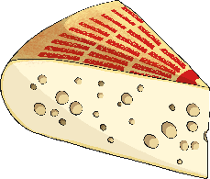
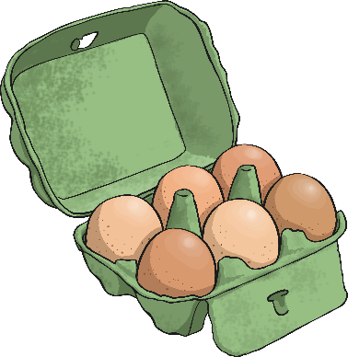
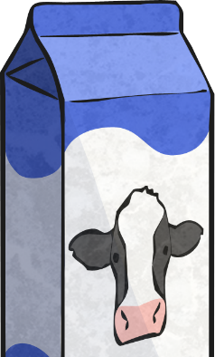
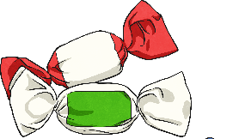
Food, Food, Food
How does this sound?
How much do you think you eat of these foods each week nowadays?
Look at the list of foods that were rationed during the war and the average allowances for a child between aged five and sixteen.
Bacon and ham: 115g
Jam: 115g
Butter: 55g
Margarine: 55g
Meat: 175g
(adults got double this)
Milk: 3 ½ pints
plus equivalent of 1 pint of powdered milk (and children got milk at school)
Cheese: 115g
Cooking Fat: 55g
Sugar: 225g
Tea: none (adults got 50g)
Eggs: 3
(adults had 1) plus equivalent of 3 powdered eggs
Sweets: 75g

Slide 6
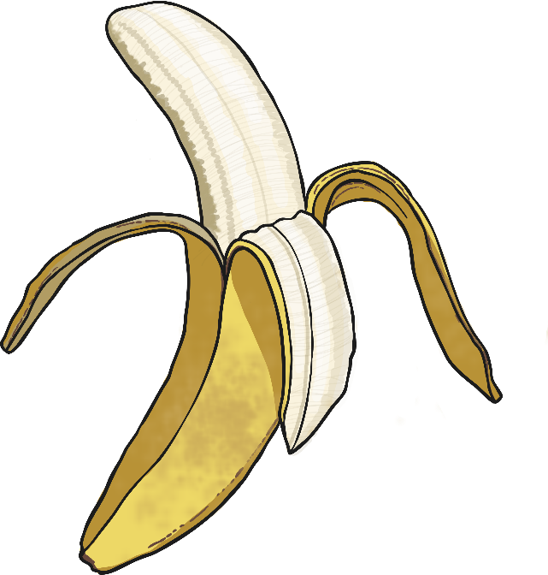
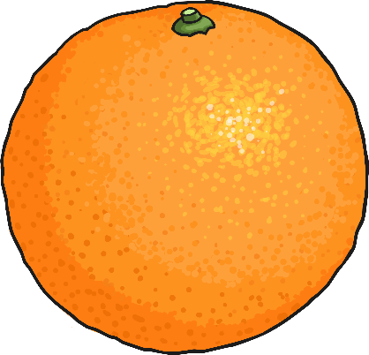
Food, Food, Food
Although many foods were not officially rationed, they were in very short supply or simply not available. Some children grew up never seeing bananas or oranges for example, as these were imported from overseas. Some people sold or traded goods on the black market, which means to illegally trade goods that were in controlled or limited supply.
What foods or other goods do you think were in short supply? Why?

Slide 7
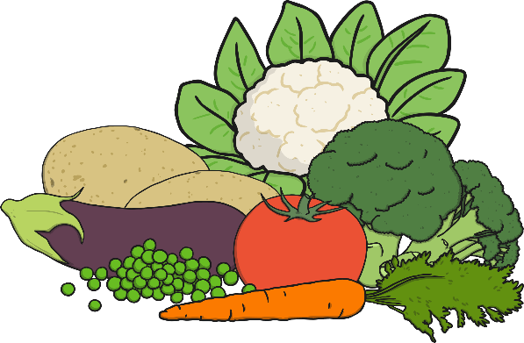
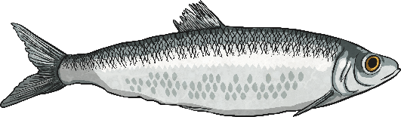
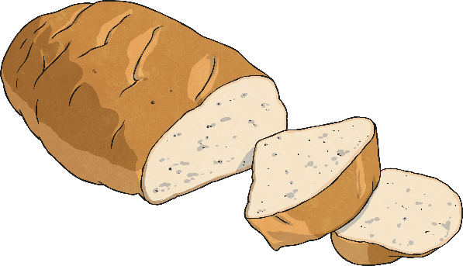
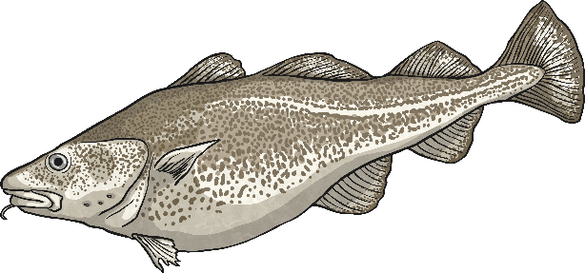

Food, Food, Food
The following foods were never rationed during the war:
Fresh Fruit and Vegetables
Bread
Fish
However, due to reduced importation of white flour, there was a ‘national loaf’ made with wholegrain flour, which many people said
was like grey mush.
Although they were not readily available.
Although it was
very expensive!
Some people also ate meat they could hunt themselves like rabbit or squirrel!
A ‘Lend Lease’ contract with America and Canada later in the war meant
that the import of powdered milk and eggs and tinned meats, like corned beef
and Spam, began.

Slide 8
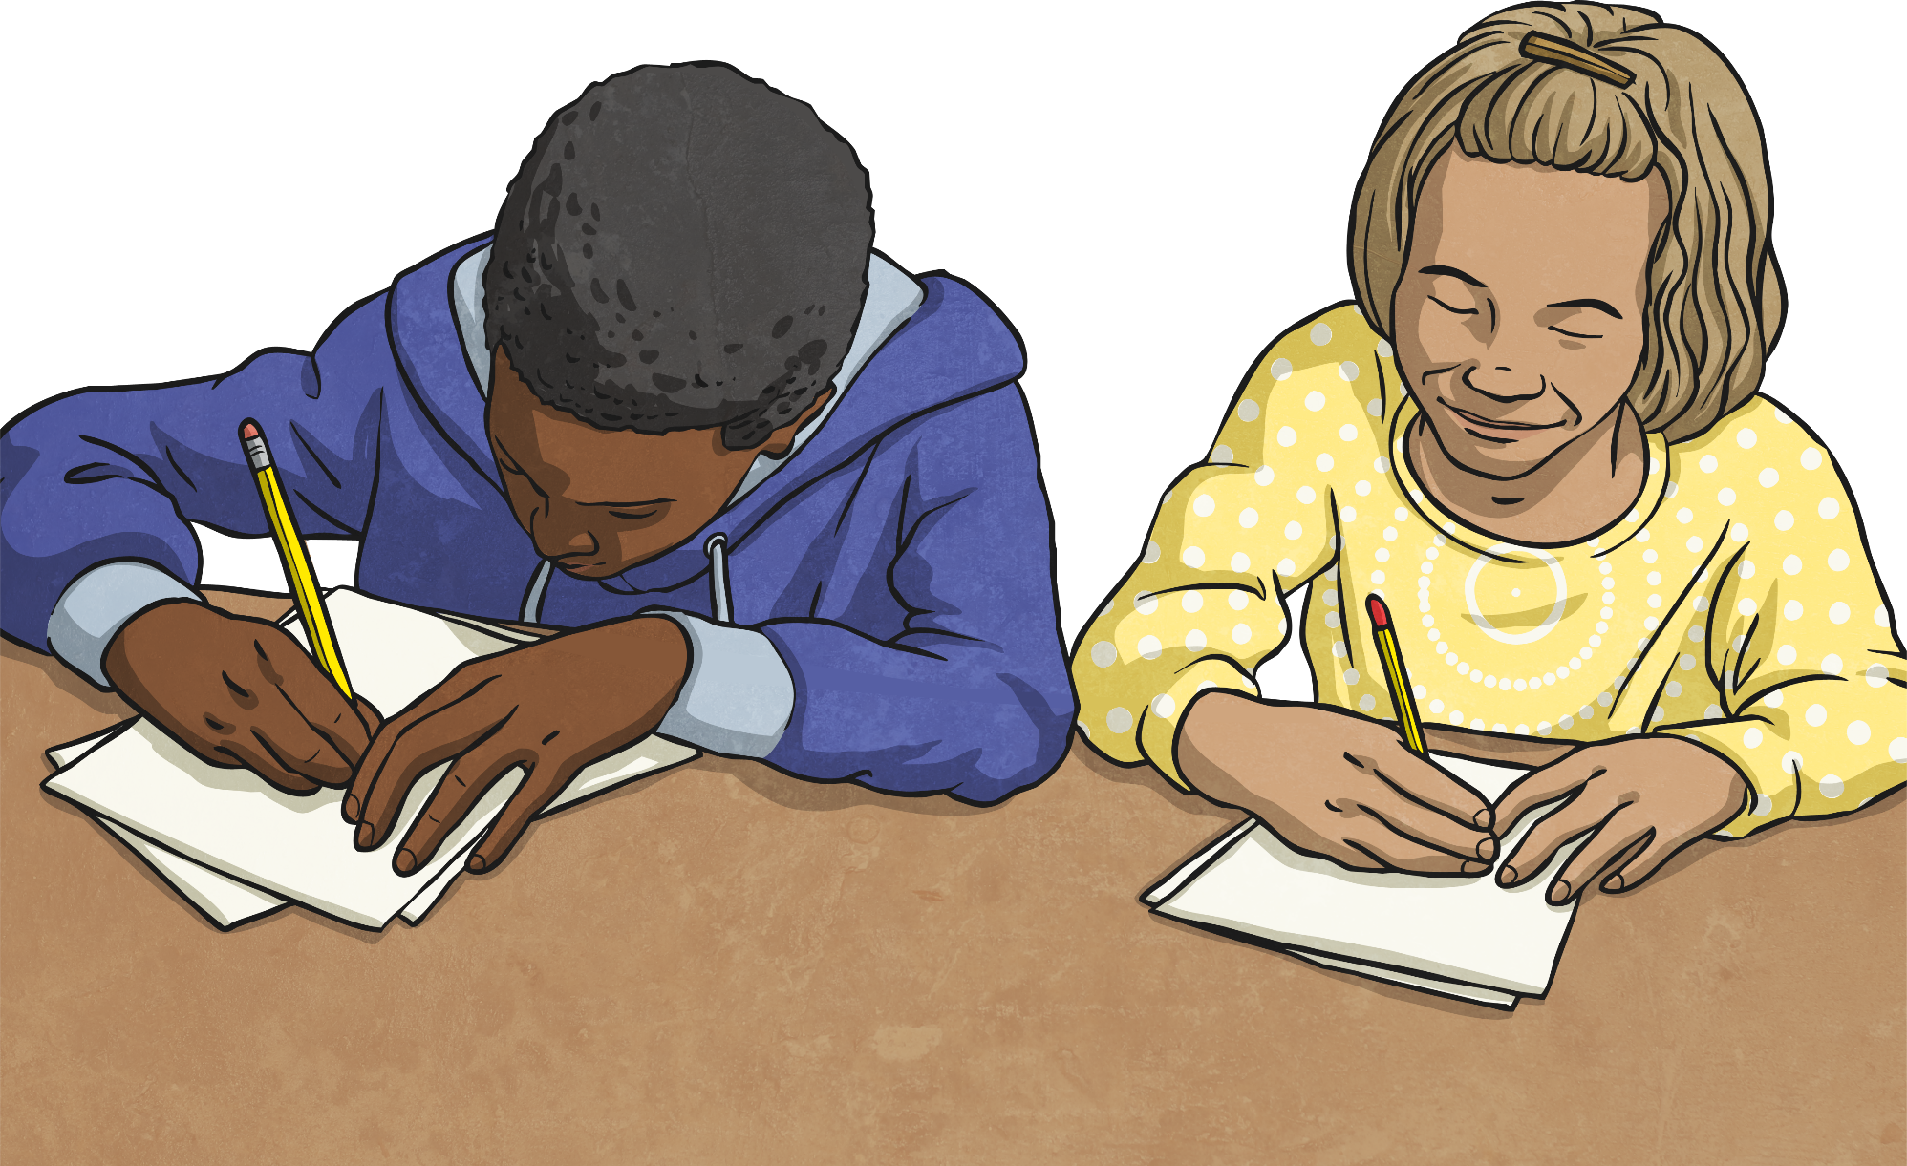
Rationing Questions
Read the information about rationing during World War II
then answer the comprehension questions on the Rationing Comprehension Activity Sheet.

Slide 9


