Slide 2
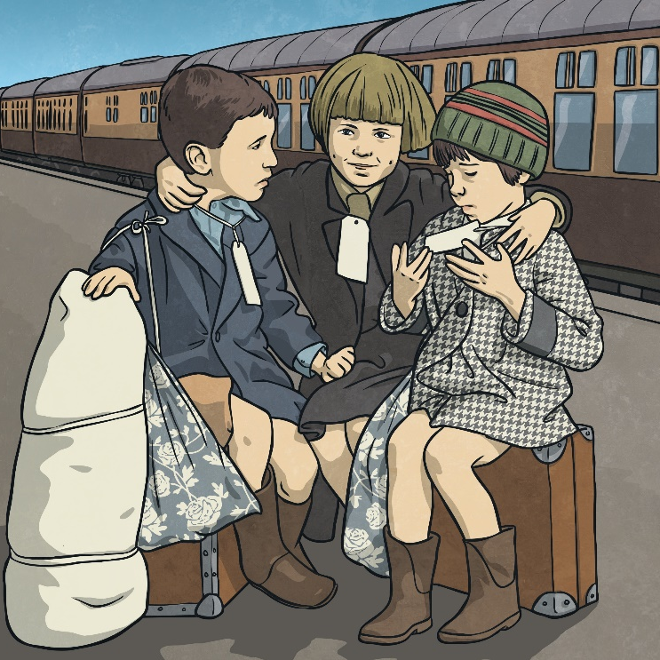
Evacuation
At the start of the war, the government realised that cities would be targeted. They decided to encourage parents to allow their children to be evacuated to safer, rural locations.
Parents were given a list of things to pack for their children. The children had labels attached to them with their name, age and home address on them.
Children were taken on trains or buses to their new locations. A person called a billeting officer would collect the children and take them to a village hall. People who had volunteered to take in the evacuees would then walk amongst them and choose the children they liked the look of.

Slide 3
Evacuation
For some children, evacuation was a positive experience. For others it was not. Talk about the positives and negatives of being evacuated.
Talk About It
Positive Points of Evacuation | Negative Points of Evacuation
Children were kept safe from bombs. | Children missed their parents.
Children got to live in the peaceful, beautiful countryside. | Sometimes brothers and sisters were kept in separate places.
Many children stayed with caring people. | Some children stayed with people who weren’t very nice to them.

Slide 4
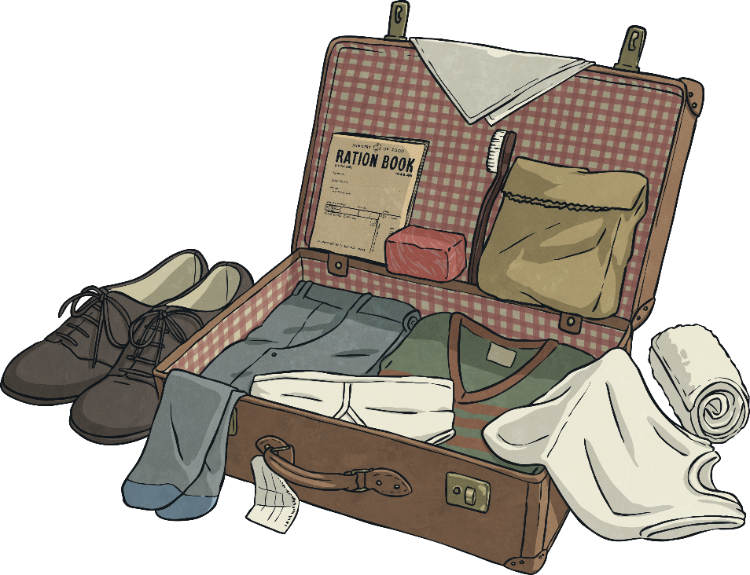
Evacuation
Parents were given a list of things to pack for their children which included a gas mask, underwear, pyjamas or a nightie, plimsolls, toothbrush, comb, a towel, soap, a flannel, handkerchiefs and a warm coat.
This list doesn’t sound like very much, but some families struggled to even get these items. A lot of children who were being evacuated came from very poor families.
Some children took a toy with them but it would have been something small. They had to be able to carry all their possessions themselves in one small suitcase.

Slide 5
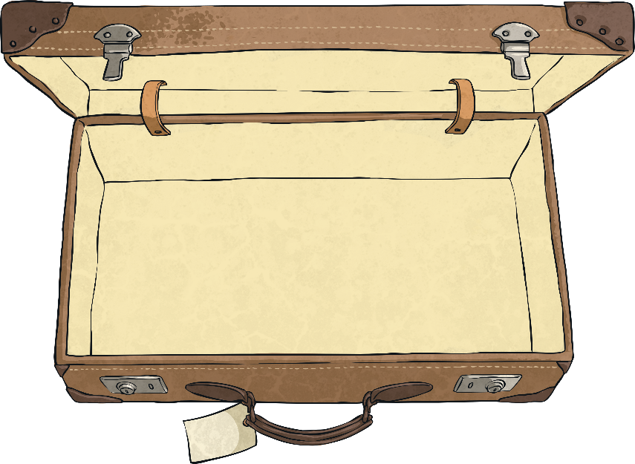
Evacuation
Your task is to imagine you are being evacuated and you have to decide what
to pack.
You will need to think about the following things:
What practical items will you need?
Will you take a toy?
Will you pack any items that remind you of home?
Whatever you pack, you must be able to carry it all yourself.
You could draw your items and write about them on the Twinkl Evacuation Suitcase Activity.

