Slide 2


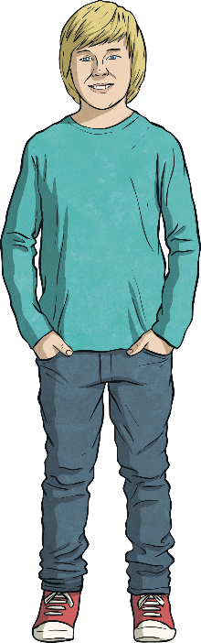

Each boy is wearing 2 shoes. There are 4 boys.
Let’s add the shoes.
2 + 2 + 2 + 2 = 8
How many times do you see the number 2?
Answer
4
We can write this sum a different way.
Answer
4 × 2 = 8

Slide 3
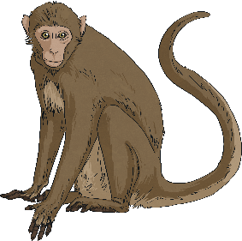

Each monkey has 2 bananas. There are 6 monkeys.
Addition sentence:
2 + 2 + 2 + 2 + 2 + 2 = 12
Click to reveal
Multiplication sentence:
6 × 2 = 12

Slide 4
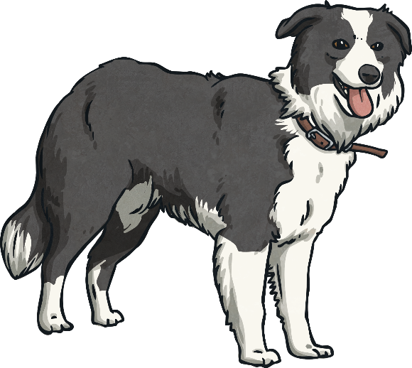


Each dog has 4 legs. There are 3 dogs here.
How do we write this as an addition sentence?
4 + 4 + 4 = 12
Answer
How do we write it as a multiplication sentence?
Answer
3 × 4 = 12

Slide 5
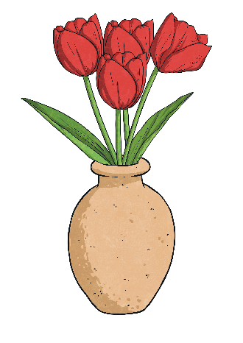
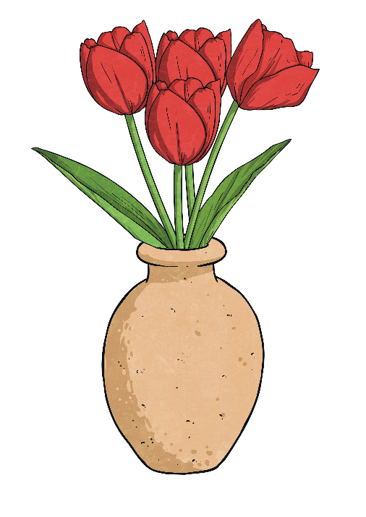
There are 4 flowers in each vase. There are 5 vases here.
How do we write this as an addition sentence?
Answer
4 + 4 + 4 + 4 + 4 = 20
How do we write it as a multiplication sentence?
Answer
5 × 4 = 20

Slide 6
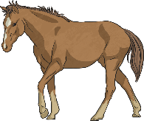
Try these with your partner.
Each horse has 4 legs. There are 6 horses here.
4 + 4 + 4 + 4 + 4 + 4 =
24
Answer
6 × 4 = 24
How do you write this as a multiplication sentence?
Answer
How many legs do the horses have altogether?
Answer
24

Slide 7



Try these with your partner.
Sam had 3 puppies. Each puppy had 2 toys.
6
How many toys were there altogether?
Answer
Answer
How do you write that as a multiplication sentence?
3 × 2 = 6

Slide 8
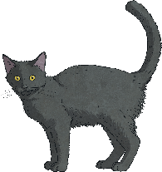


Try these with your partner.
How many legs have…
…3 cats?
…6 cats?
…4 cats?
3 × 4 = 12
6 × 4 = 24
4 × 4 = 16
Answers

