Slide 2

1942
The first rocket called the V2 was launched. It was designed by a German engineer called Wernher Von Braun.
1949
The first monkey is sent to space. His name was Albert II and was a Rhesus monkey. He flew 83 miles away from Earth!
1940
1945
1950
1947
The first animals were sent to space to see how they would react. The fruit flies were sent to space with some corn for food.

Slide 3

1957
Laika, the Russian space dog, became the first animal to orbit the earth. Her name means ‘barker’ in Russian.
1957
On the 4th October, Russia launched Sputnik, the first satellite into space. ‘Sputnik’ means ‘satellite’ in Russian. From this day on, the space age had begun!
1950
1955
1960
1959
Russian and American scientists were in a competition to send a spacecraft to the moon. Russia succeeded first. A space probe called Lunar 2 was sent and it travelled at such an immense speed that it would have killed a person if they were inside it!

Slide 4
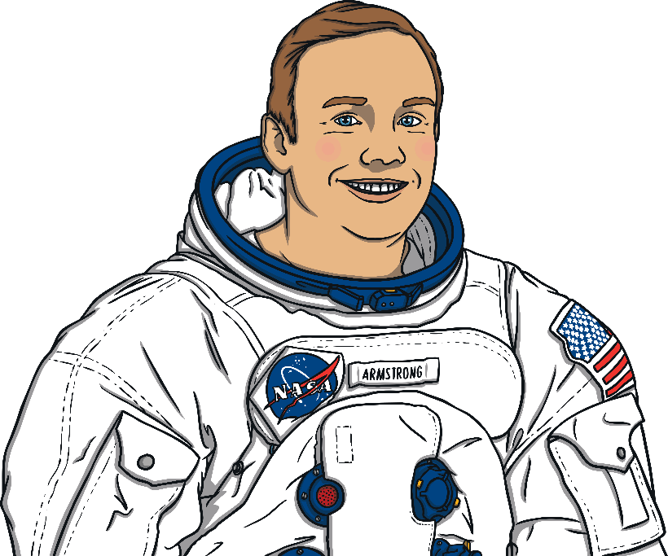
1961
Yuri Gagarin became the first man in space.
1963
Valentina Tershkova was the first woman in space and a crater on the far side of the moon is named after her!
1960
1965
1970
1969
Neil Armstrong and Buzz Aldrin set foot on the moon! The first words said on the moon were ‘the Eagle has landed’.

Slide 5

1973
A Russian probe is sent to explore Mars. It stayed in orbit for a year but it was destroyed when the parachute failed to open upon landing.
1970
1975
1980

Slide 6

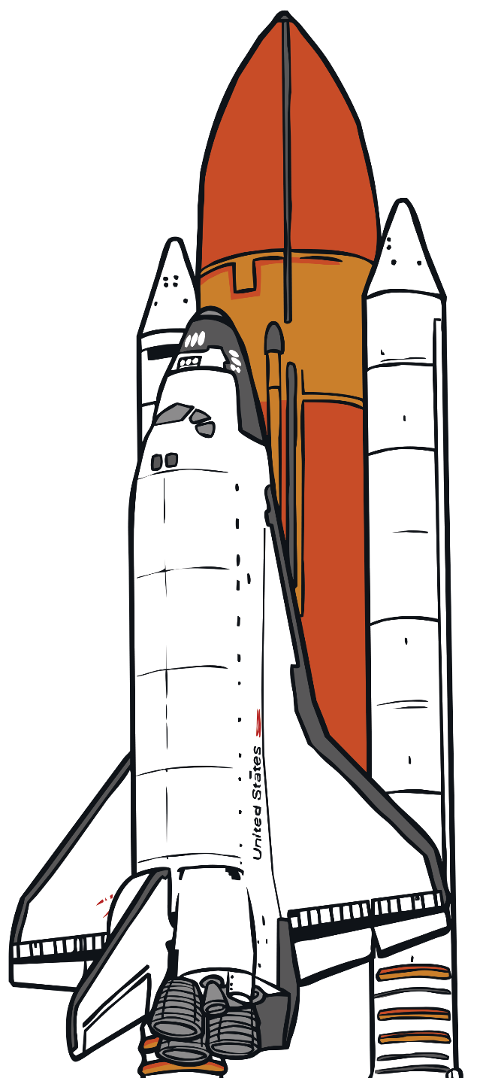
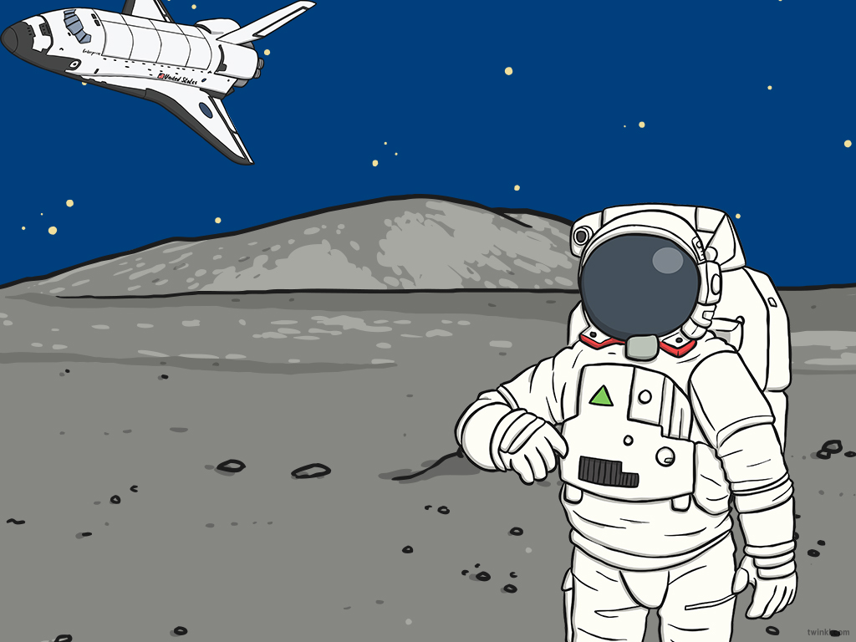
1980
1985
1990
1986
A terrible tragedy occurs as a rocket explodes shortly after it launches, killing seven astronauts. This happened on 28th January and reminded everyone just how dangerous space travel is and how brave astronauts are.

Slide 7
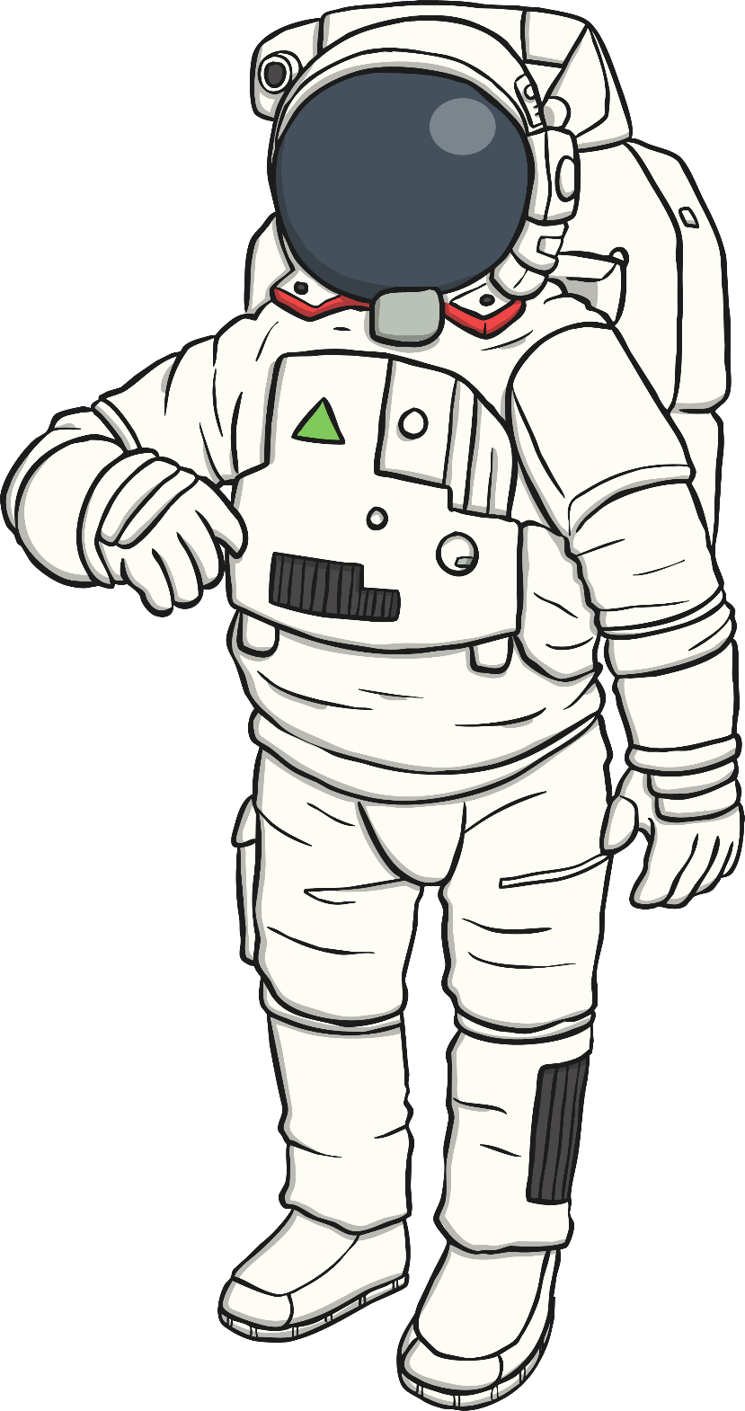
1991
Helen Sharman, born in 1963, Sheffield, won a competition to become the first British astronaut in space. She had to undergo 18 months of intensive training and was part of a mission to the MIR space station.
1990
1995
2000

Slide 8
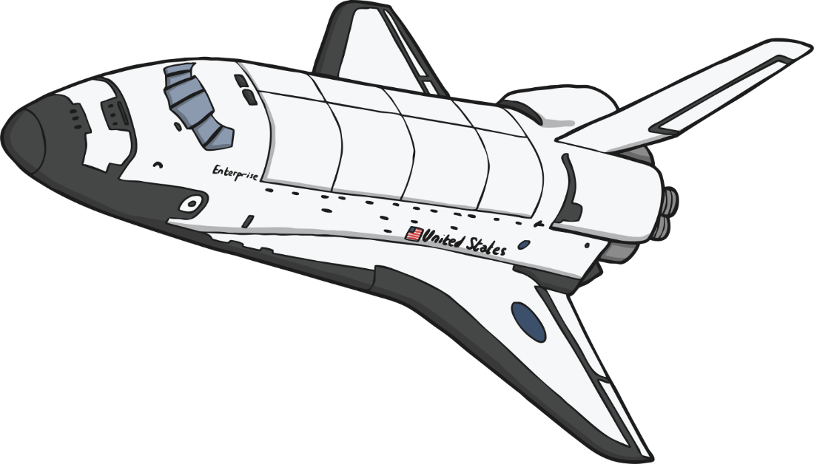
2001
American millionaire, Dennis Tito, became the first space tourist in a Russian spacecraft. He paid 20 million dollars for the privilege!
2000
2005
2010
2004
The first private space flights became available. Tickets for places on the spacecraft are available to buy now!

Slide 9
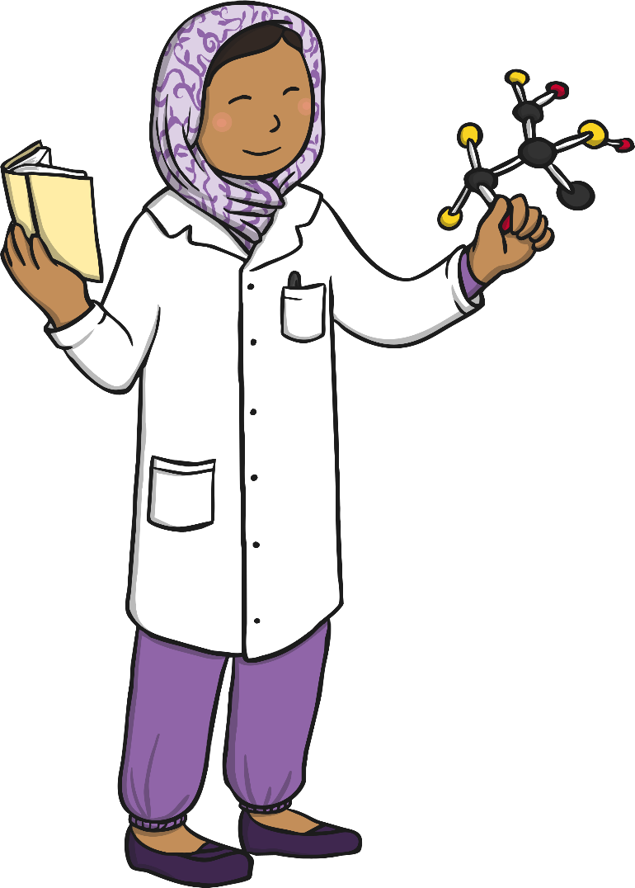
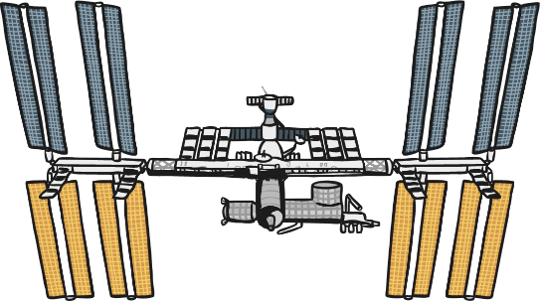
2015
Scientists find evidence of liquid water on Mars for the first time. This furthers the possibility of sustaining life on the planet.
2010
2015
2020
2020
The European Space Agency's Solar Orbiter probe takes the closest ever photographs of the Sun. The probe gets to within 77 million km of the surface of the sun!
2015
Tim Peake became the first British ESA Astronaut to visit the International Space Station.

