Slide 1


Science
Forces and Magnets
Year One
Science | Year 3 | Forces and Magnets | Magnet Strength | Lesson 4

Slide 2
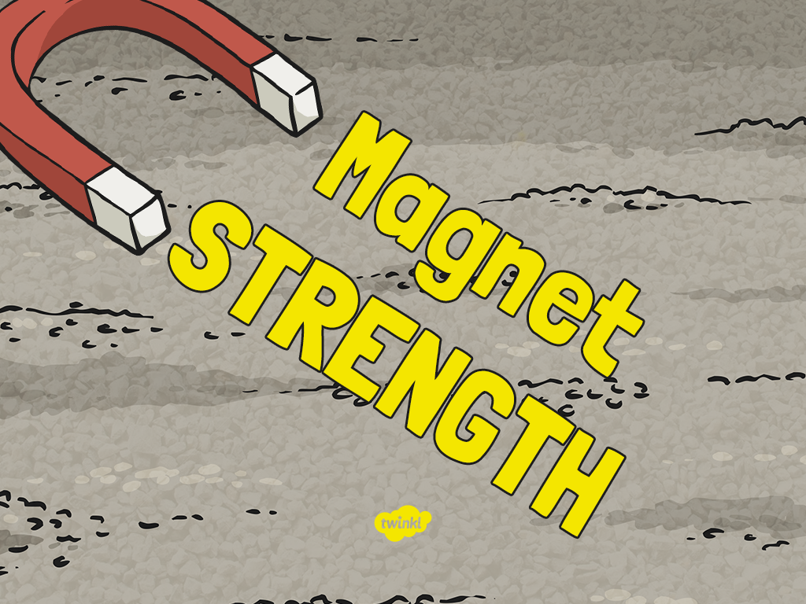

Slide 3

Aim
I can investigate the strength of magnets.
Success Criteria
I can identify different types of magnet.
I can predict which magnet will be the strongest.
I can test my prediction by adding paperclips to different magnets.
I can record my results in a table and present them in a bar chart.
I can explain my results.

Slide 4

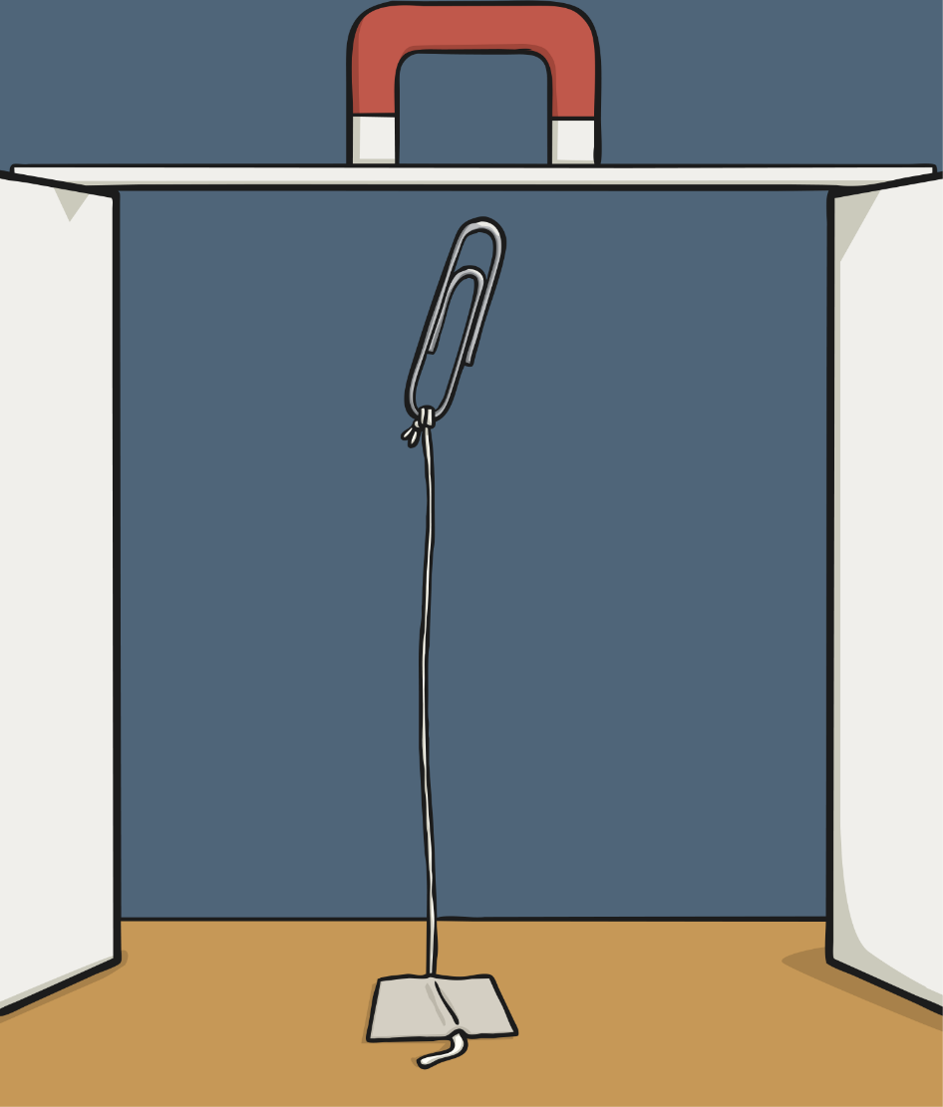
Magic Magnets
Try this trick to make a paper clip hover:
Tie a length of cotton thread to a paper clip.
Tape the end of the thread to the table.
Hold a magnet above the paper clip.
Can you make the paper clip hover above the table?

Slide 5
Magic Magnets
As you move the magnet away from the paper clip, it will fall back to the table.
The magnetic force pulling the paper clip up to the magnet is not as strong.
By seeing how many paper clips are attracted to a magnet, you can measure the strength of the magnet’s force.

Slide 6

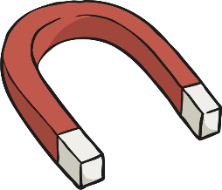





Different Magnets
There are lots of different types of magnets:
Bar
magnet
Cylindrical
magnet
Horseshoe
magnet
Button
magnet
Ring
magnet
Square
magnet
Arc/crescent
magnet

Slide 7
Different Magnets
But which is the strongest?
You are going to investigate which type of magnet is the strongest.
Bar
magnet
Cylindrical
magnet
Horseshoe
magnet
Button
magnet
Ring
magnet
Square
magnet
Arc/crescent
magnet

Slide 8
Investigation Method
To measure the strength of each magnet, you will hold a paper clip to a magnet so that it is attracted to it.
You will then hold another paper clip to the first one to see if it is also attracted to the magnet, through the first paper clip.
Keep adding paper clips in a chain, until no other paper clips are attracted in the chain.
Keep a record of how many paper clips were in the chains for each magnet.
The magnet with the longest chain of paper clips is the strongest, as its magnetic force can pull the paper clips over the longest distance.

Slide 9

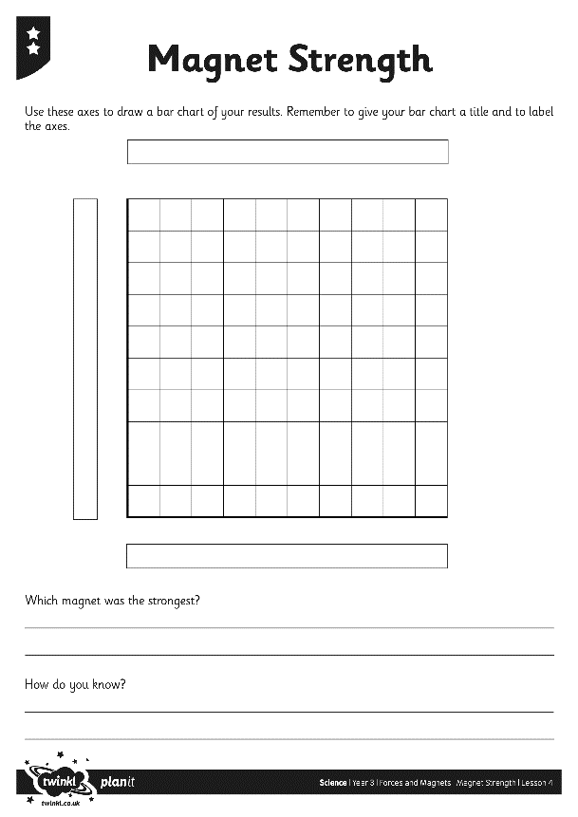
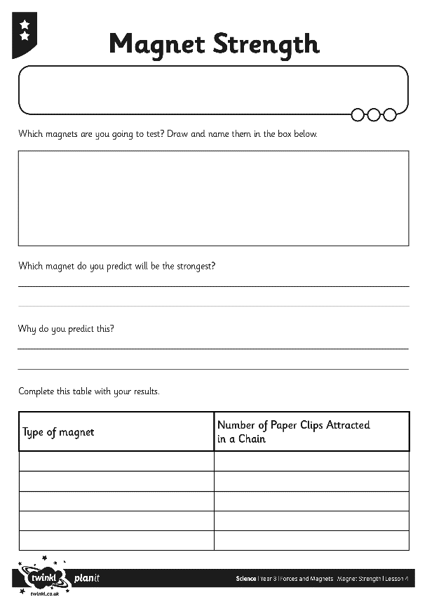
Which Magnet Is Strongest?
Complete your Magnet Strength Activity Sheet with your prediction, then carry out the investigation.
Record your results on the table provided, and represent your results on the bar chart.
Then come to a conclusion to answer this question.

Slide 10







Which Magnet Is Strongest?
Around the room you will find pictures of the different types of magnet.
Go to stand near the picture of the magnet you found to be the strongest.
Is everyone standing next to the same magnet?
Explain your results to someone standing next to you, and to someone standing next to a different magnet.

Slide 11

Aim
I can investigate the strength of magnets.
Success Criteria
I can identify different types of magnet.
I can predict which magnet will be the strongest.
I can test my prediction by adding paperclips to different magnets.
I can record my results in a table and present them in a bar chart.
I can explain my results.

