Slide 1


History
World War II
Year One
History | LKS2 | World War II | The Battle of Britain | Lesson 4

Slide 2

The Battle of Britain

Slide 3
Aim
I can describe events from the Battle of Britain and explain why it was a turning point in the war.
Success Criteria
I can order events from the Battle of Britain on a timeline.
I can explain why the Battle of Britain was a key turning point in the war.
I can use different sources of information to write an imagined witness account of a Battle of Britain dog-fight.
I can tell you some facts about the most popular planes that flew in the Battle of Britain.

Slide 4

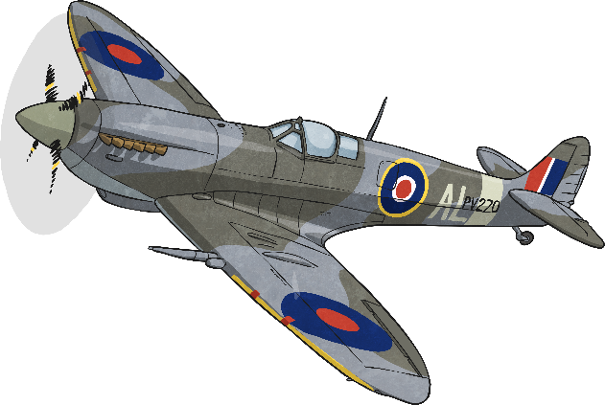
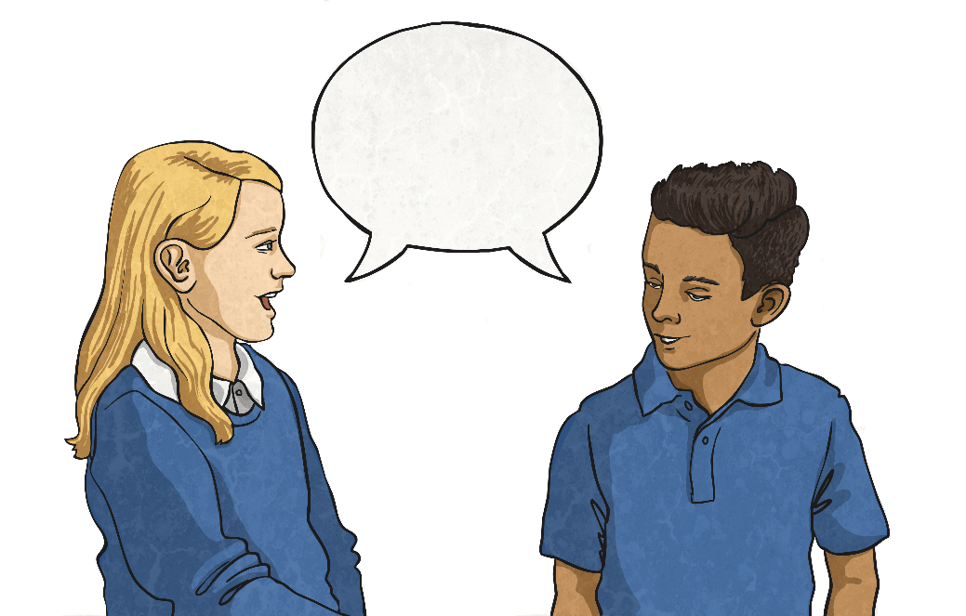
The Battle of Britain
The Battle of Britain was fought between the RAF (Royal Air Force) and the German Luftwaffe (air force).
Talk to your partner:
Do you know what the Battle of Britain was?
What do you think happened during the Battle of Britain?

Slide 5
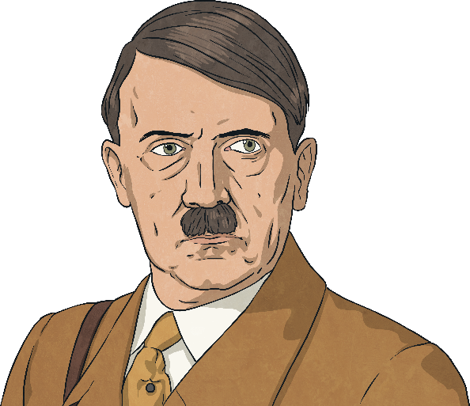
The Battle of Britain
In July 1940, the leader of Germany, Adolf Hitler, planned a secret mission which was code-named Operation Sea Lion. His plan was to invade Britain and stop the Allies from being able to fight back from Britain against his plans to secure German supremacy (ultimate power and control) across the world.
‘As England, in spite of her hopeless military situation, still shows no signs of willingness to come to terms, I have decided to prepare, and if necessary to carry out, a landing operation against her. The aim of this operation is
to eliminate the English Motherland as a base from which the war against Germany can be continued, and, if necessary, to occupy the country completely.’
- Adolf Hitler, 16th July 1940
The first thing Hitler needed to do was get control of British air space and the Battle of Britain came as a result of this. The German Luftwaffe (air force) were sent to destroy the British Royal Air Force (RAF).

Slide 6

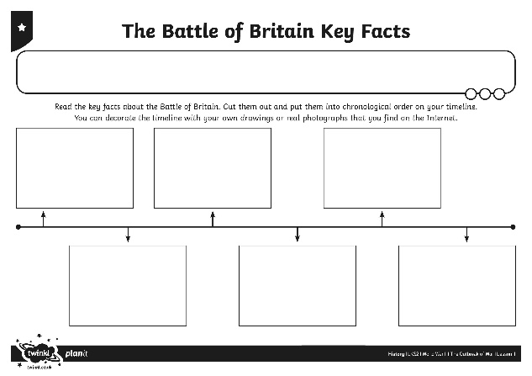
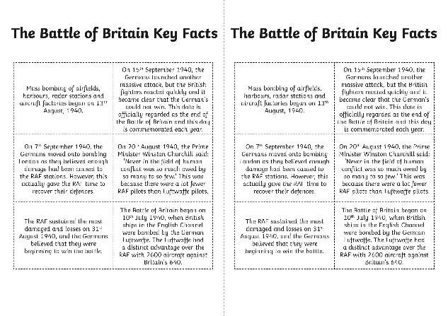
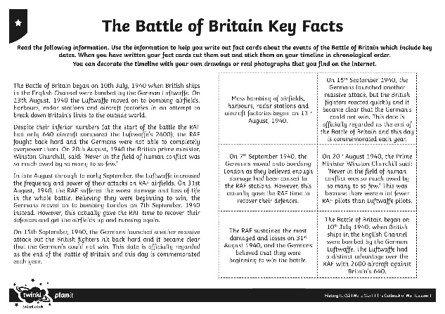
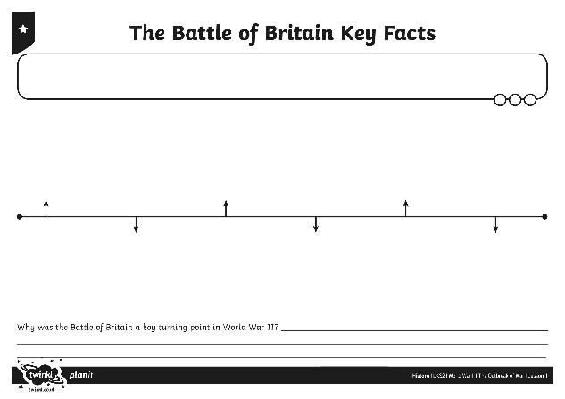
Key Facts
You are going to make your own timeline of events from the Battle of Britain.
Read the Battle of Britain Key Facts. Use the facts to create your timeline putting them into chronological order.
When you have finished your timeline, use your knowledge to answer this question: Why was the Battle of Britain a key turning point in the war?
Be ready to feedback your ideas to the rest of the class.

Slide 7
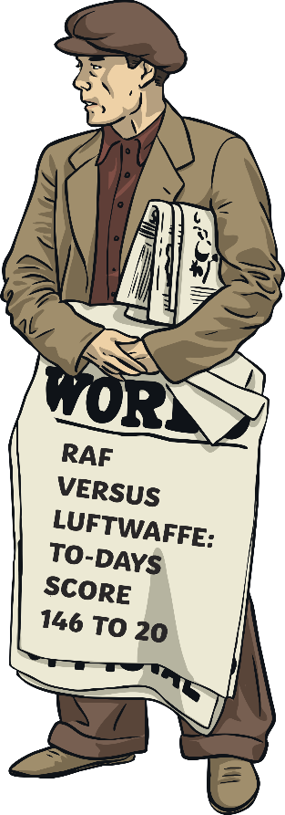
Aerial Warfare
Despite the seriousness of the situation, people in Britain could not help but be dazzled by the spectacle of British and German planes engaged in battle and carrying out daring mid-air feats in desperate bids to outsmart, and ultimately, defeat each other.
News sellers published the losses from the battles each day, almost as if they were ‘scores’ in a game and each evening people would gather around the radio to listen to news updates, like this one.

Slide 8
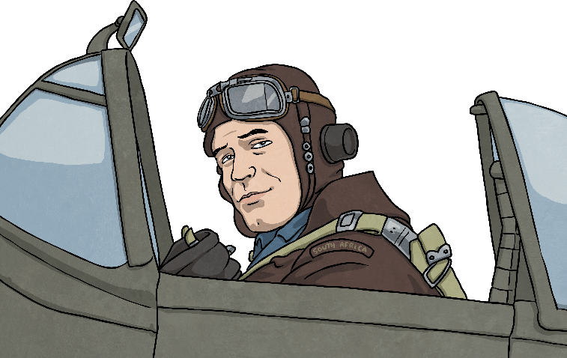
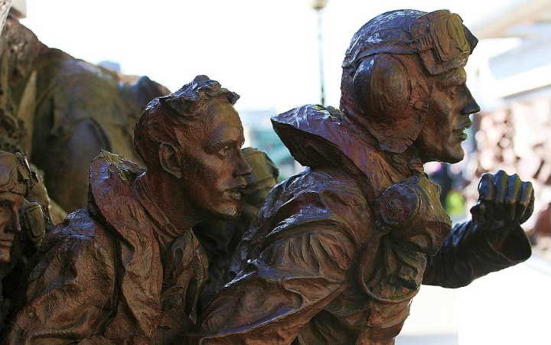
Aerial Warfare
The term dog-fight describes the intense in-air battle between small groups of aircraft fighting at close range where strategic manoeuvring was key to winning.
A pilot who destroyed 5 enemy aircrafts during a battle was known as fighter ace.
This statue was made to commemorate the pilots who fought in the Battle of Britain.
Photo courtesy of bobaliciouslondon(@flickr.com) - granted under creative commons licence - attribution

Slide 9
Aerial Warfare
Listen as your teacher reads this story extract which describes a dog-fight battle from the point of view of an Allied pilot.
Through a break in the cloud, Tom could see a band of Messerschmitts advancing towards him like a pack of wolves stalking their prey. For a few seconds, it was as if time had stood still, then the air around him exploded in deafening gun-fire as the Allied and Nazi planes flew amongst each other at crazily close-range. Tom nosed dived down though the cloud, swerving around the left-hand side of the enemy fighters to try and gain a better position, but one of the Messerschmitts was right on his tail and blasted him with a round of fire. With his heart beating wildly, Tom spun sideways and immediately pulled his Spitfire upwards into a vertical climb, somehow managing to avoid being hit. His head pounded and he felt dizzy and disorientated from the sudden change in altitude but the air in front was clear and he managed to level out. Now, with an advantageous birds-eye view of the battle scene a few hundred feet below, he dived back down. He opened fire on the enemy plane, which had forced his retreat, and almost instantly it erupted into flames.

Slide 10
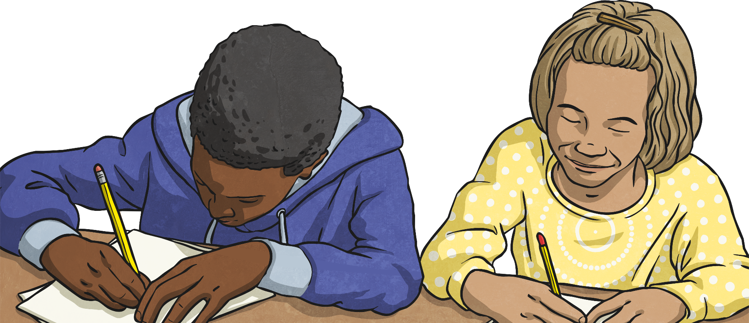
Aerial Warfare
Think about all you have learnt about aerial warfare in the Battle of Britain. Can you write some key words, phrases or sentences to describe the action and how it might have felt to witness such as thing?
Be ready to feedback your ideas to the rest of the class.

Slide 11

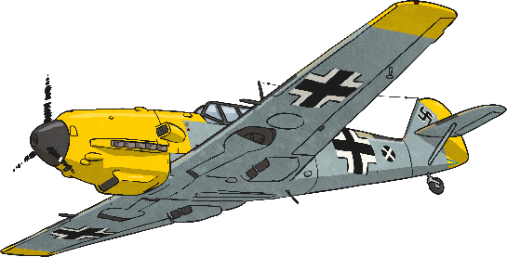
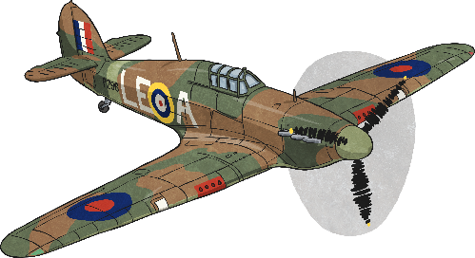
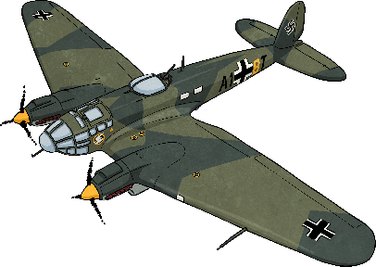
Popular Aircraft
Some of the most popular British aeroplanes to fight in the Battle of Britain were the Supermarine Spitfires and the Hawker Hurricanes. The Spitfires battled with the German fighter planes while the Hurricanes targeted the bombers.
Some of the most popular German aeroplanes were the Messerschmitt fighter planes and the Heinkel bombers.
Spitfire
Messerschmitt
Hawker Hurricane
Heinkel

Slide 12

Models and Paintings
Use the Battle of Britain Planes Posters to help you draw, paint or make a collage picture of one of the British or German aeroplanes.
Or…
Use the Spitfire Paper Model to make your very own model Spitfire.

Slide 13

Aim
I can describe events from the Battle of Britain and explain why it was a turning point in the war.
Success Criteria
I can order events from the Battle of Britain on a timeline.
I can explain why the Battle of Britain was a key turning point in the war.
I can use different sources of information to write an imagined witness account of a Battle of Britain dog-fight.
I can tell you some facts about the most popular planes that flew in the Battle of Britain.

