Slide 2
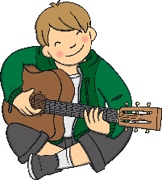
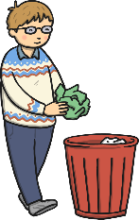

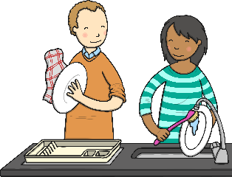

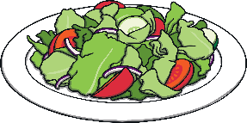
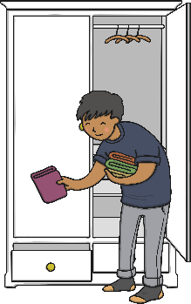
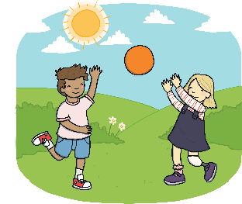
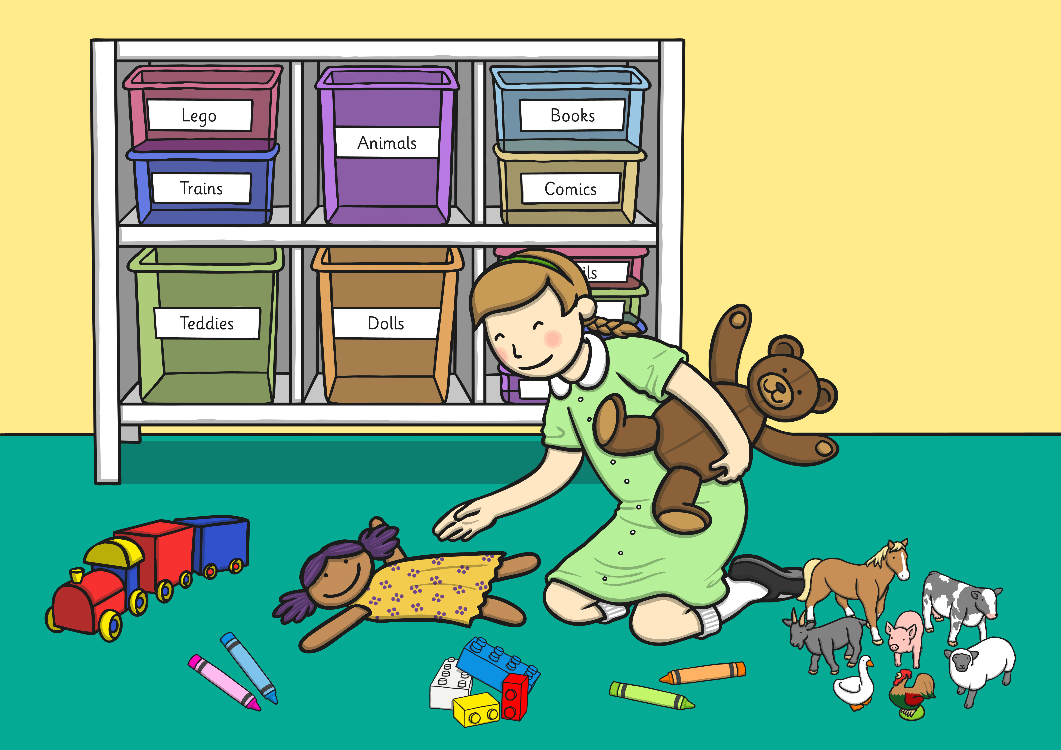
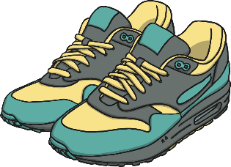
Can you write a sentence for each of these picture pairs using the conjunction if? The first one has been done for you.
if
if
if
You can have your cake if you have eaten your salad.
You can play your guitar if you have put the rubbish away.
You can have an ice cream if you help to wash up.
if
if
You can play outside if you have tidied your bedroom.
You can have new trainers if you put away your clothes.
Show answers
Can you write a sentence about something you get to do if you finish something else?

Slide 3
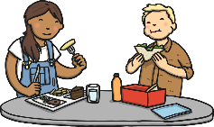
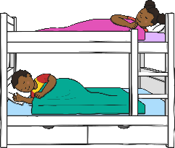


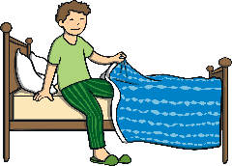

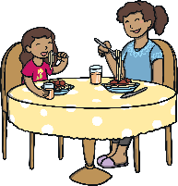
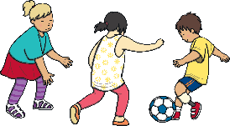
Look at the pictures around the clock. Can you choose two pictures and write a sentence about when you do these two things, using the conjunction when to join the clauses? For example, ‘I will go to bed when I have eaten my dinner.’
eat my lunch
I will do my work when I have eaten my lunch.
I will go to sleep when I have gone to bed.
do my work
go to sleep
I will go to bed when I have eaten my dinner.
go to bed
I will go home when I have done my work.
go home
I will eat my dinner when I have played outside.
eat dinner
play outside
I will play outside when I get home.
Show answers
Can you re-write one of your sentences so that it begins with when rather than using it in the middle?

Slide 4
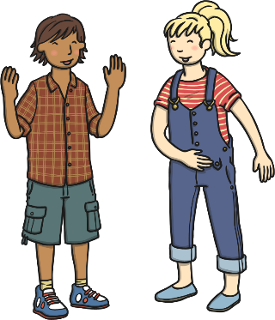
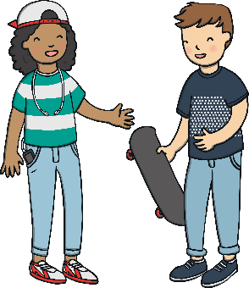
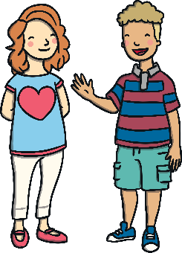
Can you change each of these conversations into a complex sentence using the conjunction because?
Why are there 365 days in a year?
Why are flamingoes pink?
That’s how long it takes for the Earth to go around the sun.
Why do I have to exercise?
Exercise helps to keep your body healthy.
Flamingoes eat pink shrimp.
You have to exercise because it helps to keep your body healthy.
Flamingoes are pink because they eat pink shrimp.
There are 365 days in a year because that’s how long it takes for the Earth to go around the sun.
Show answers
Can you write your own question and answer conversation? Can you swap with a friend to see if they can change it into a complex sentence using the conjunction because?

Slide 5


These sentences are missing conjunctions. Can you sort them into either the because or the if lunchbox?
because
if
if
because
if
because
because
if
because
if
I had a drink of water _____ I was thirsty.
___ you leave now, you will arrive on time.
My sister ate all the biscuits _____ they are her favourite.
Put your hand up _____ you need help.
We can play board games ____ it is a rainy day.
You can have a sticker ____ you tried your best.
We can play board games ____ it is a rainy day.
You can have a sticker ____ you tried your best.
Show answers
Can any of these be used with both conjunctions?

Slide 6
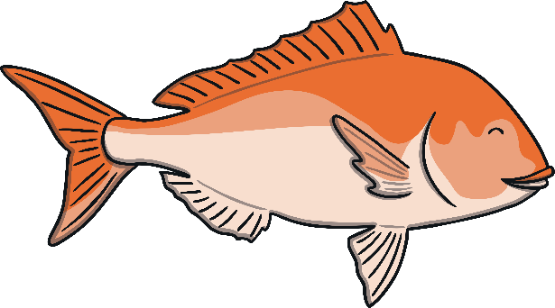






Can you catch the correct conjunction fish to complete the complex sentence?
that
when
Correct!
if
because
Harry washed the car ______ it was very dirty.
because

Slide 7
Can you catch the correct conjunction fish to complete the complex sentence?
that
when
Correct!
if
because
Gran said Cheng could go to the park tomorrow ______it was not raining.
if

Slide 8
Can you catch the correct conjunction fish to complete the complex sentence?
that
when
Correct!
if
because
Manoj was going to play on his computer ______ he got home from school.
when

Slide 9
Can you catch the correct conjunction fish to complete the complex sentence?
that
when
Correct!
if
because
Leah received a trophy _______ she won the spelling competition.
because

