Slide 2
Aims
To understand what bullying is and why it happens.
To understand the purpose of Anti-Bullying Week and the theme for 2020.
To think of ways that we can all try to stop bullying.

Slide 3


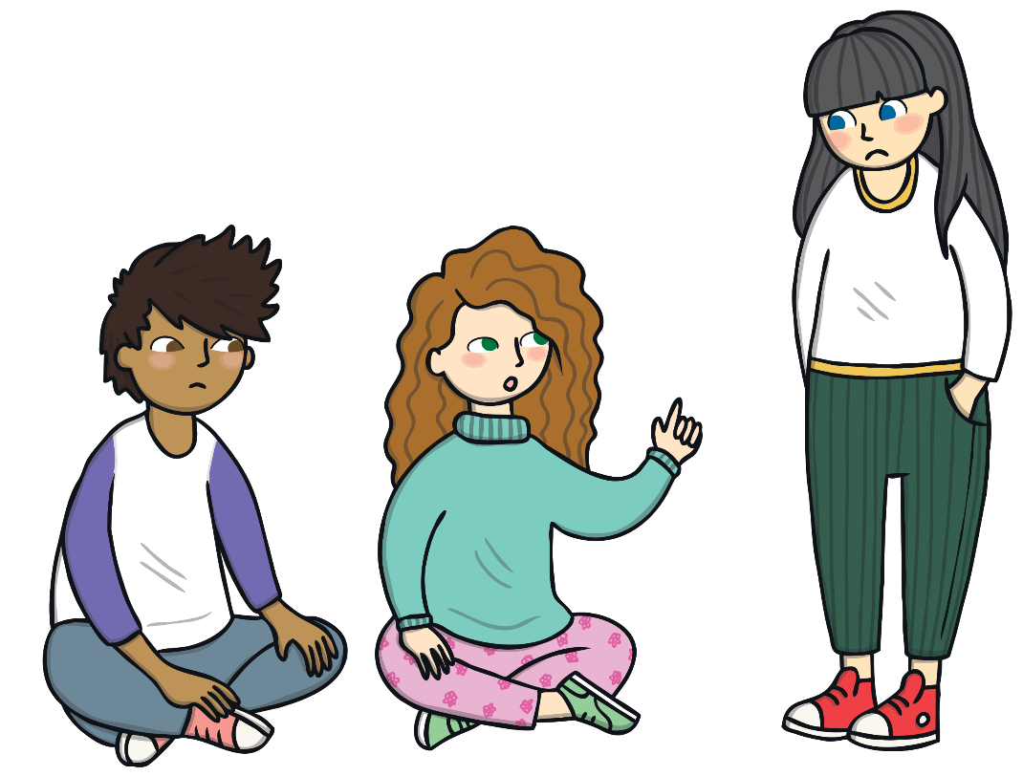
What Do You Know about Bullying?
Have you ever been bullied?
Do you know anybody who has been bullied?
Bullying is hurting someone on purpose, over and over again.
It can happen face to face with actions or with words, or it can happen online through a phone, tablet or computer.

Slide 4
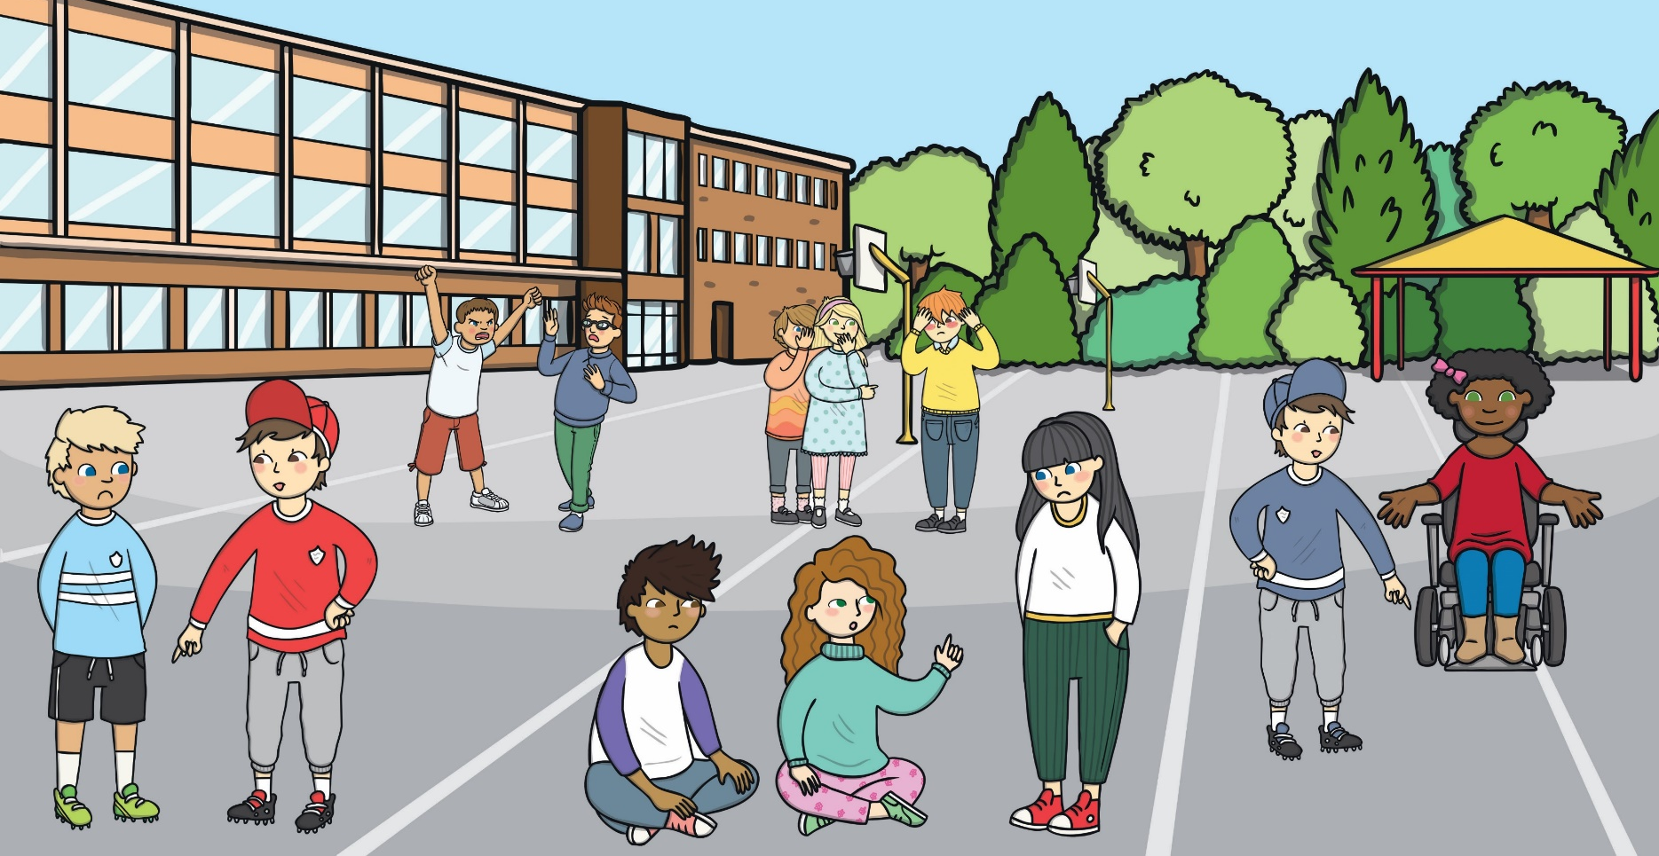
What Is Bullying?
Can you spot any behaviour in this picture that might show bullying?
Remember, bullying is hurting someone on purpose, over and over again. It is not when an unkind thing happens only once.
Click on the hotspots.
Bullying can be saying unkind things to somebody or whispering unkind things about somebody else.
Bullying can be shouting at or teasing another person.
Bullying can be saying unkind things about someone’s body.
X
2
3
X
Bullying can be saying unkind things about how somebody looks, what they are wearing or what they are doing.
5
X
Bullying can be saying somebody can’t join in.
X
1
X
4

Slide 5
Why Does Bullying Happen?
Bullying sometimes happens because we are all different.
different.
?
Bullies might be jealous of someone else’s talents.
?
Bullies might be jealous of other friendships.
?
Bullies might feel angry or bad about themselves.
?
Bullies might have been bullied or might not understand what bullying is.

Slide 6
We Are All Different
We are different for lots of different reasons.
eye colour
what we find tricky to do
height
skin colour
body shape
weight
what we find easy to do
Can you think of anymore?
hair colour
family

Slide 7
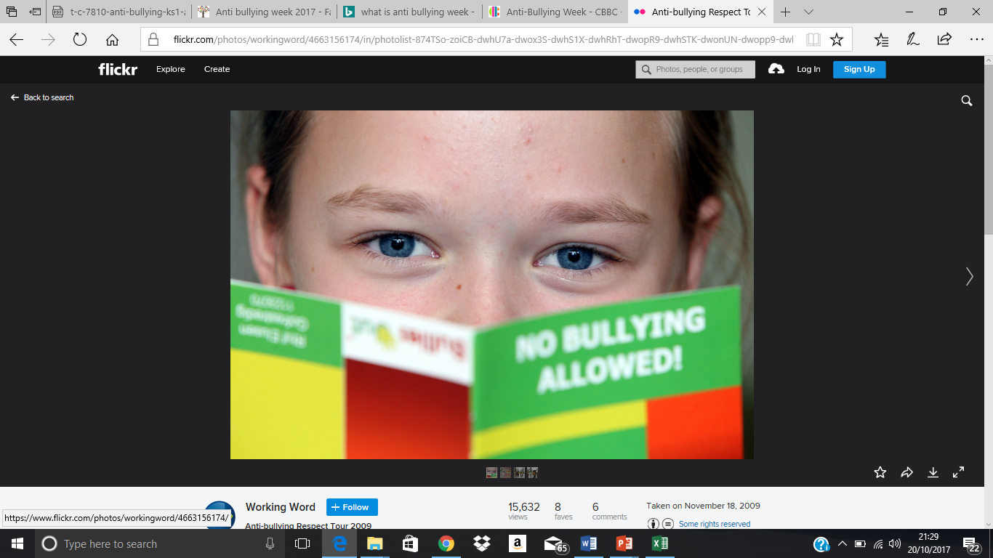
What Is Anti-Bullying Week?
?
It is an annual event that is held every November.
?
It is an event that takes place in schools.
?
It aims to raise awareness of bullying.
Photo courtesy of Working Word (@flickr.com) - granted under creative commons licence - attribution

Slide 8


Anti-Bullying Week 2020
In 2020, Anti-Bullying Week is between Monday 16th and Friday
20th November.
The theme this year is:
United Against Bullying
Together we are united against bulling.
Remember:
We can all make a change by listening, by noticing and by working together to stop bullying.
Some children may wear odd socks for Anti-Bullying Week. Odd socks show that were are all different.

Slide 9
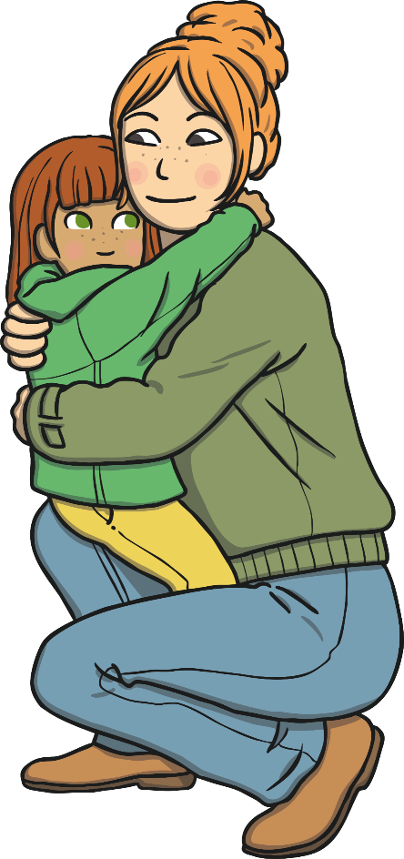
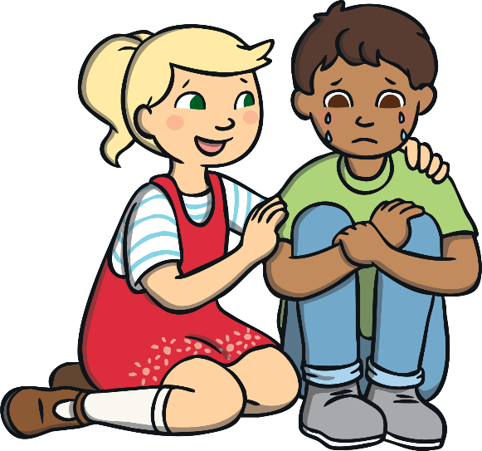
What Should You Do If You Are Being Bullied?
Tell someone!
Even if it’s not you being bullied, help other people around you. Ask if they are OK or if they need something.
Somebody can always help.

Slide 10
True or False?
You can tell somebody is a bully just by looking at them.
false
?
If you are a bully, you will always be a bully.
?
false
true
Bullies make people feel upset.
?
Nobody should be bullied because they are different.
true
?

