Slide 1


Maths
Addition and Subtraction
Year One
Maths | Year 3 | Addition and Subtraction | Add and Subtract Numbers Mentally | Lesson 7 of 7: Against the Clock

Slide 2
Learning Objective
To be able to add and subtract three-digit numbers and hundreds, tens and ones.
Success Criteria
I can recognise how much each digit is worth in a number.
I can add ones, tens and hundreds to a three-digit number.
I can subtract ones, tens and hundreds from a three-digit number.

Slide 3

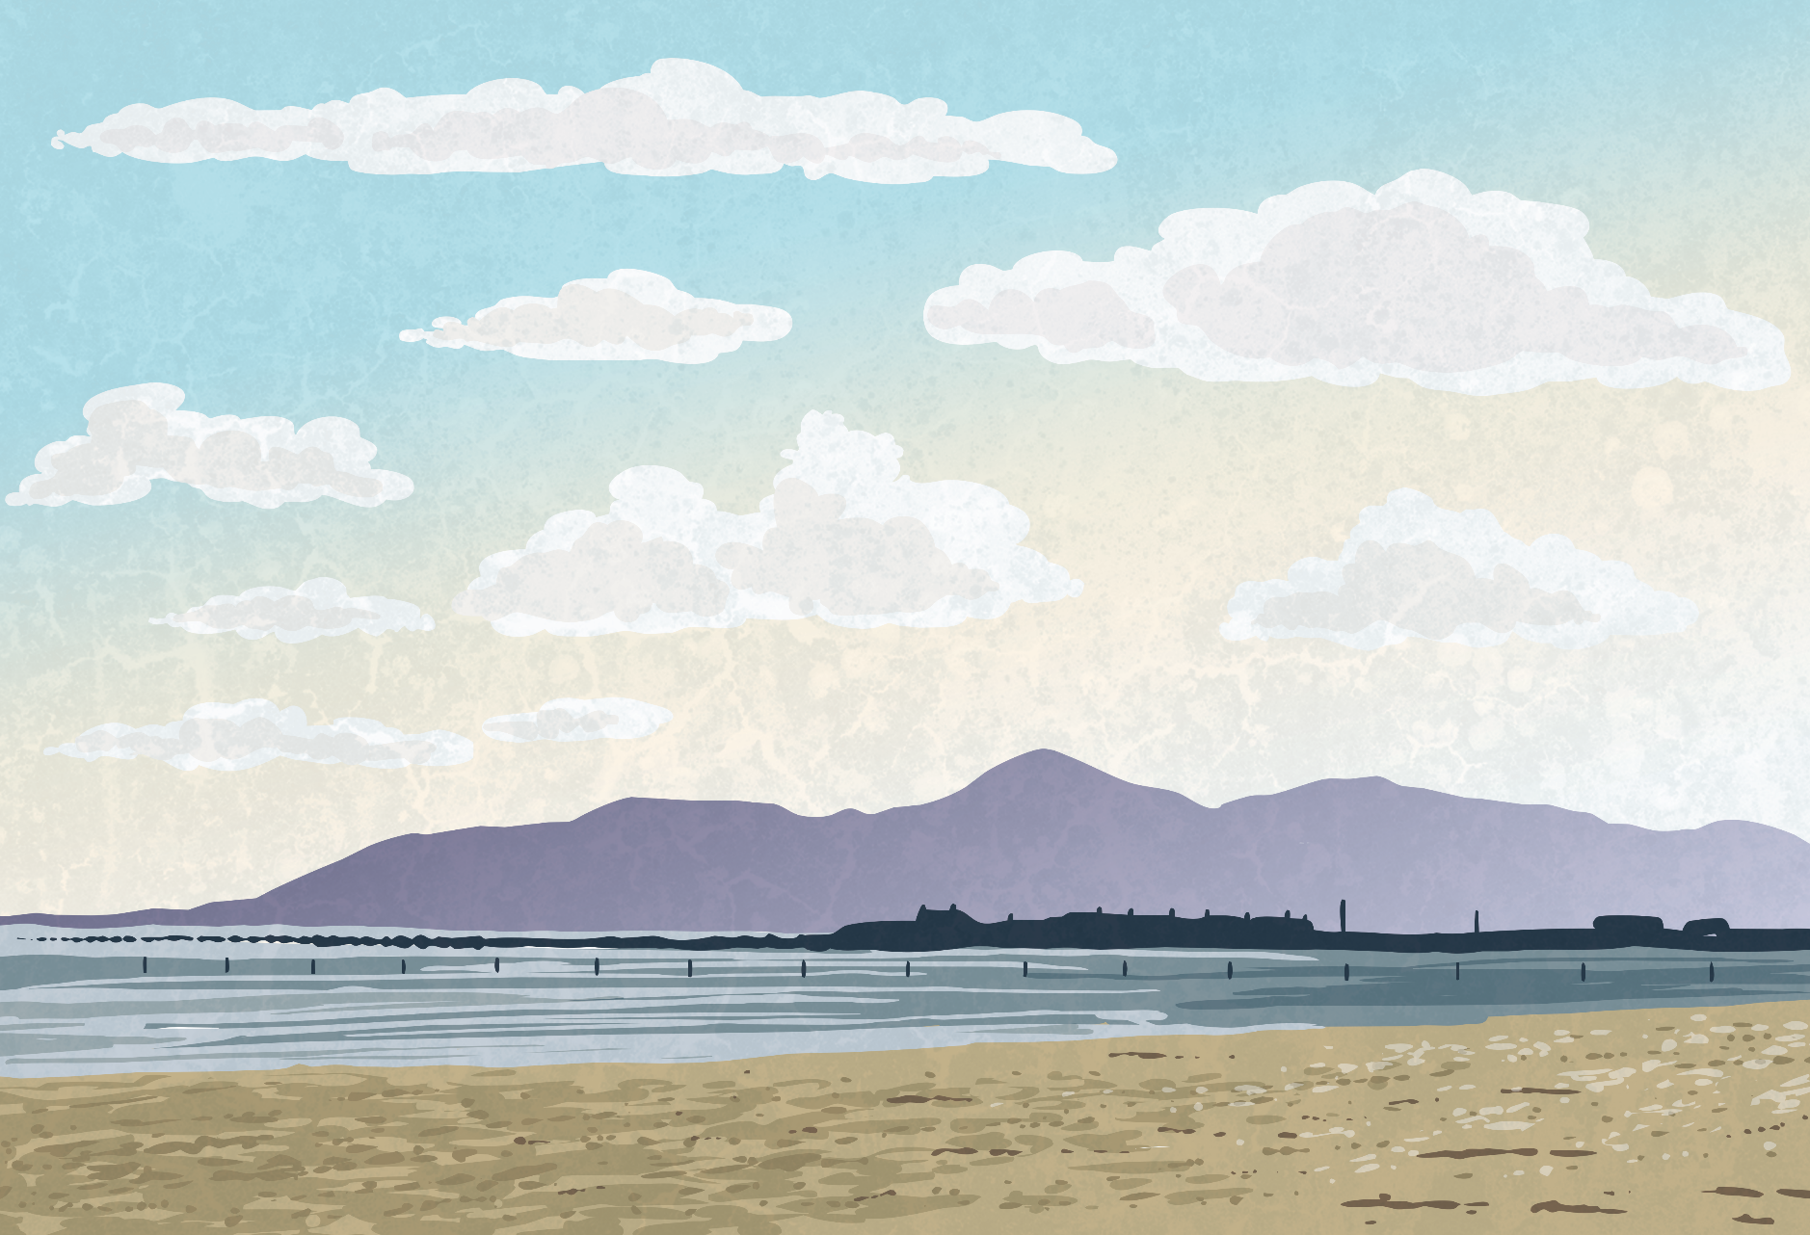
Practice Round
255 + 7 =

Slide 4


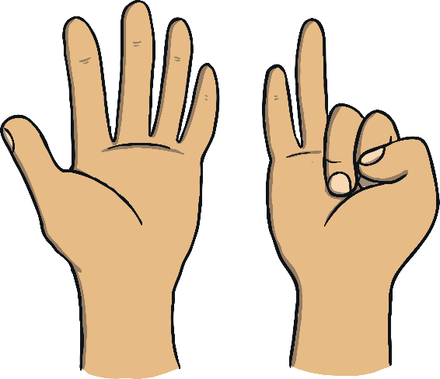


Practice Round
To work this out, you can use a range of methods.
The first method you can use is using your fingers.
258
255
Place the biggest number in your head.
3
259
261
2
4
260
257
6
5
262
7
256
1
Hold 7 fingers up.
Count on 7 more from 255 using your fingers to help you.
255
The answer is 262.

Slide 5


Mission Control
Another way to help you work this out using number bonds to 10.
Place the biggest number in your head.
+7
255
+5
+2
255
260
262
Count 5 to get to 260 then add the remaining 2.
The answer is 262.

Slide 6
Practice Round
214 - 8 =

Slide 7
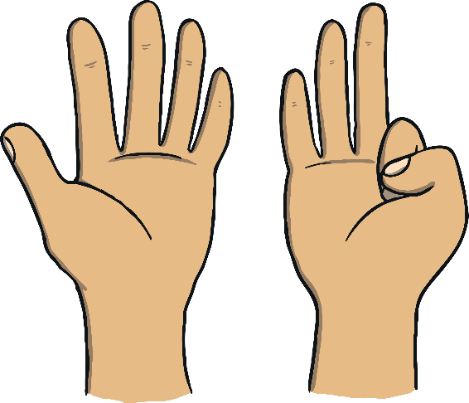


Mission Control
To work this out, you can use a range of methods.
The first method you can use is using your fingers.
214
210
7
Place the biggest number in your head.
3
4
208
211
209
6
207
2
5
8
212
1
206
213
Hold 8 fingers up.
Count 8 numbers back from 214 using your fingers to help you.
214
The answer is 206.

Slide 8
Mission Control
Another way to help you work this out using number bonds to 10.
Place the biggest number in your head.
-8
214
-5
-3
206
210
214
Count back to the nearest multiple of 10 then subtract the rest of the number.
The answer is 206.

Slide 9
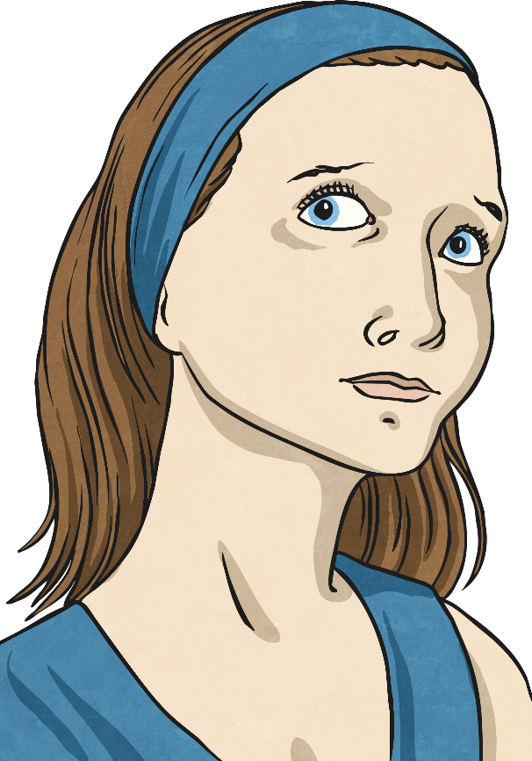
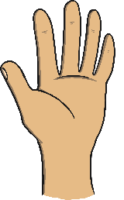
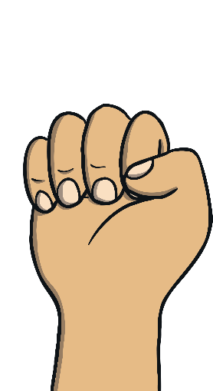


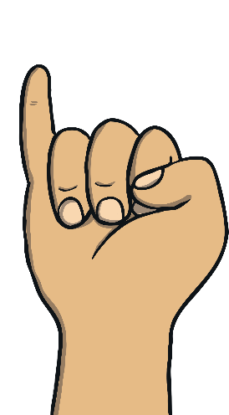
245
Practice Round
What is the total of 245 and 40?
Hold up four fingers. Each finger represents 10. Count on, in steps of 10, putting a finger down for each 10 you count on until you have no more fingers to count.
Put the largest number in your head.
To work this, we can complete the calculation in our heads. We can use our fingers to help.
The answer is 285.
265
275
255
285

Slide 10
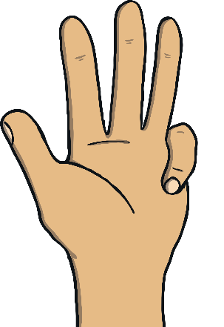
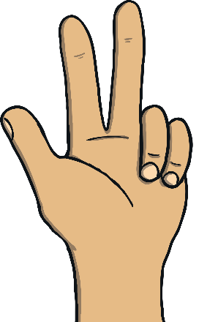
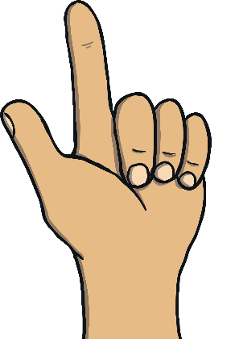


333
Practice Round
What is 50 less than 333?
Hold up five fingers. Each finger represents 10. Count back in 10s, putting a finger down for each 10 you count on until you have no more fingers to count.
Put the largest number in your head.
To work this out, we can complete the calculation in our heads. We can use our fingers to help.
The answer is 283.
303
293
313
283
323

Slide 11
597
Practice Round
What is the total of 597 and 400?
Hold up four fingers. Each finger represents 100. Count on, in steps of 100, putting a finger down for each 100 you count on until you have no more fingers to count.
Put the largest number in your head.
To work this, we can complete the calculation in our heads. We can use our fingers to help.
The answer is 997.
797
897
697
997

Slide 12
731
Practice Round
What is the total of 731 and 500?
Hold up five fingers. Each finger represents 100. Count on, in steps of 100, putting a finger down for each 100 you count on until you have no more fingers to count.
Put the largest number in your head.
To work this out, we can complete the calculation in our heads. We can use our fingers to help.
The answer is 1231.
1031
1131
931
1231
831

Slide 13
581
Practice Round
What is 200 less than 581?
Hold up two fingers. Each finger represents 100. Count back, in steps of 100, putting a finger down for each 100 you count back until you have no more fingers to count.
Put the largest number in your head.
To work this out, we can complete the calculation in our heads. We can use our fingers to help.
The answer is 381.
303
481
313
381
323

Slide 14
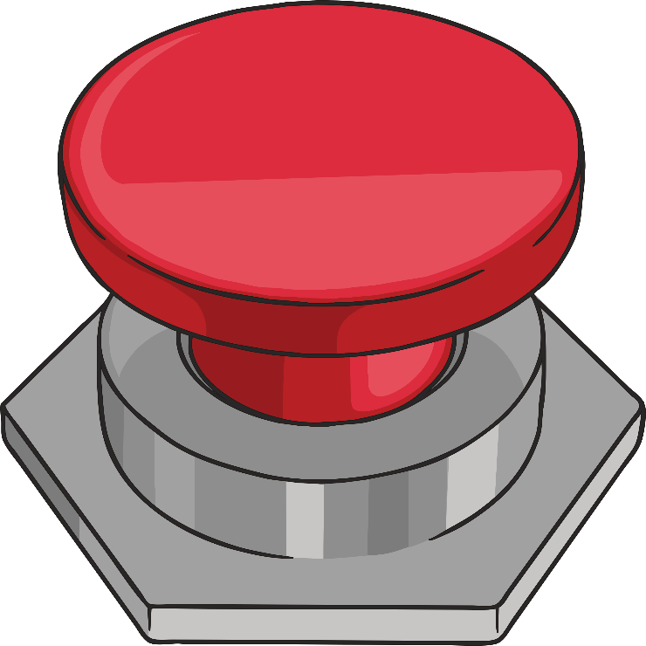
Red Button
Find the incorrect calculation before anybody else does.
Once you have found the incorrect calculation, hit the red button!

Slide 15
Red Button
STOP!
Hit the button again to reveal the answer
683 + 60 = 743
592 – 70 = 422
593 + 20 = 613
592 – 70 = 522
977 – 60 = 917
433 + 9 = 442

Slide 16
Red Button
STOP!
Hit the button again to reveal the answer
952 – 40 = 912
952 – 40 = 992
592 + 40 = 632
782 + 5 = 787
374 – 8 = 366
509 – 30 = 479

Slide 17
Red Button
STOP!
Hit the button again to reveal the answer
598 + 400 = 998
298 – 100 = 198
985 + 300 = 1285
945 + 400 = 1345
945 + 400 = 1335
274 + 200 = 474

Slide 18
Red Button
STOP!
Hit the button again to reveal the answer
698 – 5 = 693
500 + 9 = 509
493 – 5 = 488
285 + 8 = 293
294 + 6 = 300
294 + 6 = 310

Slide 19

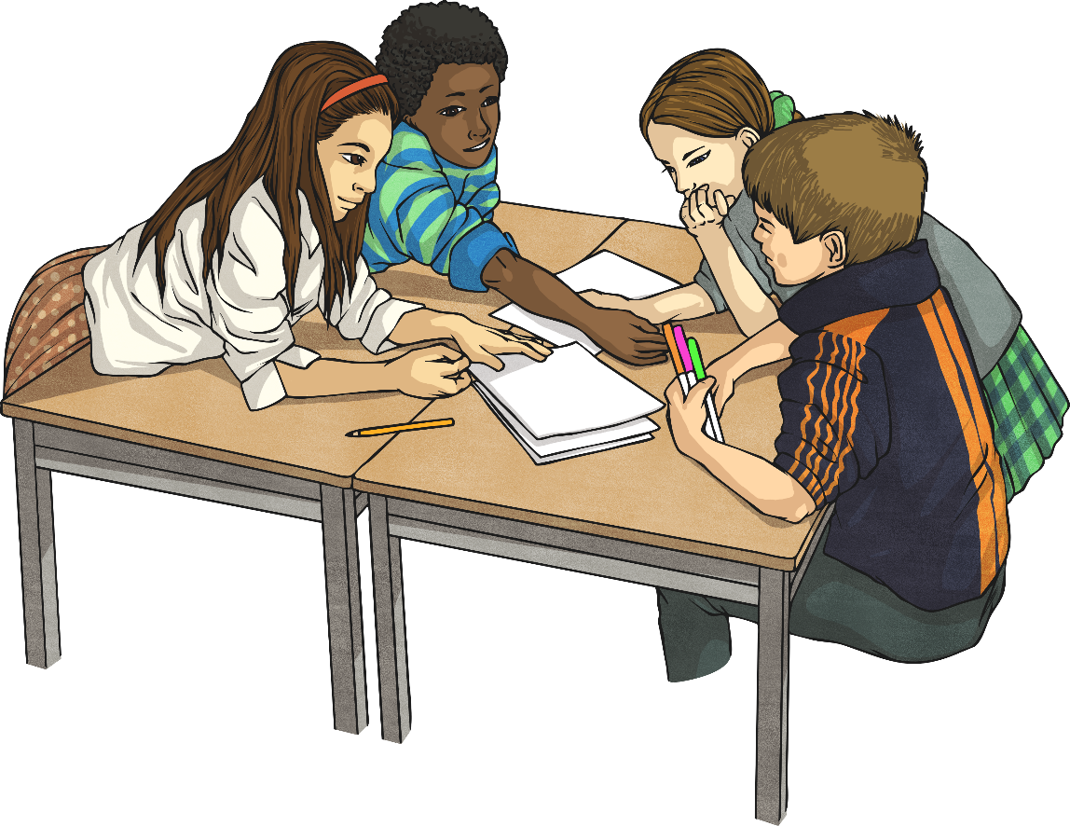
Against the Clock
find the answers to a set of questions. You can answer the questions in any order.
Once an answer to a question has been found, you must write the answer on the sheet. Time how long it takes you to answer the questions on the first sheet. See if you can beat your time when answering the second sheet

Slide 20
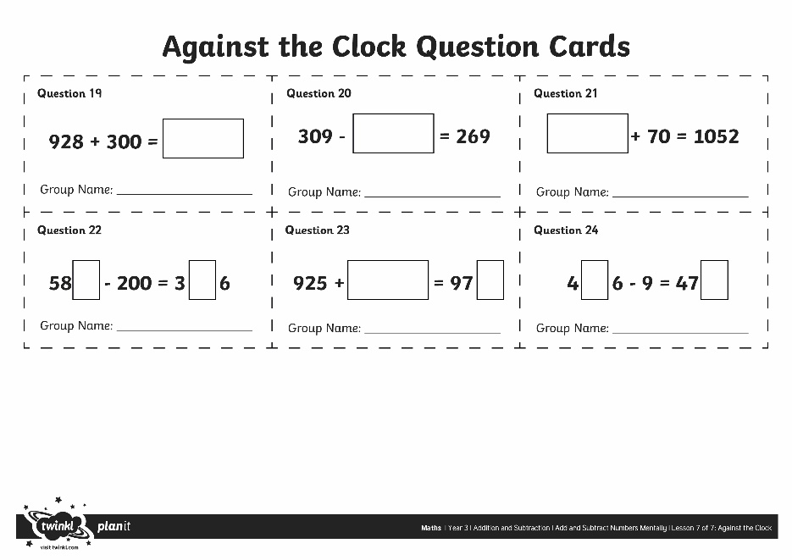
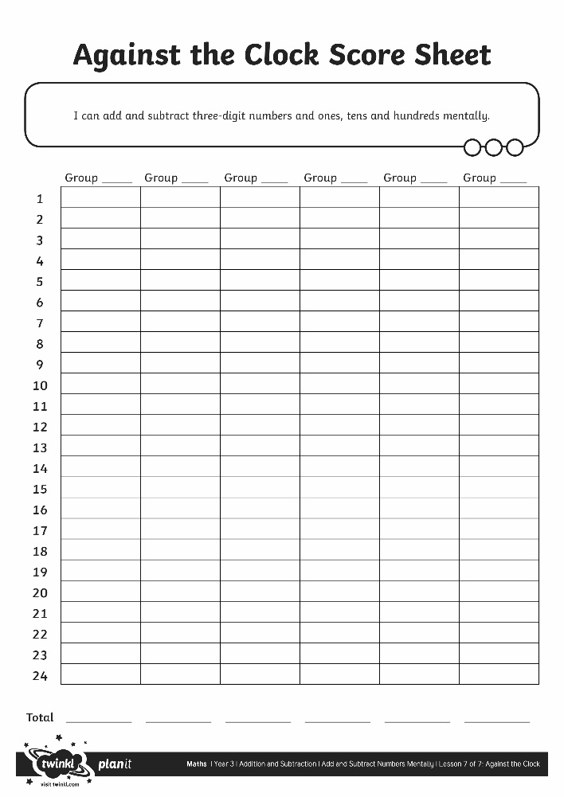
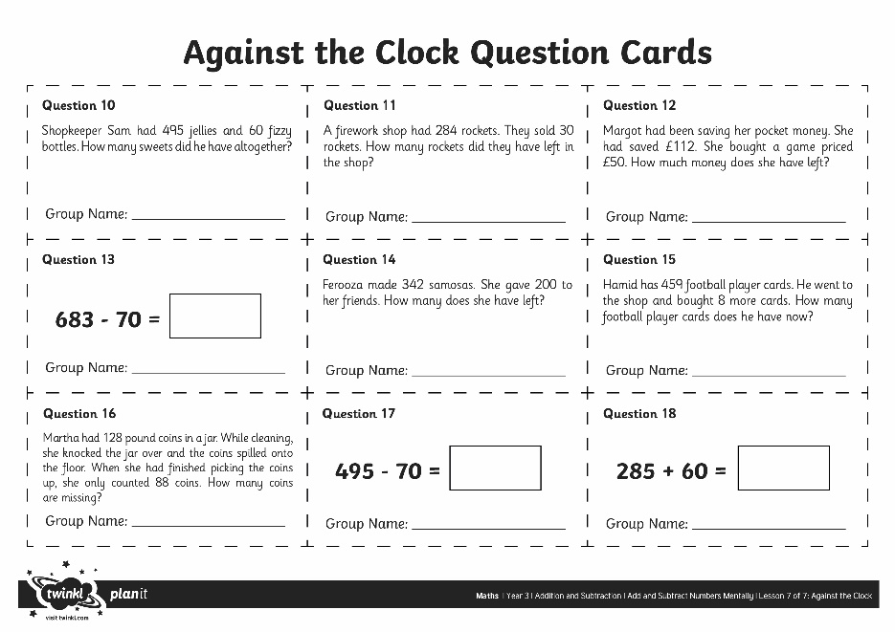
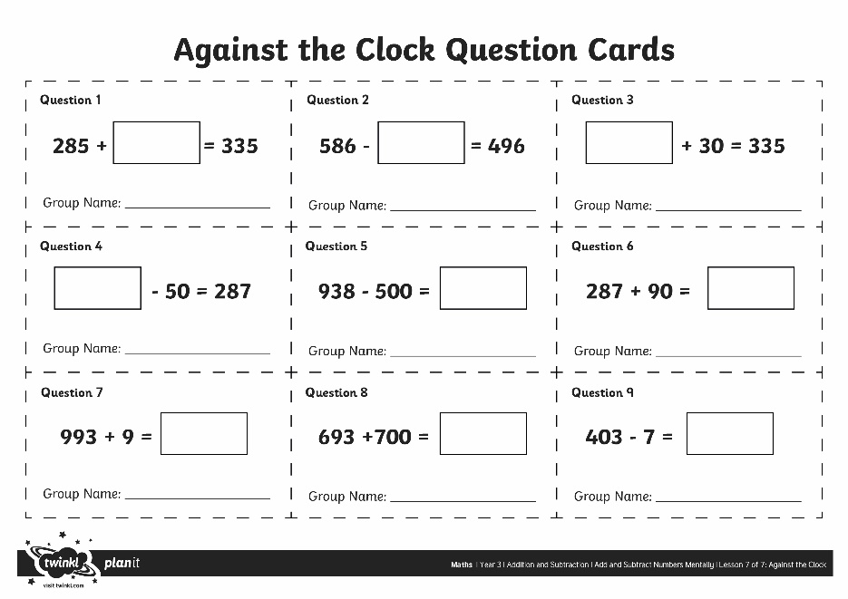
Against the Clock

