Slide 1
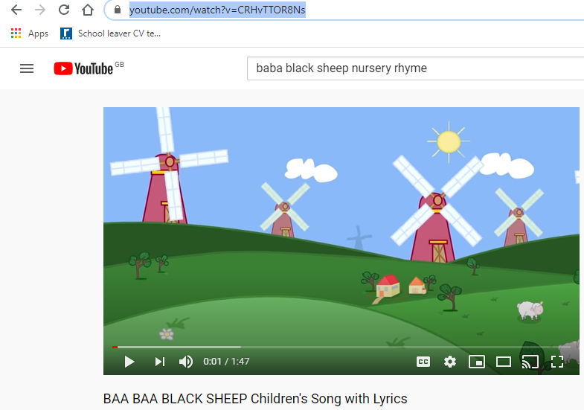
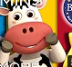
Change the lyrics of a popular nursery song =
Listen to “BABA Black sheep” song
https://www.youtube.com/watch?v=CRHvTTOR8Ns
- Check the lyrics
- Change the lyrics about = a cow (or any other animal you can think of)

