Slide 1
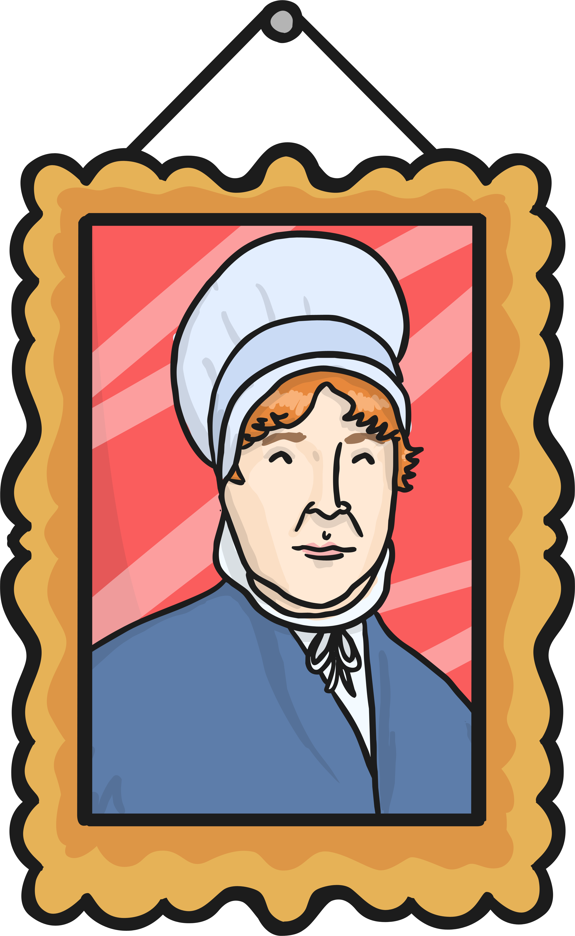

Elizabeth Fry
A task setting Powerpoint Pack about Elizabeth Fry

Slide 2
LO: To know about Elizabeth Fry
To know who Elizabeth Fry is.
To know what Elizabeth Fry did.

Slide 3
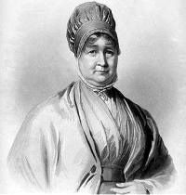
Who is Elizabeth Fry?
Elizabeth Fry was a brave reformer who helped people in prison.
She believed even people in prison should be treated well.

Slide 4
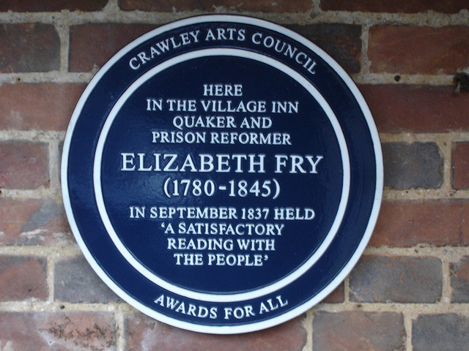
Elizabeth Fry’s Life
Elizabeth Fry was born on 21st May 1780 in a time where Britain was changing.
She married Joseph Fry in 1800.
She died in 1845 at the age of 65.
She came from a family of bankers.
Photo courtesy of SimonHarriyott(@flickr.com) - granted under creative commons licence - attribution

Slide 5
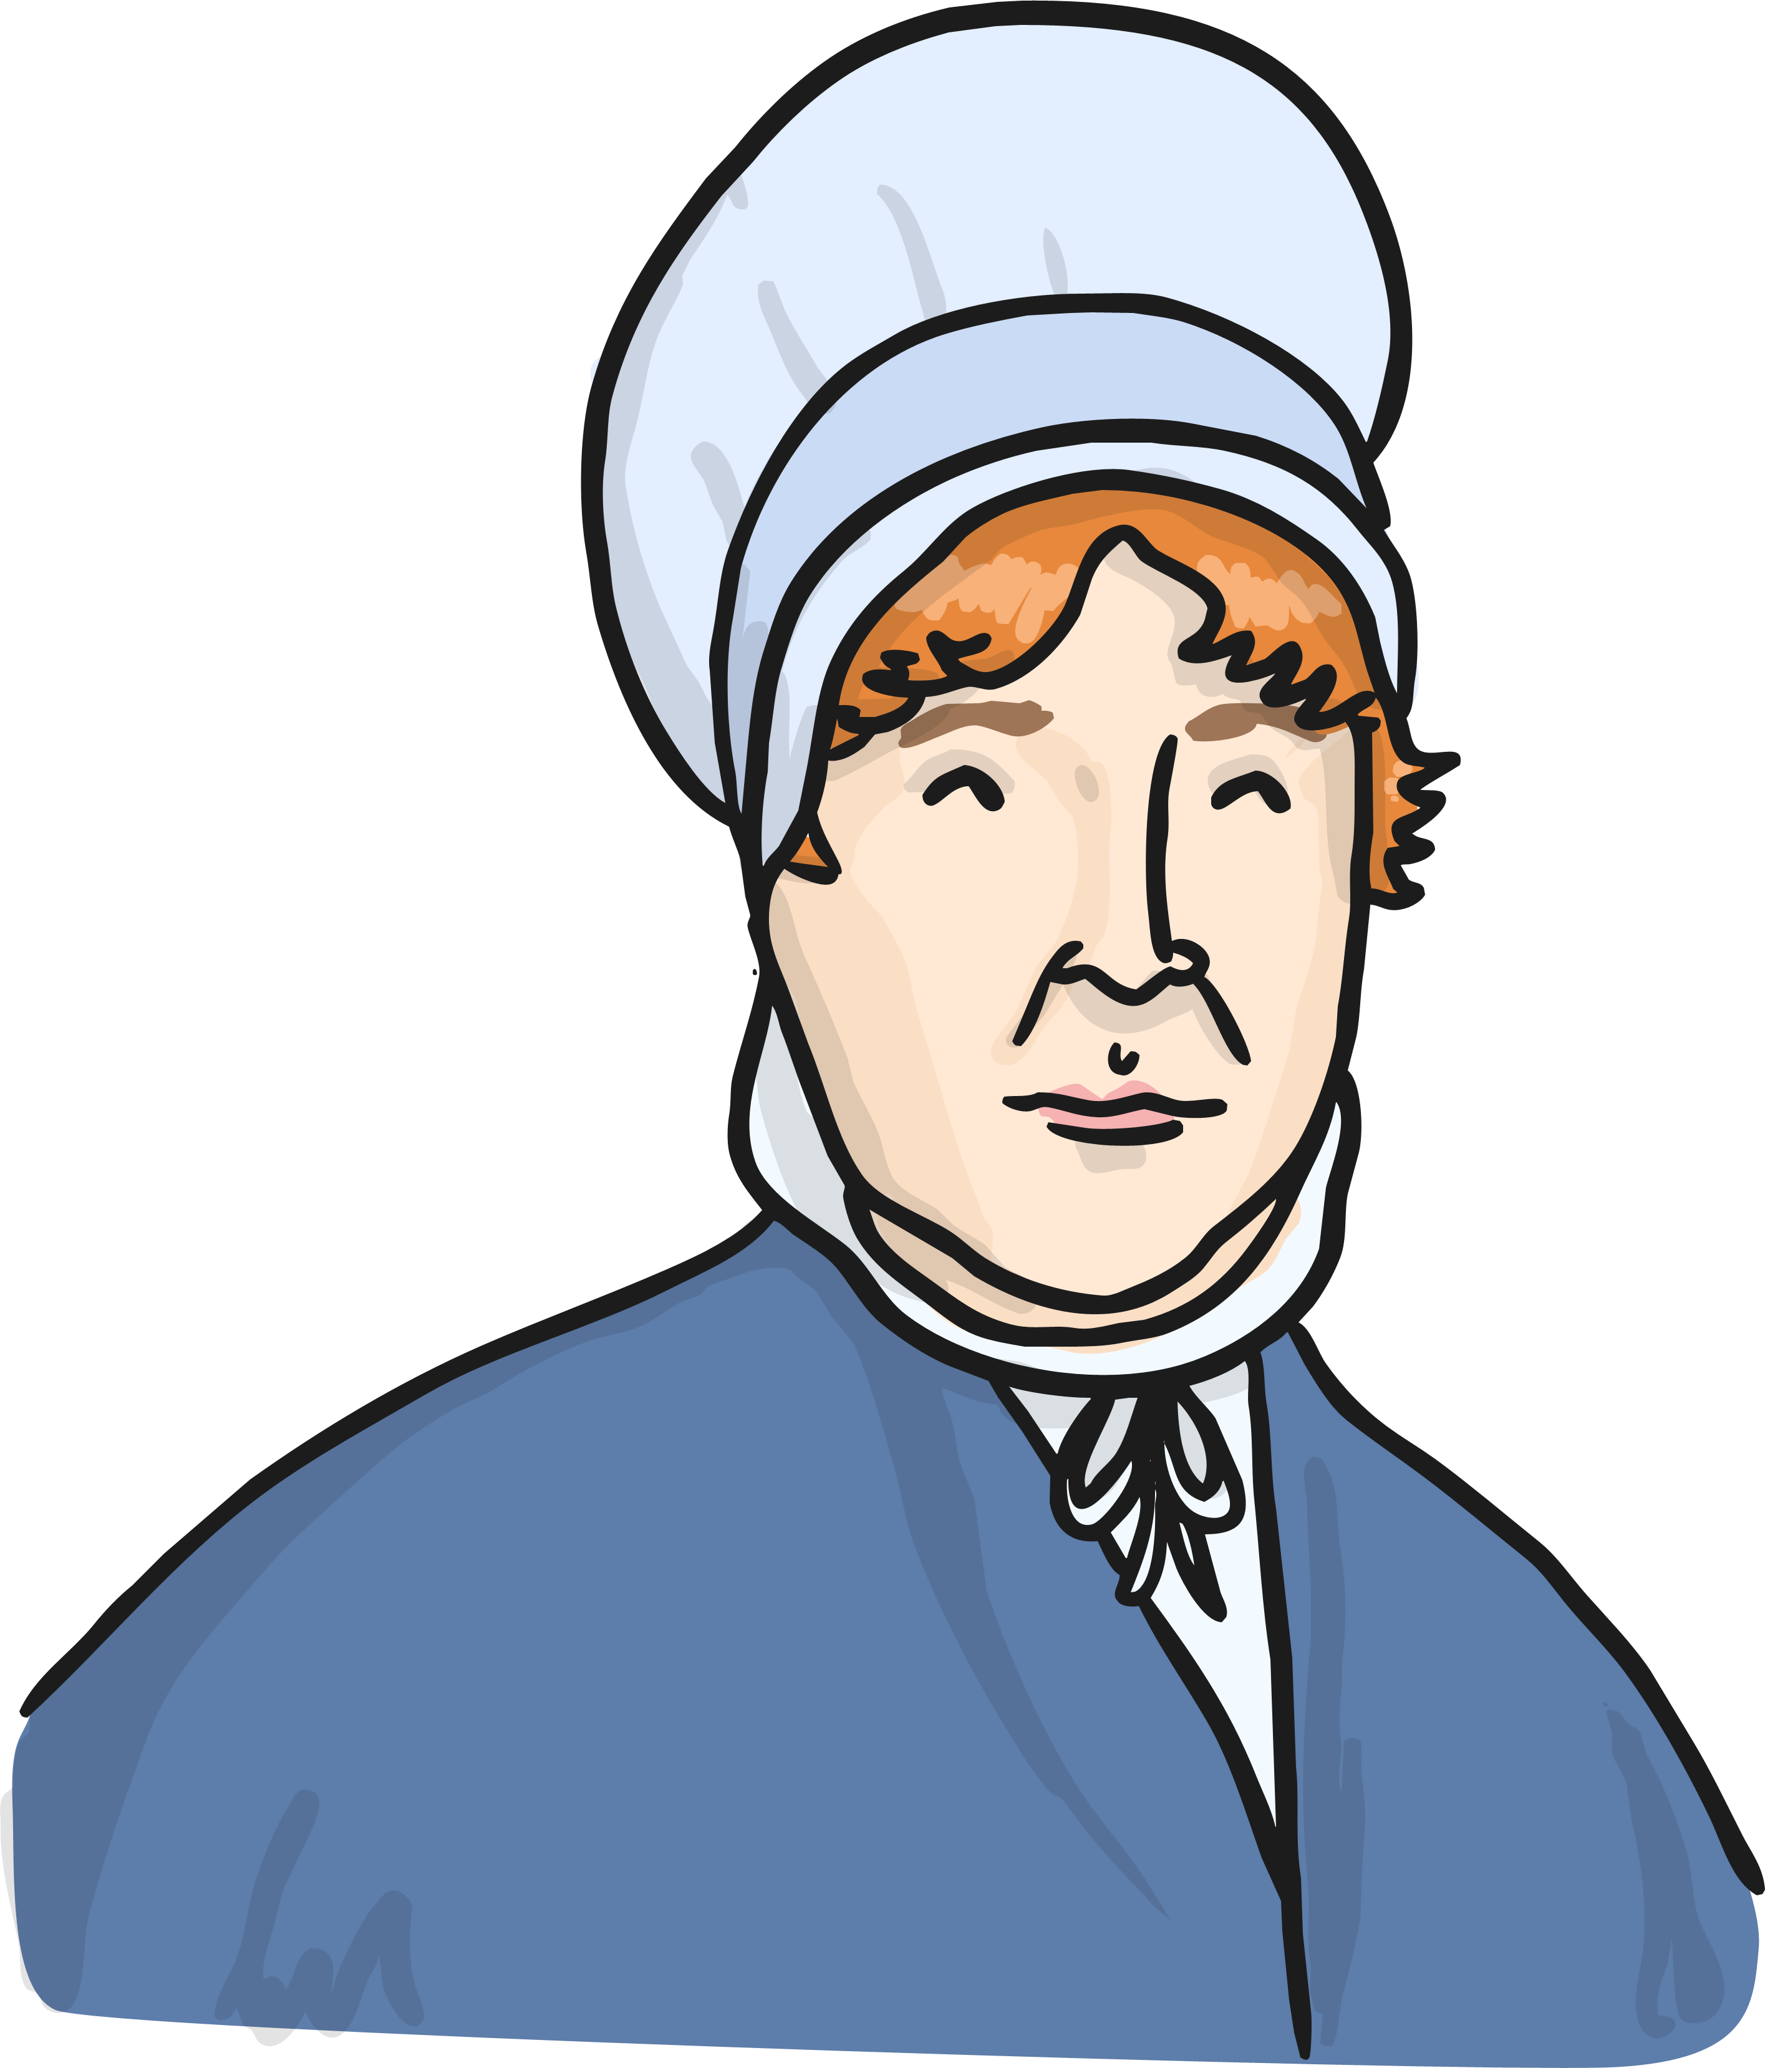
Elizabeth Fry’s Family Life
Elizabeth’s mother was a strong believer of helping those less fortunate and would give food and clothes to those who needed it.
Her mother died when she was only 12 years old and had to look after her brothers and sisters.

Slide 6
Out in the Real World
Elizabeth helped people from a young age and started a Sunday school for poor children.
She was only 18 when she decided she needed to do something important with her life.
After marrying, she had 11 children while still helping others.

Slide 7
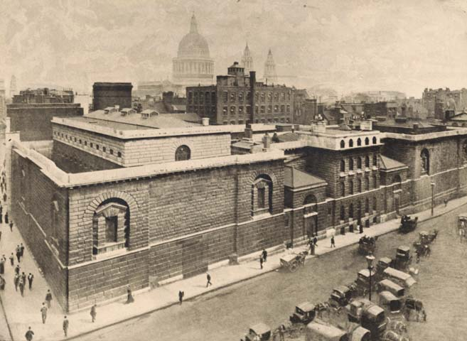
Newgate Gaol
Elizabeth wanted to make sure people in prisons were being looked after well.
In 1813 she visited Newgate Gaol, the most horrible prison in London.
People slept on the floors, there was only one tap for water and the toilet was a bucket!
Photo courtesy of M&SLiterayAdventures(@flickr.com) - granted under creative commons licence - attribution

Slide 8
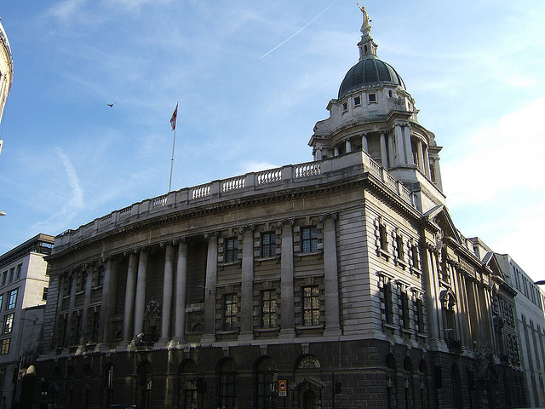
Newgate Gaol
Elizabeth wanted to help the women and children that were in the prison.
The children were in there with murderers and only there because their mothers were in there.
Some women were hanged for using fake money!
Photo courtesy of NZ Blair(@flickr.com) - granted under creative commons licence - attribution

Slide 9


The Reforms
Elizabeth took clean clothes into the prisons and set up a school so people could learn to read the bible.
In 1817 she set up a society to make prisons better.
She was the first woman to campaign for better prisons.

Slide 10
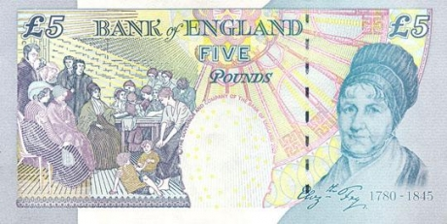
Interesting facts
You can see a picture of Elizabeth Fry on the bank of a £5 note.
Canada celebrates National Elizabeth Fry week in May.
Her husband’s family were famous for making chocolate.
Photo courtesy of NASA on The Commons(@flickr.com) - granted under creative commons licence - attribution

Slide 11

Task
Your task is to create a poster showing information about Elizabeth Fry.
What to include:
TEXT HERE
TEXT HERE
TEXT HERE
Timeline
TEXT HERE
TEXT HERE
TEXT HERE

Slide 12
Plenary
What is Elizabeth Fry famous for?
Where can we see her picture on a day to day basis?
What was the name of the prison she visited?
Who did she help in the prisons?

Slide 13
THE END

