Slide 1
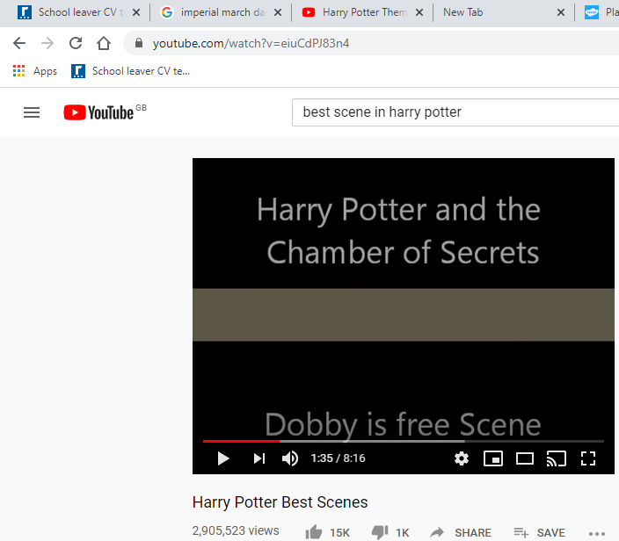
Harry Potter best scenes =
Give details of each of the scenes from the video =
of the scene (location, items and people)
of the direction (where are they all in the scene)
of the actions (what is happening)
https://www.youtube.com/watch?v=eiuCdPJ83n4

