Slide 1


Science
Scientists and Inventors
Year One
Science | Year 3 | Scientists and Inventors | Marie Curie | Lesson 2

Slide 3
Aim
To explain how Marie Curie’s work on x-rays helped us identify bones.
Success Criteria
I can describe Marie Curie’s life and work.
I can explain how her scientific ideas about x-rays changed health and medicine.
I can identify the bones shown in x-rays, and explain the bones’ functions.

Slide 4


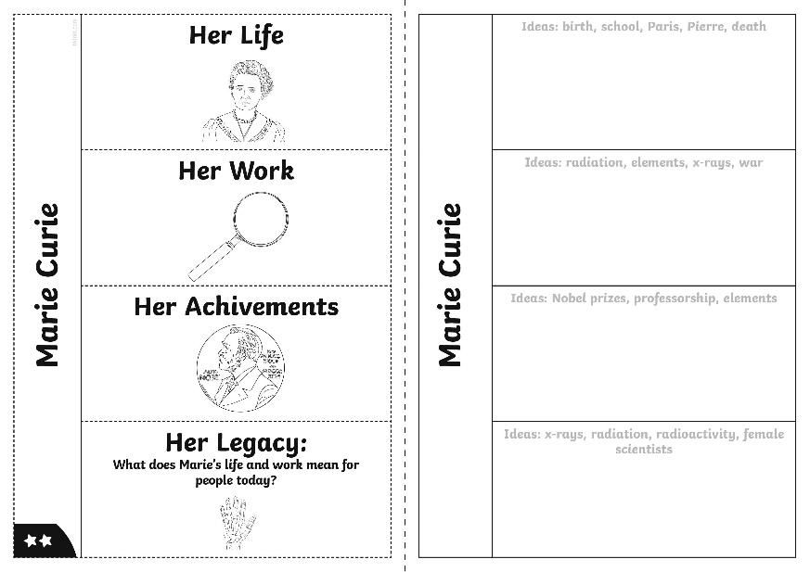
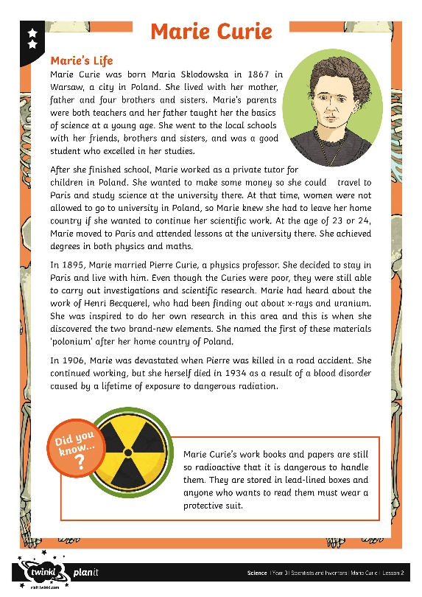

Who Was Marie Curie?
Marie Curie was a very famous scientist who worked on physics and chemistry.
She is best known for discovering two new elements (radium and polonium) and for developing the use of x-rays and radiation in medicine.
Use the Marie Curie Fact Sheet to create your Marie Curie Poster all about Marie's life and career and the discoveries she made.

Slide 5
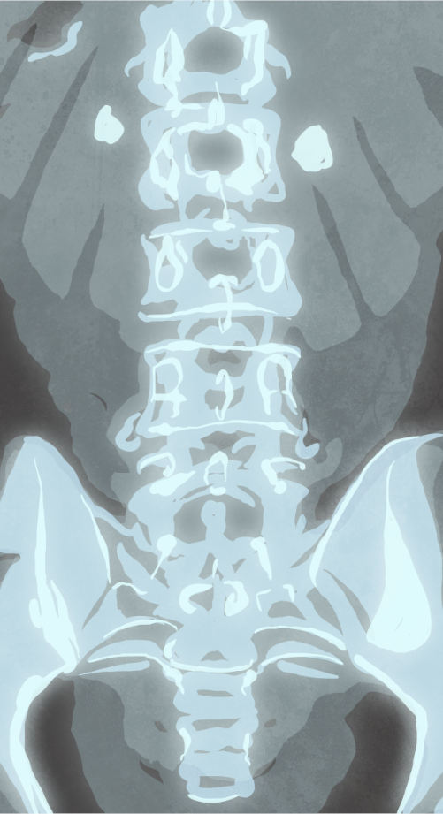
X-Rays
X-rays are waves of electromagnetic radiation that can pass through many opaque materials.
They can be used to take photographs of the inside of the body.
An x-ray machine sends invisible x-ray particles through the body. The images produced are recorded on a computer or on film.
X-rays cannot travel easily through dense parts of the body, such as bones, so these will appear white on the x-ray image. X-rays can pass through softer parts of the body more easily, so muscles and organs will appear grey on the image.
X-rays can be used to examine most parts of the body. They are most often used to look at bones, teeth and joints, but are also sometimes used to investigate soft tissue, such as internal organs.
Doctors look at x-ray images to identify fractures and other problems.

Slide 6
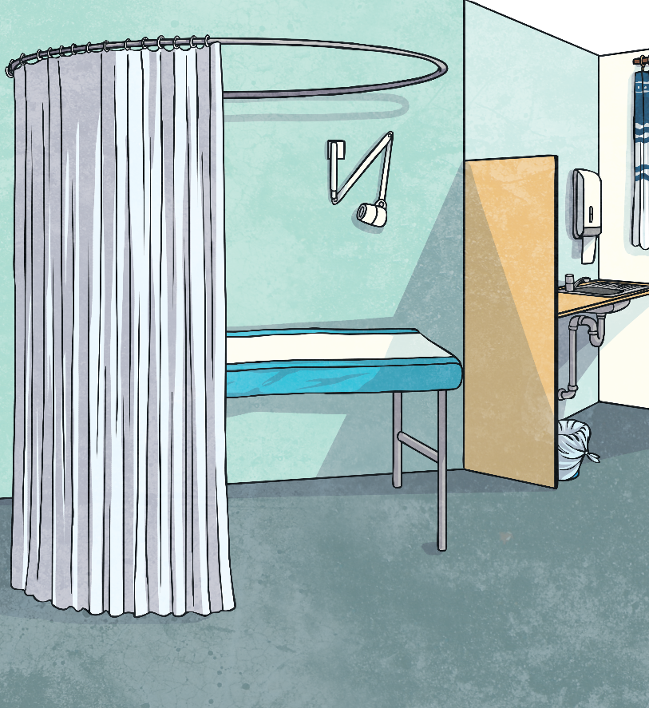
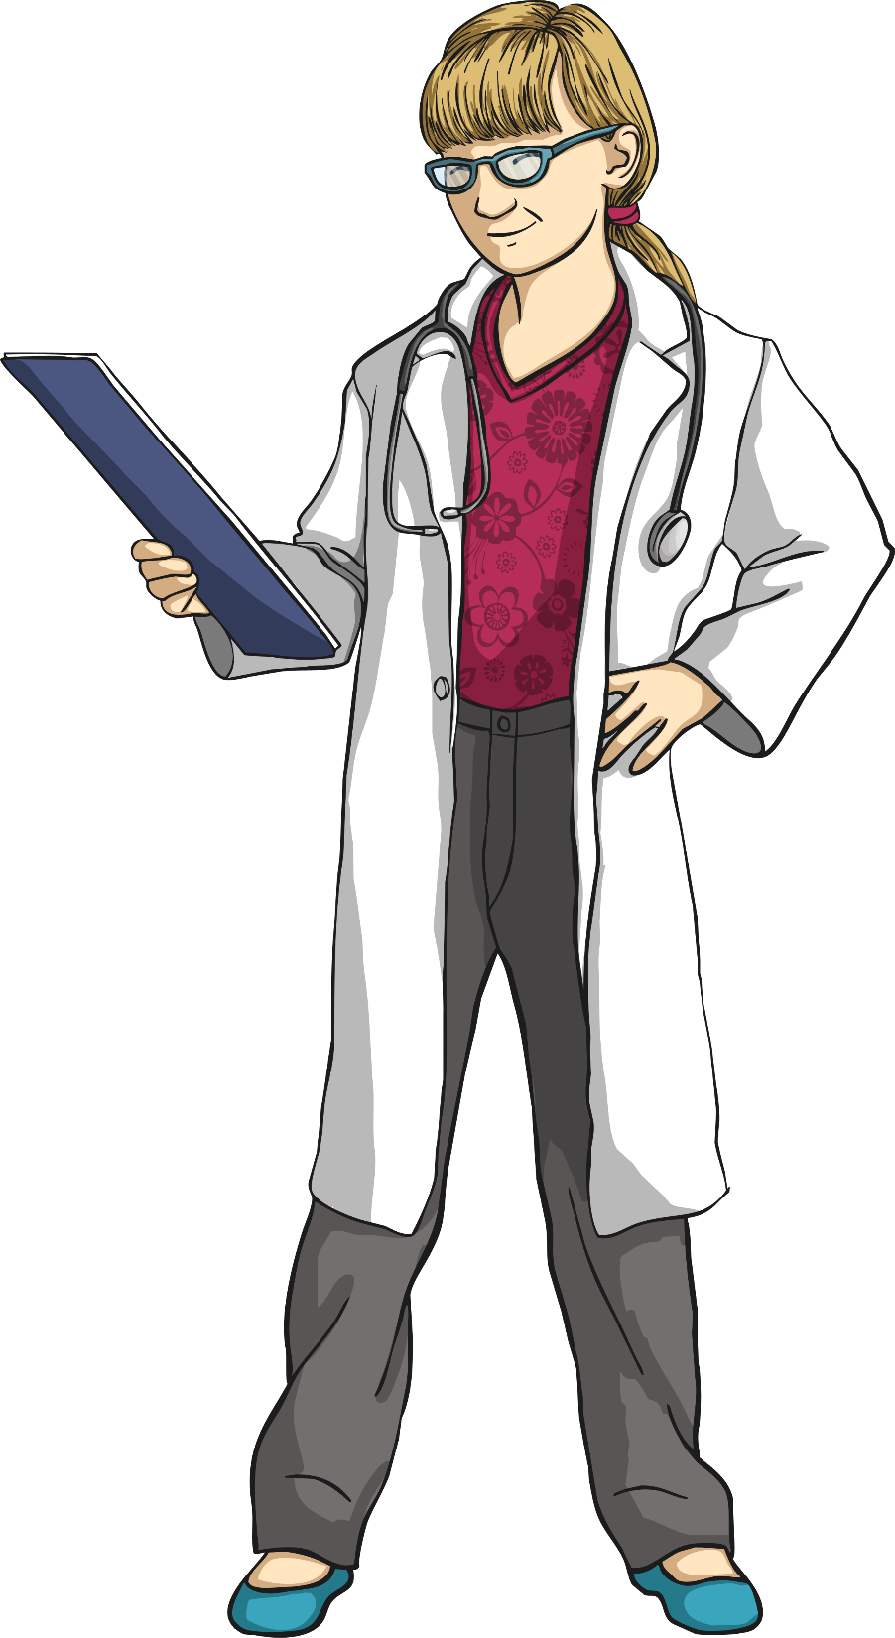
X-Rays
Before Marie Curie developed the use of x-rays in medicine, doctors had to diagnose broken bones and other problems simply by physical examination, which meant feeling for any injuries.
Sometimes, this meant that injuries and problems were not spotted or not treated correctly. It could be dangerous for patients if their problems were not treated properly.
Once x-ray machines were developed and available, doctors could identify problems much more quickly and accurately. Now, x-rays are regularly used in hospitals and patients can be cared for properly and safely.
Marie Curie's scientific work changed medicine and surgery for the better!

Slide 7

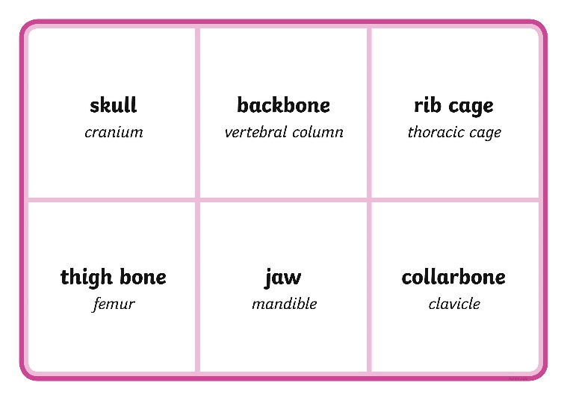
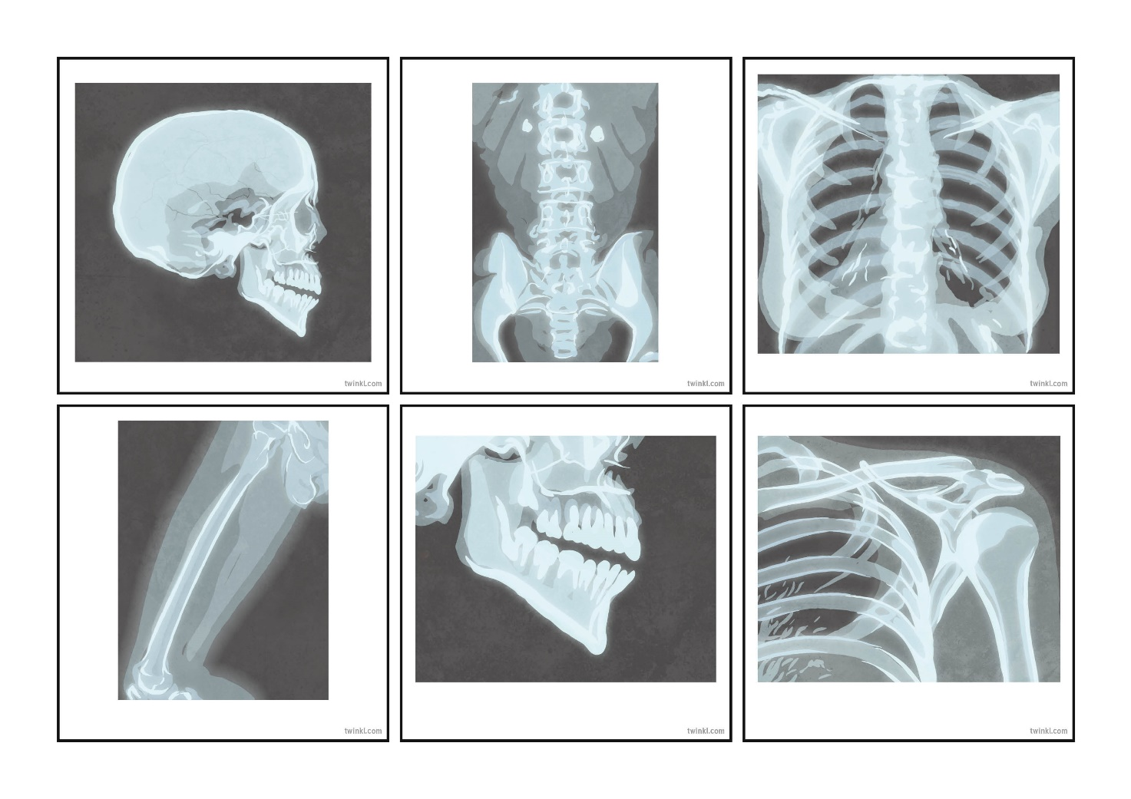
Bone Bingo
?
Can you identify bones by looking at x-ray images?
On your Bone Bingo Board, you will see the names of different bones.
Look at the different x-ray images. When you see one that matches the name of a bone on your Bone Bingo card, cross it off.
The aim is to be the first person to cross off all the names of bones in a full line or row.
Good luck!

Slide 8

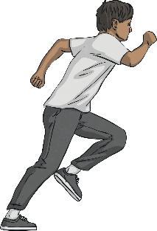

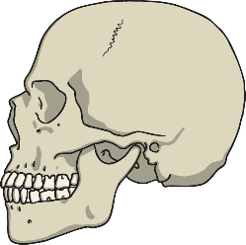
What Do Bones Do?
Bones have three main functions in our bodies.
?
Can you recall any of these functions?
Bones are used for support, protection and movement.
Support
Our bones support our bodies and keep us upright.
Protection
Bones protect some of our most important organs. For example, the skull protects the brain.
Movement
Joints between bones allow our bodies to move. The knee joint allows the leg to move.
?
Can you think of any other examples?

Slide 9
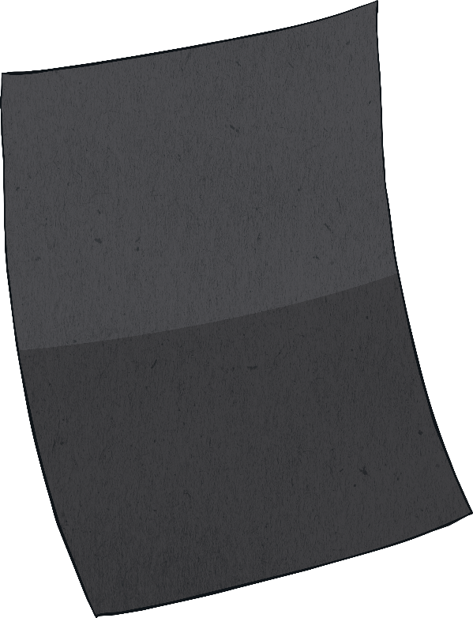


X-Ray
Your task is to create your own model of an x-ray image of a bone or bones.
Use black paper or card as the background of your x-ray image. Use art straws or white card to create the bones, and stick them to the background. Make sure you try your best to stick the bones on in the correct layout.
Can you label some of the bones?

Slide 10
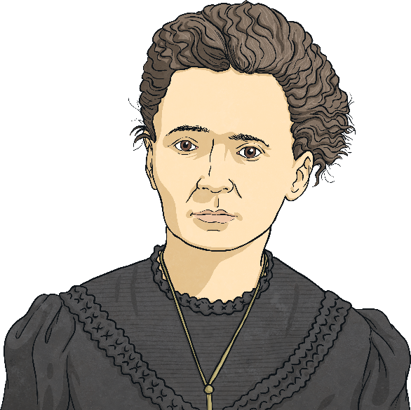
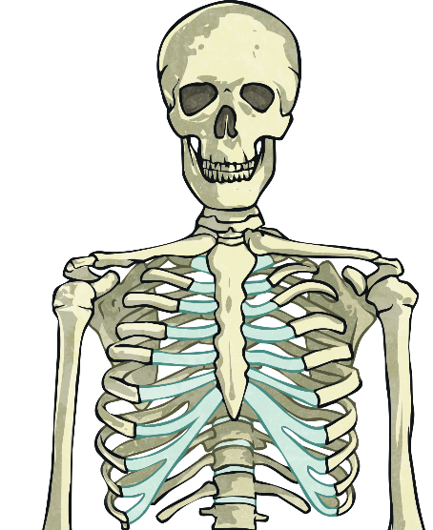
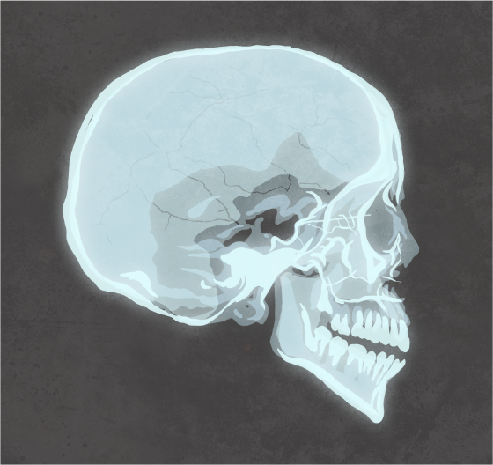
What Have You Learnt?
In this lesson, you will have found out about Marie Curie, x-rays and the skeleton.
Tell your partner five things you have learnt in this lesson, including:
two facts about Marie Curie;
two facts about x-rays;
one fact about the skeleton.

Slide 11

Aim
To explain how Marie Curie’s work on x-rays helped us identify bones.
Success Criteria
I can describe Marie Curie’s life and work.
I can explain how her scientific ideas about x-rays changed health and medicine.
I can identify the bones shown in x-rays, and explain the bones’ functions.

