Slide 1




WALT: rewrite a poem

Slide 2
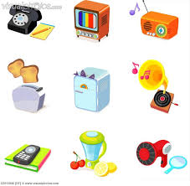
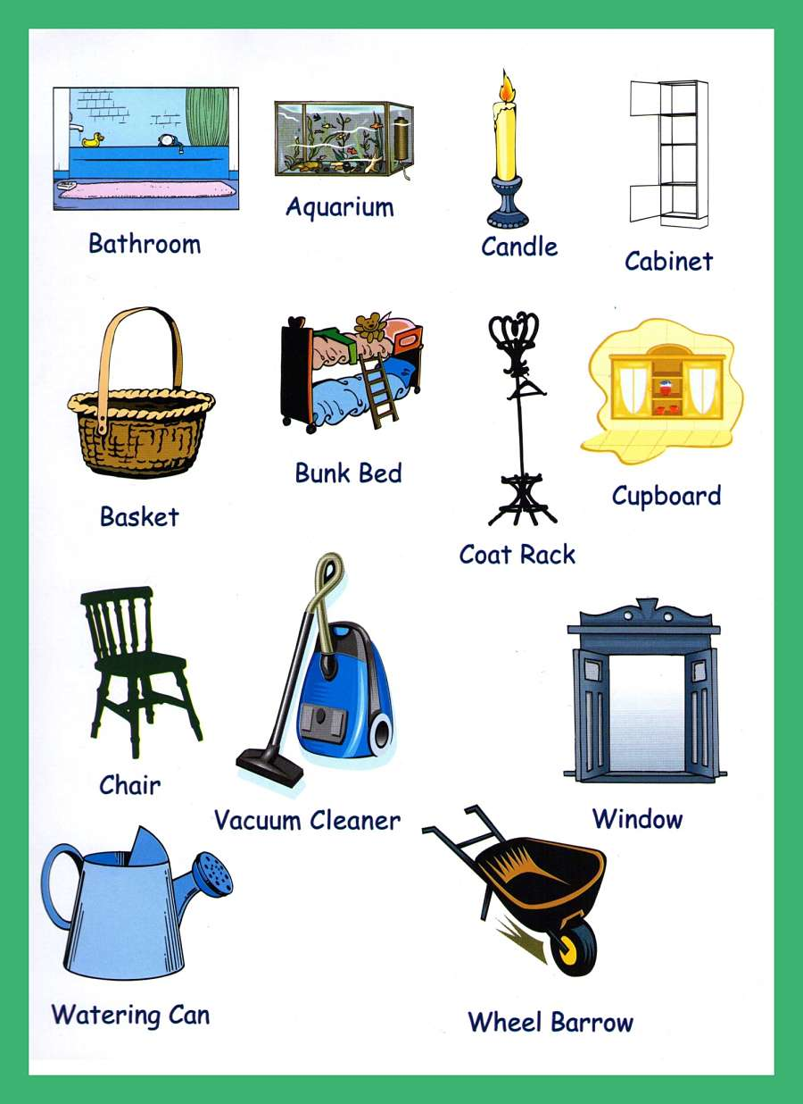
What kind of sounds might you hear in a house?

Slide 3
A stranger called this morning
Dressed all in black and grey
Put every sound into a bag
And carried it away.

Slide 4
How can we make this poem our own?
The _______________ of the _______
The _______________of the lock.
The ____________of the ____________
The _____________ of the clock.

Slide 5
The ______________of the _____________
The _______________ of the flakes.
When you spread the ____________
The ___________ noise it makes.

Slide 6
WALT: plan a poem

Slide 7
What do we need to keep the same?
Each verse is 4 lines long.
‘The ________ of the ______’
Where it is set- in a school!
It doesn’t need to rhyme!
What can we change?

Slide 8
What I am Looking For…
WALT: write a poem based on ‘The Sound Collector’. | I think... | Miss G thinks...
Followed the structure of the original poem ‘The _____ of the _____’
Use verbs to describe sounds (crunching, growling, tinkling).
Read my poem through to check it makes sense.

Slide 9
The Sound Collector is in school!

Slide 10

A teacher called this morning
Dressed all in black and grey
Put every sound into a bag
And carried it away.

Slide 11
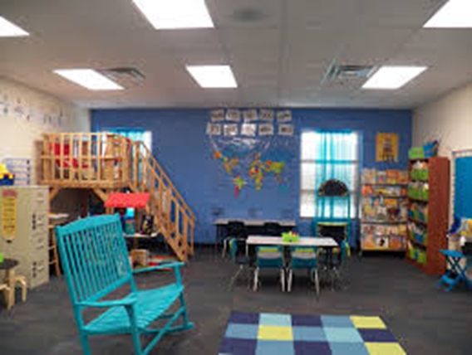
What sounds might we hear in the classroom?

Slide 12
The ringing of the morning bell
The sharpening of the pencils
The stamping of the feet.
The scraping of the chairs.

Slide 14
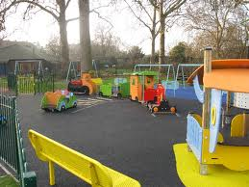
What sounds might we hear on the playground?

