Slide 1
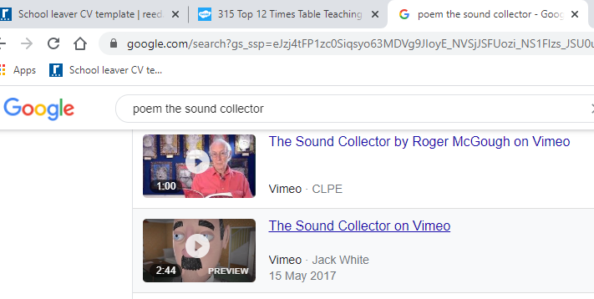
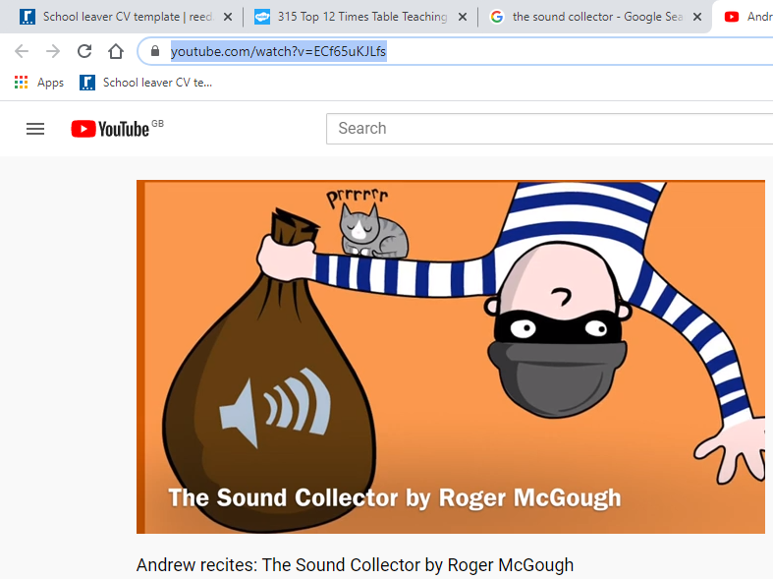
Watch video of the poet Roger McGough reading his poem “the sound collector”.
Follow link =
https://vimeo.com/217477785
Or watch and listen to this version on YouTube =
https://www.youtube.com/watch?v=ECf65uKJLfs

Slide 2

Think of an object for each of the sounds=
BAM = a door closing

