Slide 2
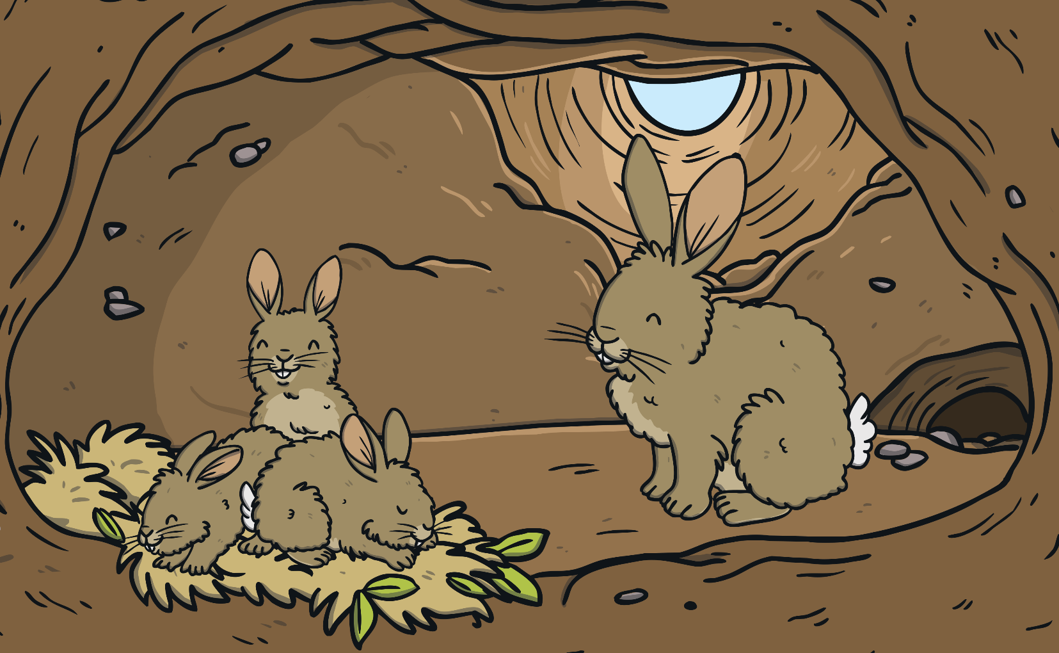
Animal Habitats
A habitat is a natural environment that an animal lives in. A habitat provides animals with 3 important things:
food;
shelter;
a safe place to raise their young.

Slide 3
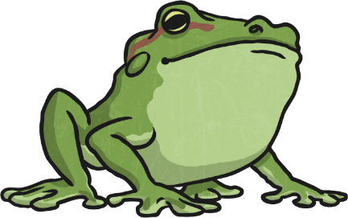
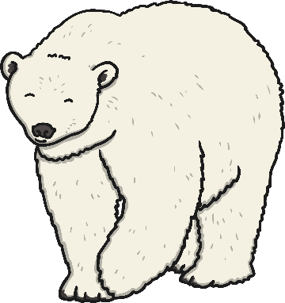
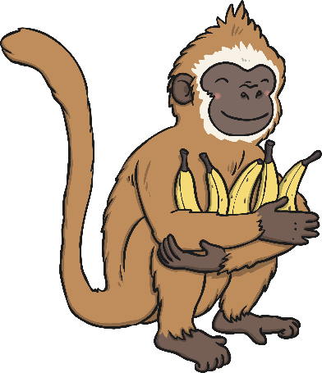
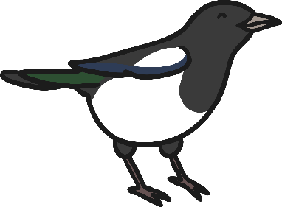

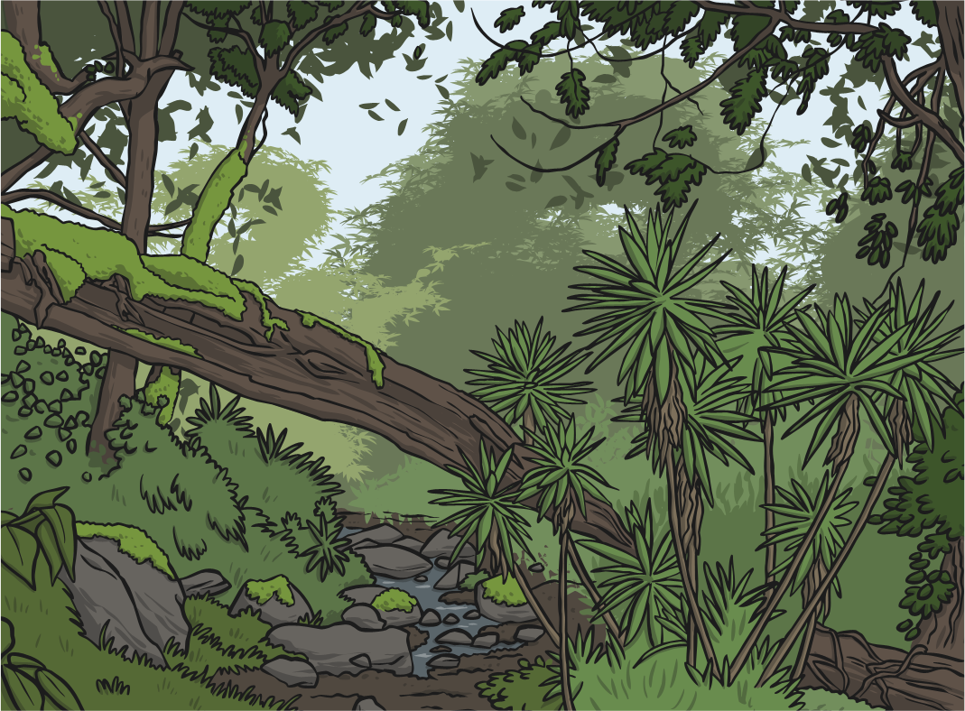
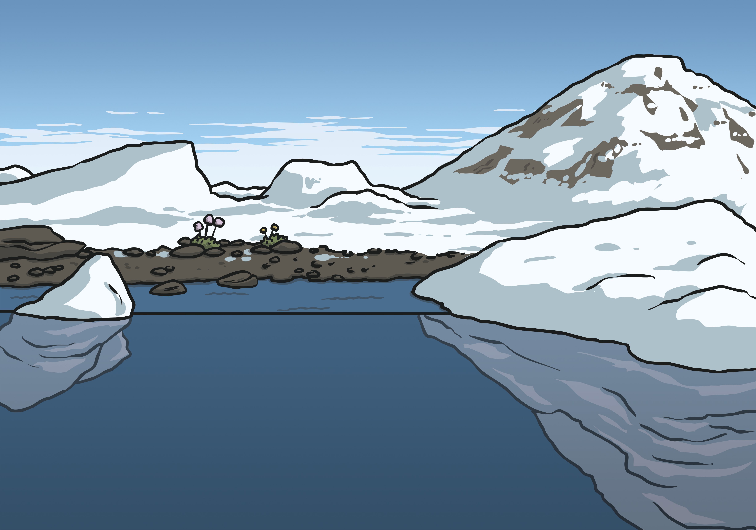
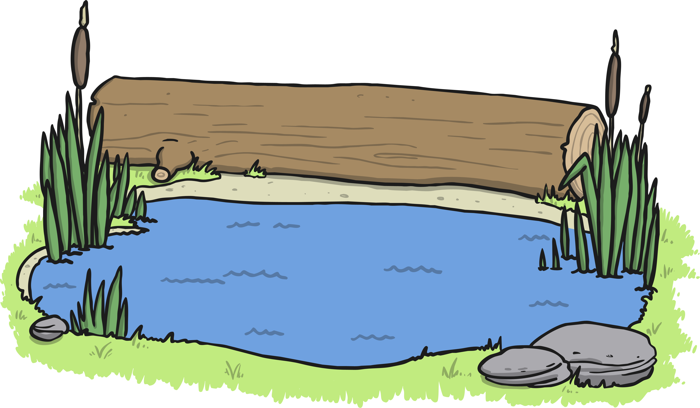
Animal Habitats
How have these animals adapted to their environment?
Can you match the animal with their environment?

Slide 4
What Do Frogs Need in a Habitat?
Food, such as flies, cockroaches and spiders are caught on the frog’s long, sticky tongue. Bigger frogs can eat bigger animals, like mice and birds.
Camouflage, so that they are less visible to predators, such as otters, birds and fish.
Water is needed for drinking and for laying their eggs in.
This means…
… frogs are best suited to living in places where there is water, such as near a pond or lake.
predator: an animal that hunts other animals.

Slide 5
What Do Polar Bears Need in a Habitat?
Food, such as seals, reindeer and fish. They can even use their sense of smell to find seals hiding under
the snow.
Camouflage, so that they are harder to spot. Their see-through fur reflects the white of the snow around them and lets them blend in.
Sea ice for hunting on, living on and breeding on.
This means…
… polar bears are best suited to living in the Arctic Circle.

Slide 6

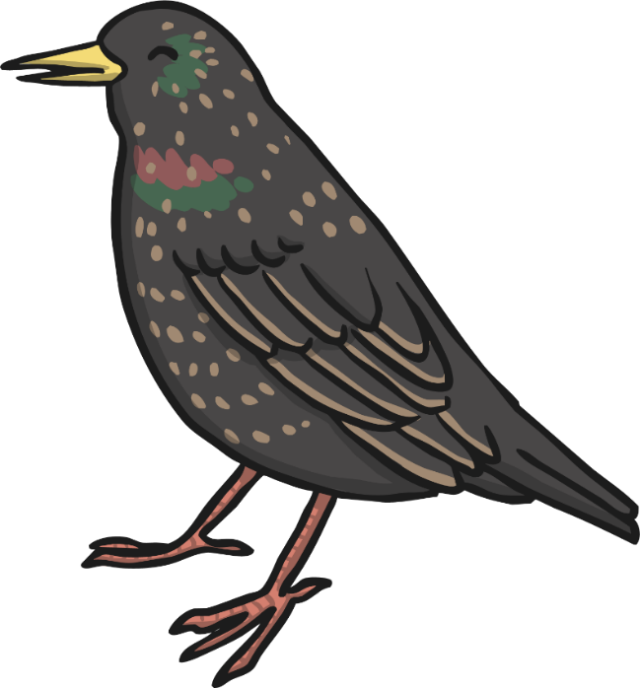
What Do Birds Need in a Habitat?
Food, such as berries, worms and small insects.
Camouflage, so that they are less visible to predators.
Materials for nest-building, such as twigs and leaves.
This means…
… birds are best suited to living in places where there are plenty of trees, such as woods, gardens and parks.

Slide 7
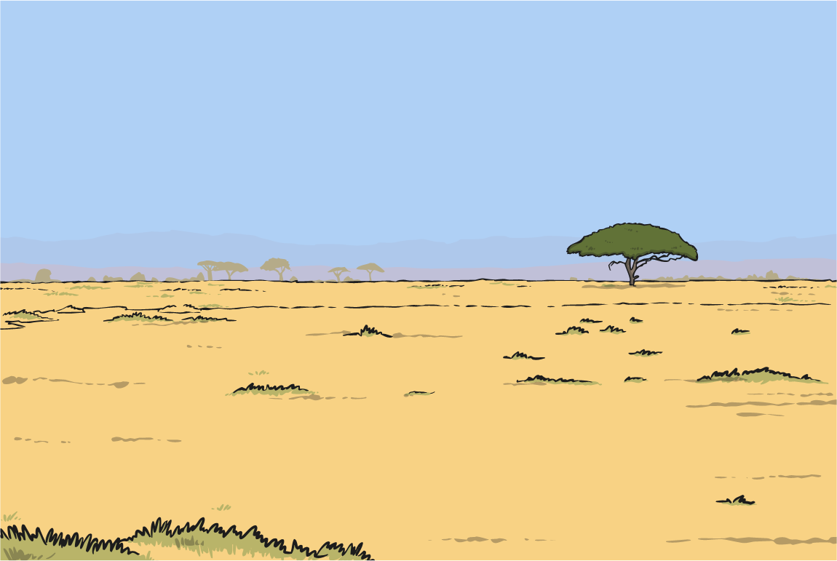
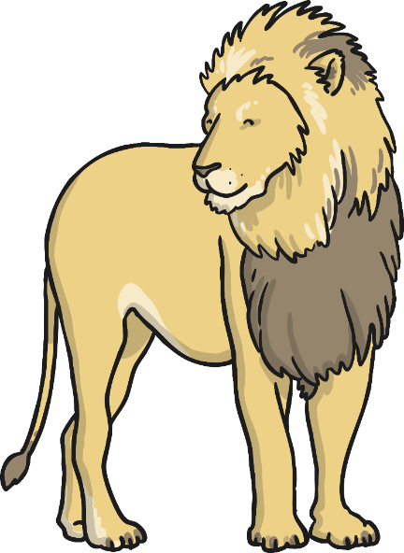
What Do Lions Need in a Habitat?
Water to stay hydrated in hot conditions.
Prey, such as antelopes and zebras, to eat.
Camouflage, such as long grass to hide in whilst they hunt
their prey.
prey: an animal that is hunted and eaten by another animal.
This means…
… lions are best suited to living in places where there are plenty of zebras to eat and there is long grass to hide in, such as the plains of Africa.

Slide 8
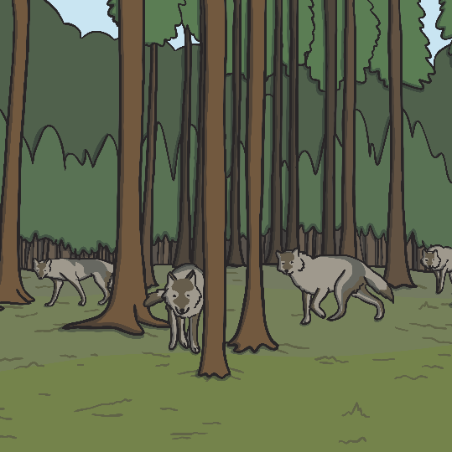
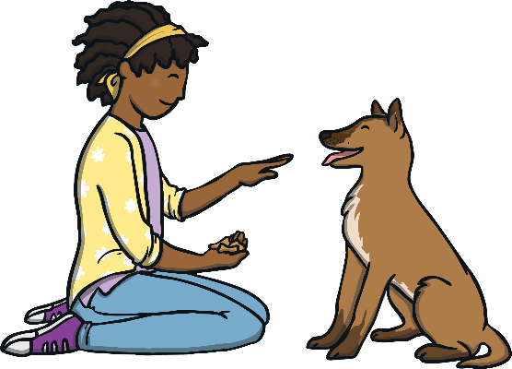
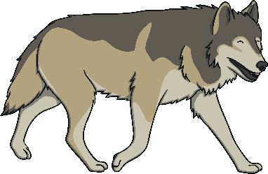
What Do Dogs Need in a Habitat?
Water to stay hydrated in all conditions.
Prey, such as mice, voles, rabbits, and other small animals are caught and eaten by wild dogs. Pet dogs are fed a diet of either dry food or meat by their owners.
A den to feel safe in. In the wild, this is a warm, dry place like a cave but, for a pet dog, this would be a crate or bed.
This means…
… wild dogs are best suited to living in places where there is plenty of water and caves to stay dry in. Pet dogs are best suited to living with their owners in a warm, dry house.

Slide 9
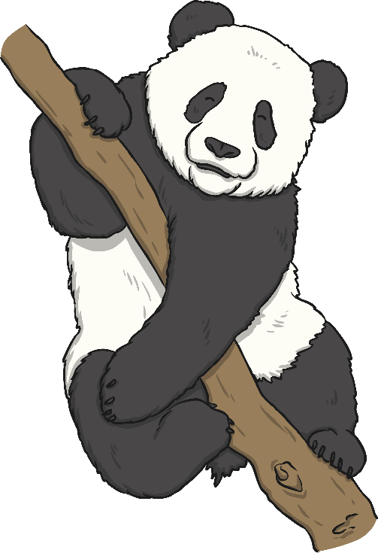
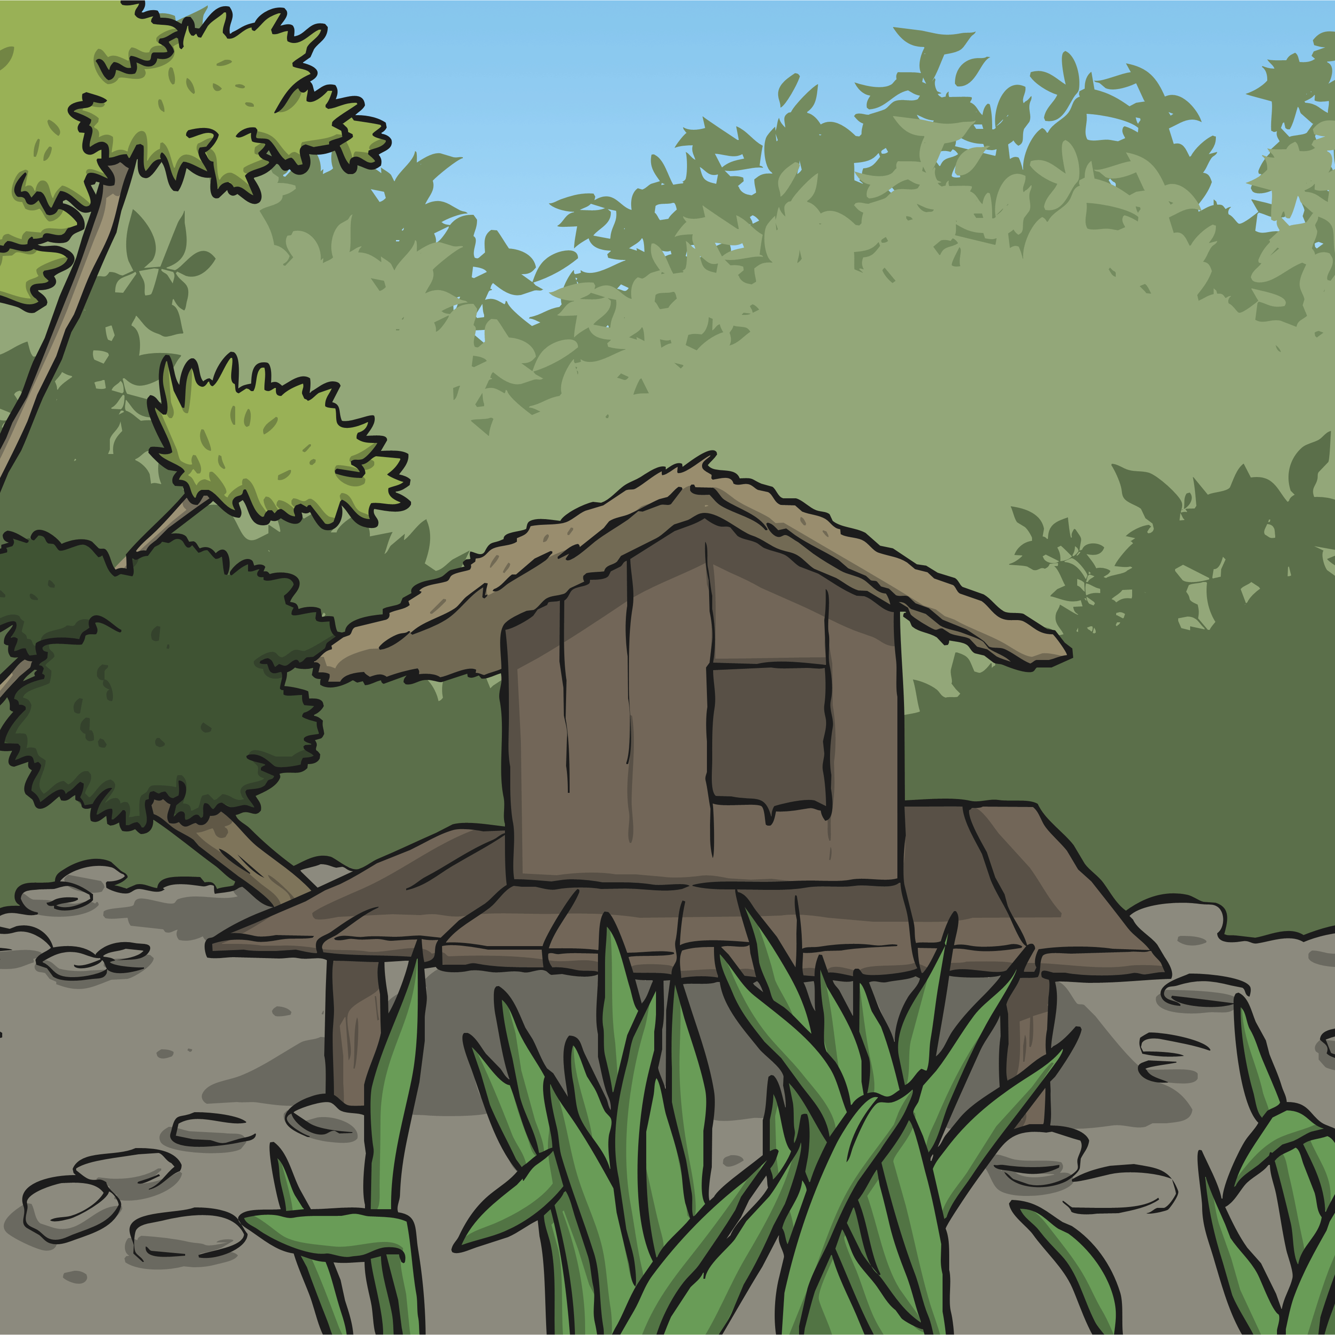
What Do Pandas Need in a Habitat?
Food and Water, to stay healthy and hydrated in all conditions. Both come from bamboo, which grows in cool forests. They also eat other plants and even small rodents.
Camouflage to hide in. The panda’s white fur helps it hide in the snow in the mountains, while the black patches help it hide in the shade.
This means…
… pandas are best suited to living in places where there is plenty of bamboo and places to hide, such as a forest.

Slide 10
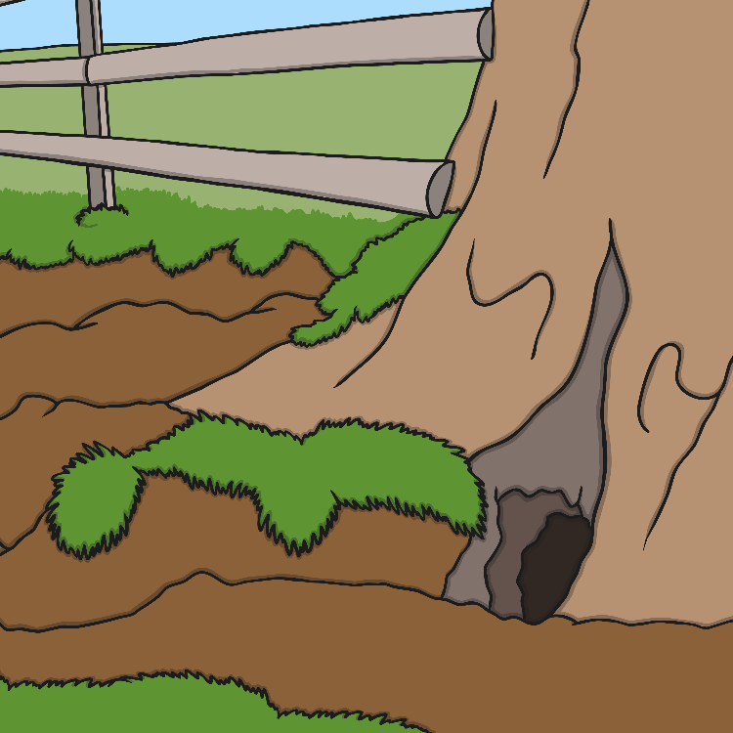
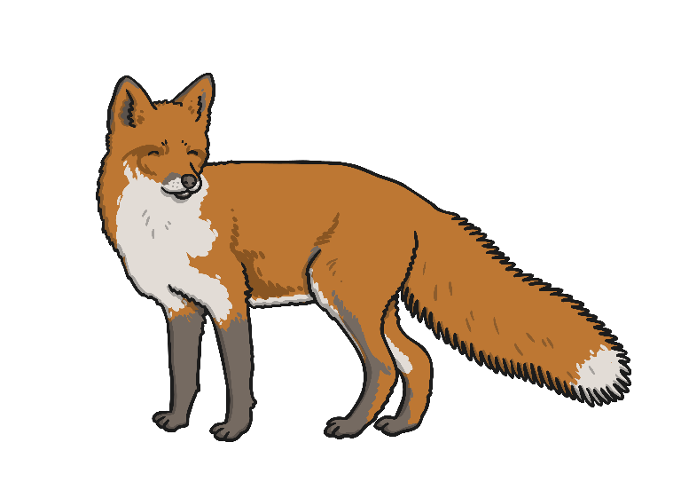
What Do Foxes Need in a Habitat?
Water, to stay hydrated in all conditions.
Prey, such as birds and mice. They are scavengers, which means they will eat almost anything like insects, earthworms, fruit, berries, and food waste left by humans.
A den to live in. This is usually a hole under the ground.
This means…
… foxes are best suited to living in places where there is plenty of water, prey and somewhere for them to make a den, such as a forest.

Slide 11

Animal Habitats
We (humans) are able to change our environments to make them habitable with technology and buildings. We are able to live in most conditions. Some animals cannot do this and have become
extinct as a result.
extinct: there are no more of that species/animal left in the world.

Slide 12

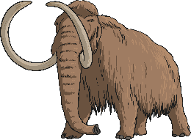
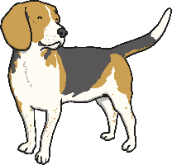

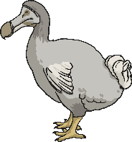
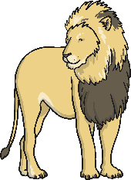
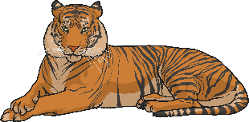
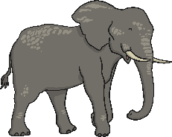
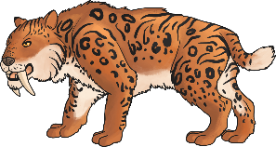
Can you sort these animals into extinct and living?
woolly mammoth
dog
panda
dodo
fox
Sabre-toothed cat
lion
javan tiger
elephant
Extinct | Living

