Slide 1

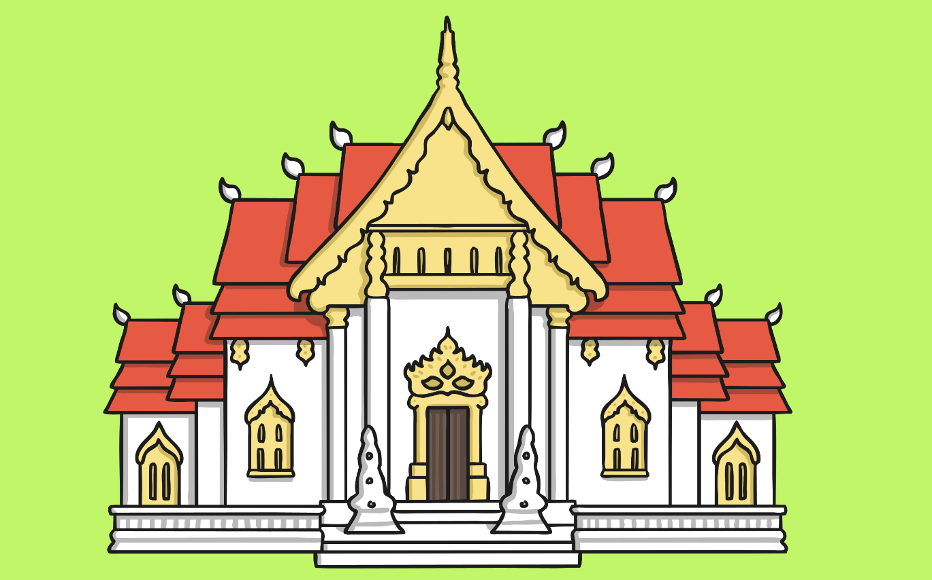
Places of Worship
A task setting PowerPoint about the Buddhist temple for Key Stage 1.

Slide 2
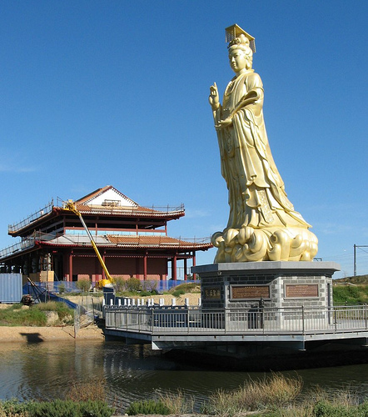
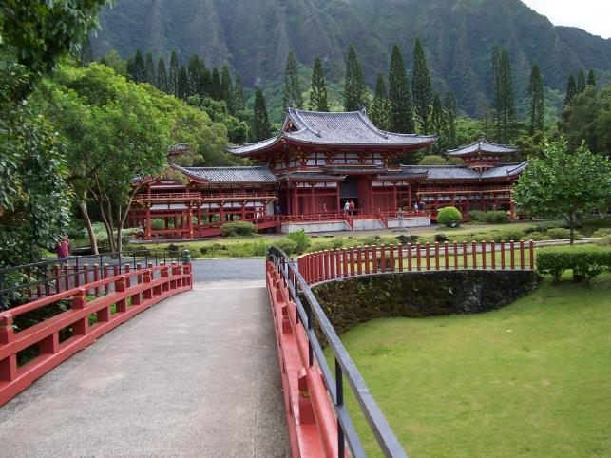
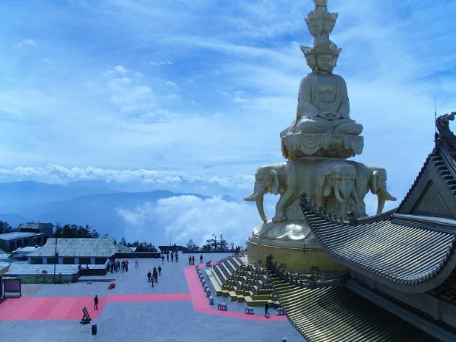
Places of Worship
What do all of these buildings have in common?
Photos courtesy of archer10 (Dennis), kkalyan and NCBrian @flickr.com) - granted under creative commons licence - attribution

Slide 3
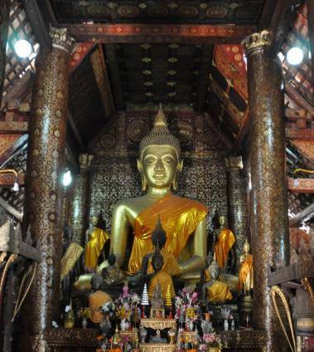
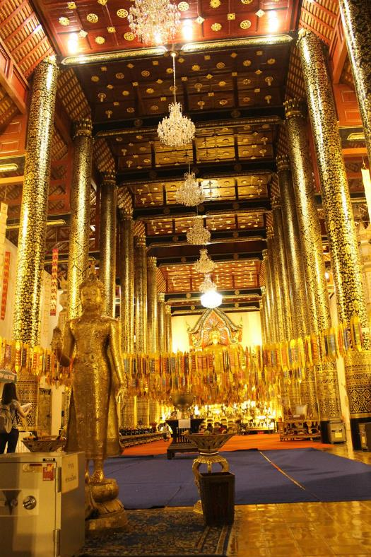
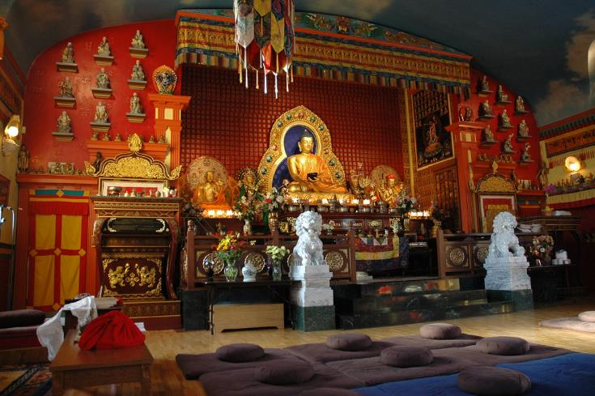
What is it like inside a Buddhist Temple?
Photos courtesy of archer10 (Dennis), kkalyan and NCBrian @flickr.com) - granted under creative commons licence - attribution

Slide 4
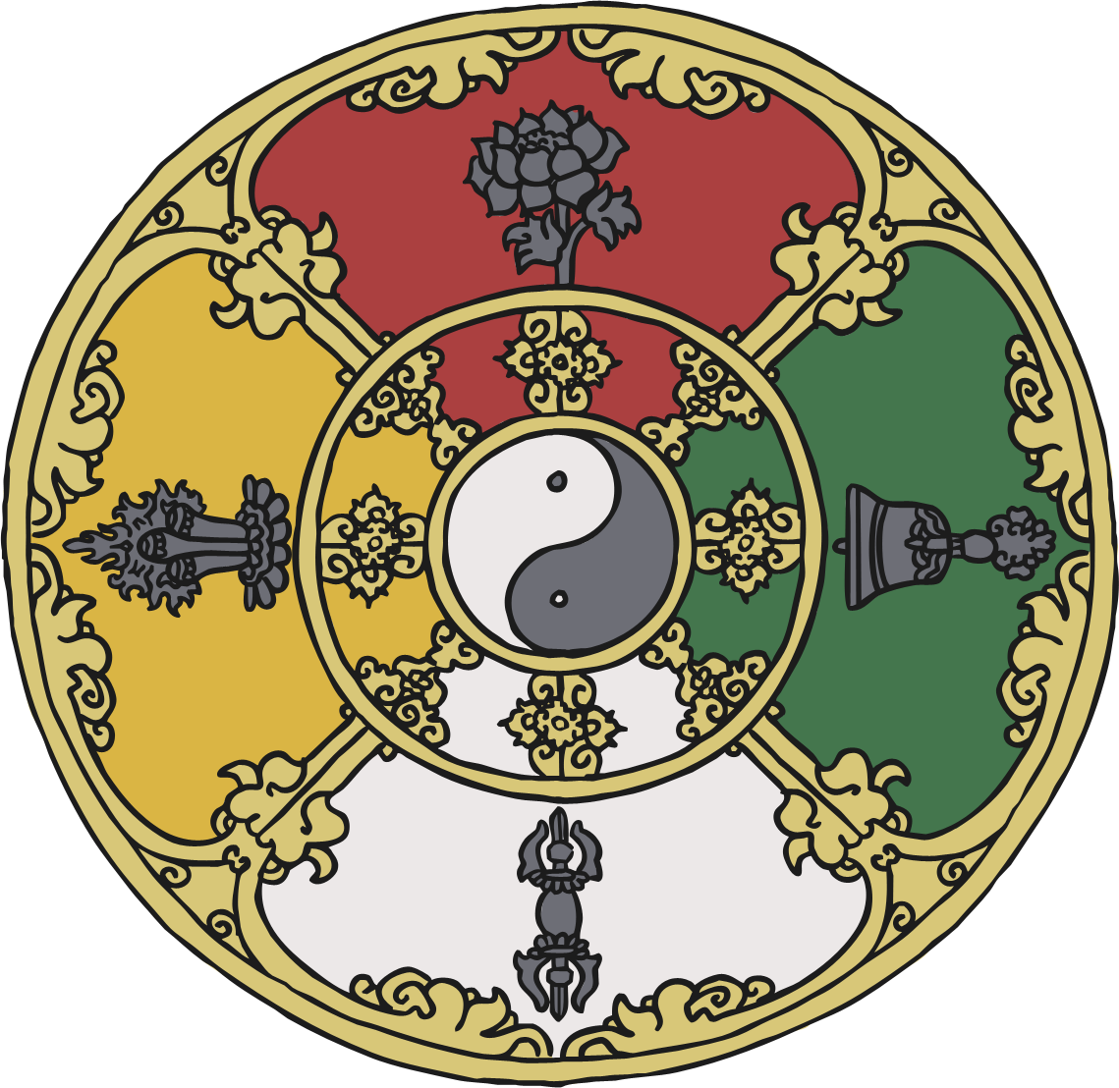
Learning Objective
To learn about what you might see and experience at a Buddhist temple.
To learn about why it is an important place to many people.
To learn about how and why Buddhists worship at home.

Slide 5
Success Criteria
I can list the things that are the same and different about Buddhist temples around the world.
I can name and describe special objects that can be found inside.
I understand why the temple is an important place by describing what happens during worship.
I can list rules for how to behave inside a Buddhist temple.
I can talk about how and why Buddhists also worship at home.

Slide 6
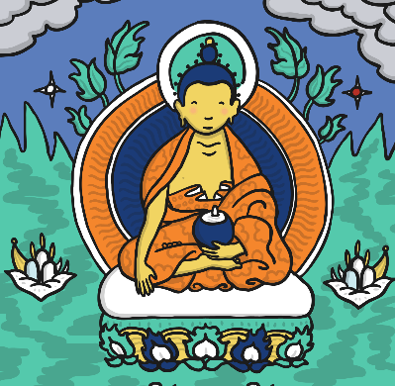
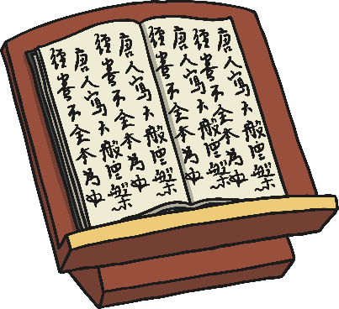

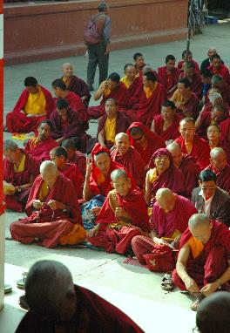
Lectern
From here, the head monk may give a talk to the worshippers.
Important Features of a Buddhist Temple
Buddha
All Buddhist temples contain an image or statue of Buddha.
Wheel of Life
This is the Buddhist symbol. You might see this if you are ever visiting a Buddhist temple.
Courtyard or Meditation Area
A temple may have a silent area for meditation.
Photo courtesy of archer10 (@flickr.com) - granted under creative commons licence - attribution

Slide 7
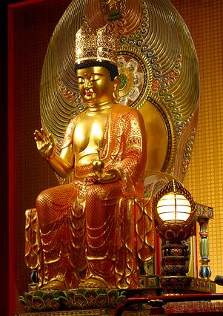
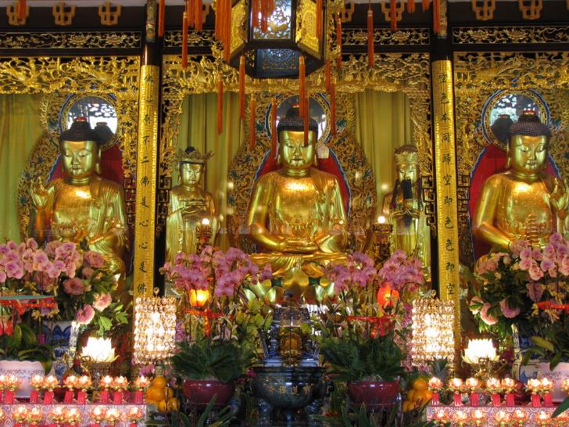
Why do people go to a Buddhist Temple?
People go to the temple to worship the image of Buddha. Worshippers usually sit on the floor barefoot.
Worshippers give offerings to Buddha such as flowers or candles. Worship is led by monks and is mostly meditation and chanting.
Photo courtesy of williamcho and oldandsolo (@flickr.com) - granted under creative commons licence - attribution

Slide 8
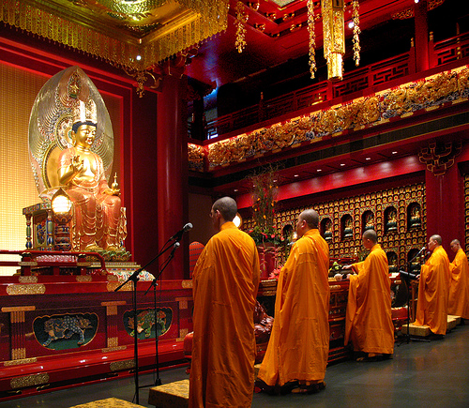
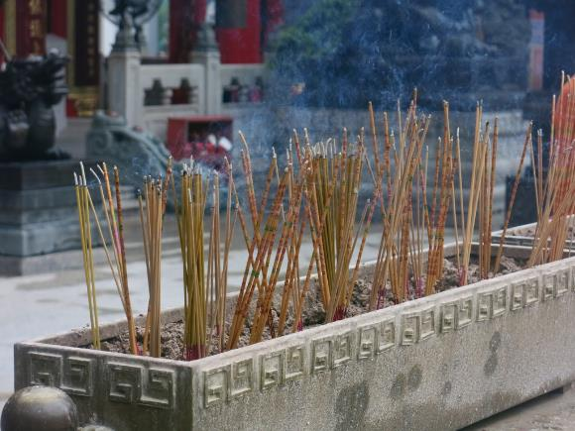
Why do people go to a Buddhist Temple?
Many Buddhists believe that worshipping together with other Buddhists helps them to understand their religion better and to feel part of a faith family. Being in the temple also helps Buddhists to get better at meditation which is a way of being calm and still.
Incense (a nice smelling fragrance) is used during worship to remind everyone that Buddha is all around them.
Photo courtesy of dungodung and williamcho (@flickr.com) - granted under creative commons licence - attribution

Slide 9
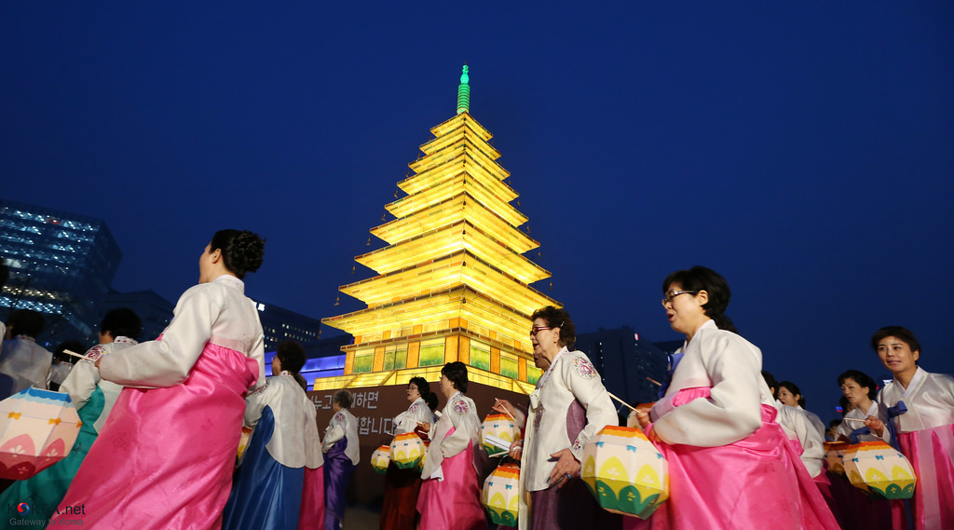
Why do people go to a Buddhist Temple?
Buddhists also attend temple for special occasions such as weddings and religious festival days.
Photo courtesy KOREA.NET - Official page of the Republic of Korea (@flickr.com) - granted under creative commons licence - attribution

Slide 10

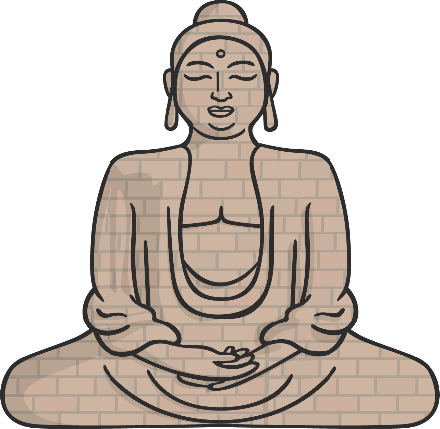


Buddhist Worship at Home
Buddhists can worship both at the temple and at home.
In a Buddhist home, there will be one room or area used as a shrine with a statue of Buddha, incense and candles.
Having a shrine in the home is an opportunity for a Buddhist to worship daily.
Photo courtesy KOREA.NET - Official page of the Republic of Korea (@flickr.com) - granted under creative commons licence - attribution

Slide 11
Showing Respect
No talking in the shrine room.
Wear appropriate clothing and no shoes to be worn inside.
Special books should be kept off the floor.
Sit with your legs crossed on the floor, do not straighten out your legs (this is a sign of disrespect, so is lying down).
Bow to the statue of Buddha.
Make offerings.

Slide 12
Plenary
Why do you think visiting the temple is important to many Buddhists?
Do you have any further questions about Buddhist temples?

