Slide 1
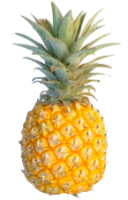
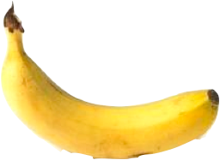
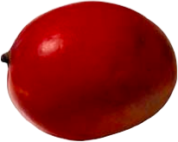
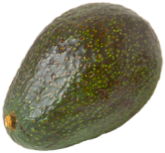

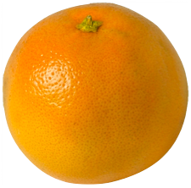
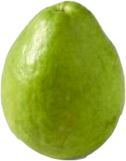
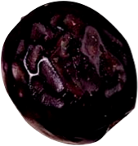

Handa’s Suprise
Eileen Brown

Slide 2
Handa put seven delicious fruits in a basket for her friend Akeyo,

Slide 3
I wonder which fruit she’ll like best

Slide 4
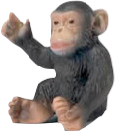
Will she like the soft yellow banana…

Slide 5
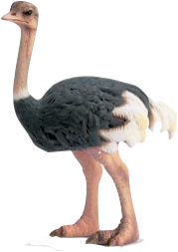
Or the sweet-smelling guava?

Slide 6
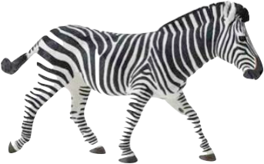
Will she like the round juicy orange…

Slide 7
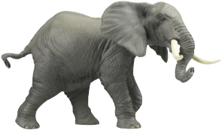
Or the ripe red mango?

Slide 8
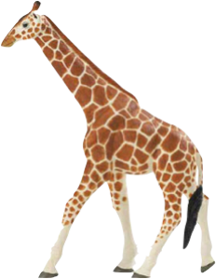
Will she like the spiky leaved pineapple…

Slide 9
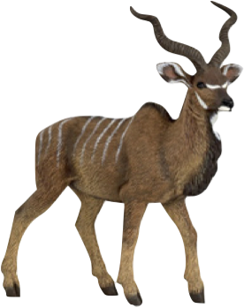
The creamy green avocado?

Slide 10
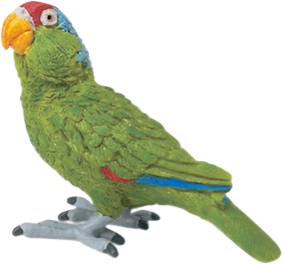
Or the tangy purple passion fruit?

Slide 11
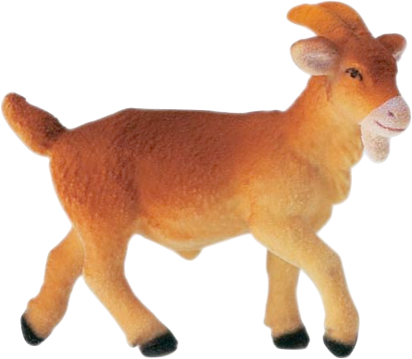
Which fruit will Akeyo like best?

Slide 12
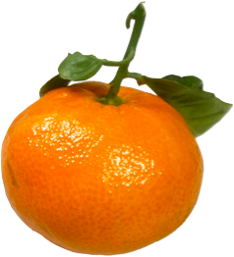
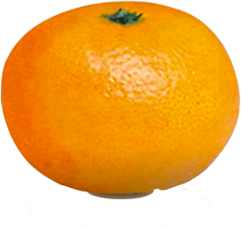

Slide 13
“Hello Akeyo”. Said Handa.
“I’ve brought you a surprise.”

Slide 14
“Tangerines!” said Handa
That is a surprise!

