Slide 1






Guidance for Video/Audio in PowerPoints
1. Open the folder and copy all the files.
2. Paste the copied files into a new folder.
3. Open the PowerPoint file, enable editing and enter presentation mode (start the slide show). Go to slide 3 and the backing track will start automatically.
Please note the embedded audio may not be compatible with early versions of PowerPoint.
You may wish to delete this slide before beginning the presentation.

Slide 3



Pirate crew, they played 1,
Swashbuckled in the morning sun.
With an eye patch, scrub the deck, looking out to sea,
Pirate crew have room for me.

Slide 4

Pirate crew, they played 2,
Swashbuckled when the parrot flew.
With an eye patch, scrub the deck, looking out to sea,
Pirate crew have room for me.

Slide 5
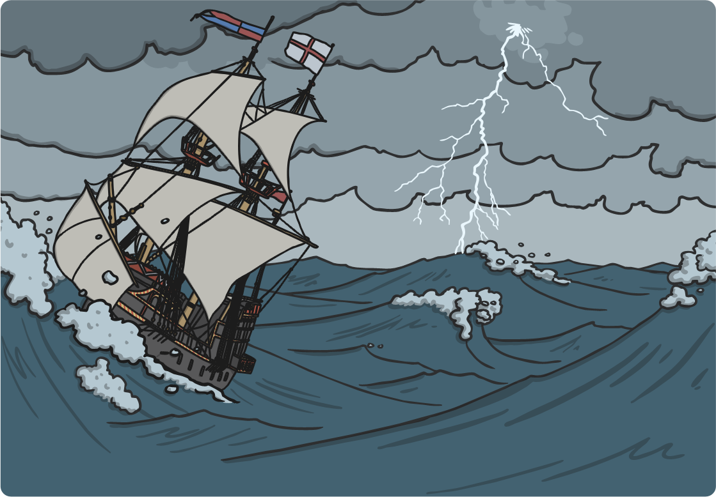
Pirate crew, they played 3,
Swashbuckled on the stormy sea.
With an eye patch, scrub the deck, looking out to sea,
Pirate crew have room for me.

Slide 6

Pirate crew, they played 4,
Swashbuckled on the captain’s door.
With an eye patch, scrub the deck, looking out to sea,
Pirate crew have room for me.

Slide 7

Pirate crew, they played 5,
Swashbuckled to stay alive.
With an eye patch, scrub the deck, looking out to sea,
Pirate crew have room for me.

