Slide 1
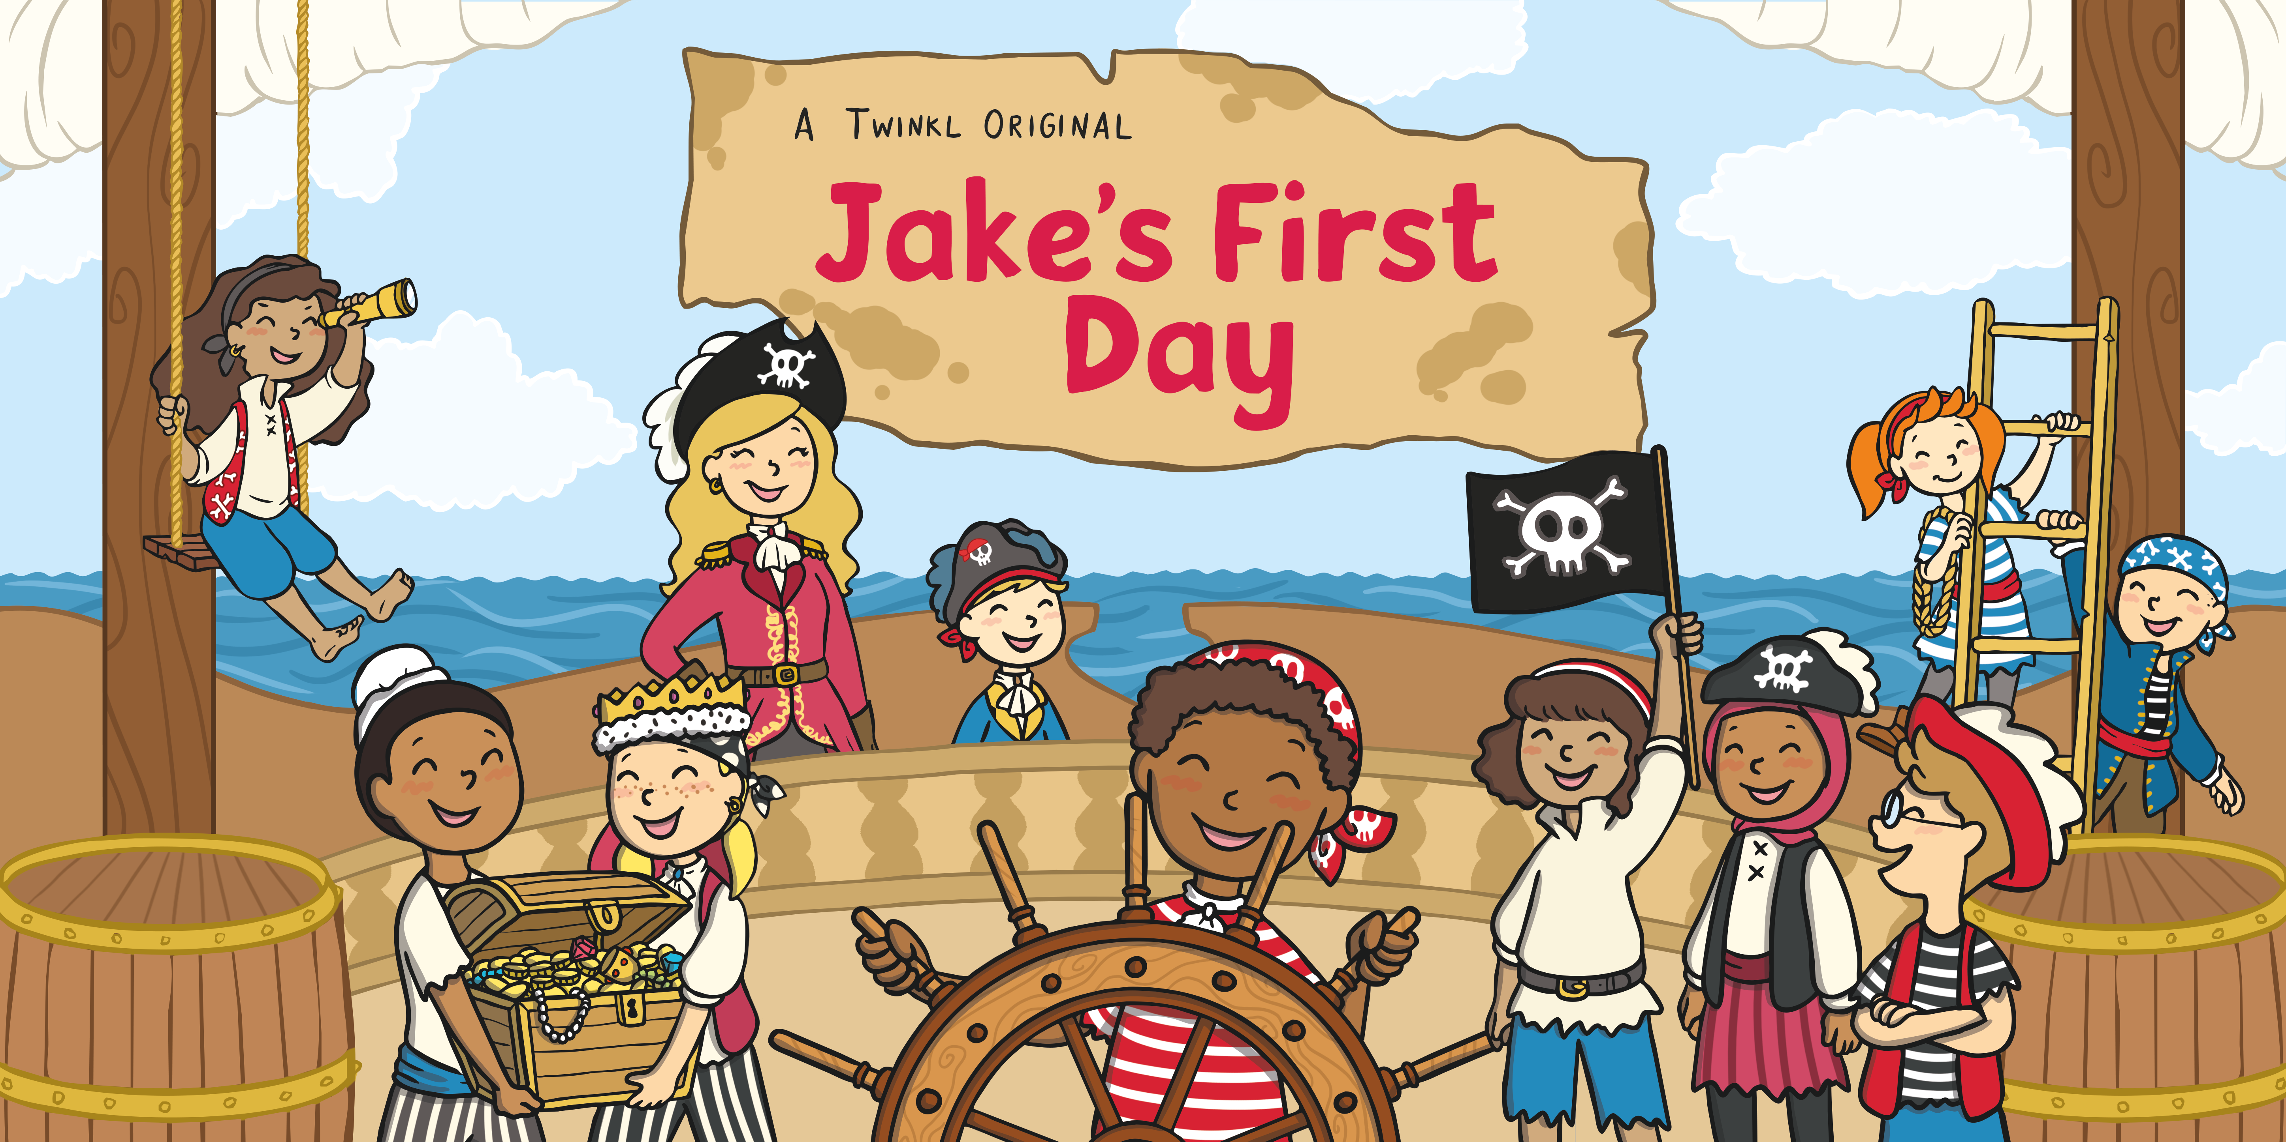

Slide 2
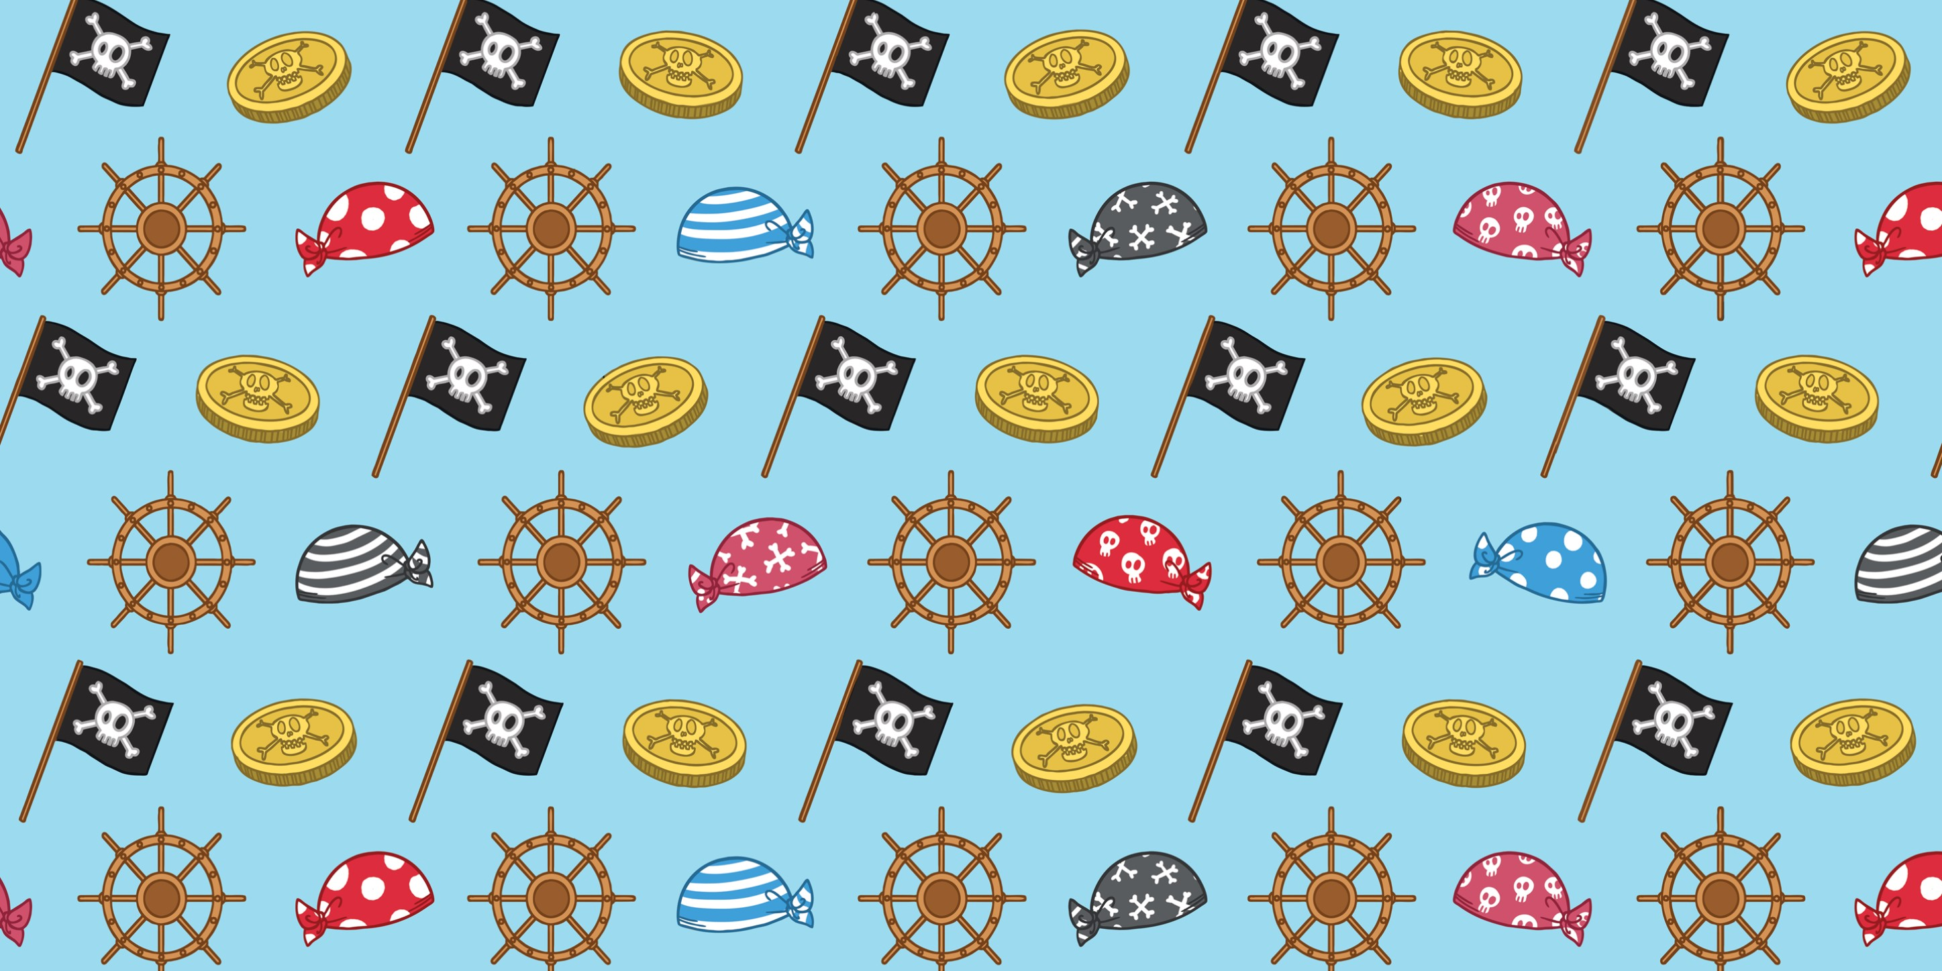

Slide 3
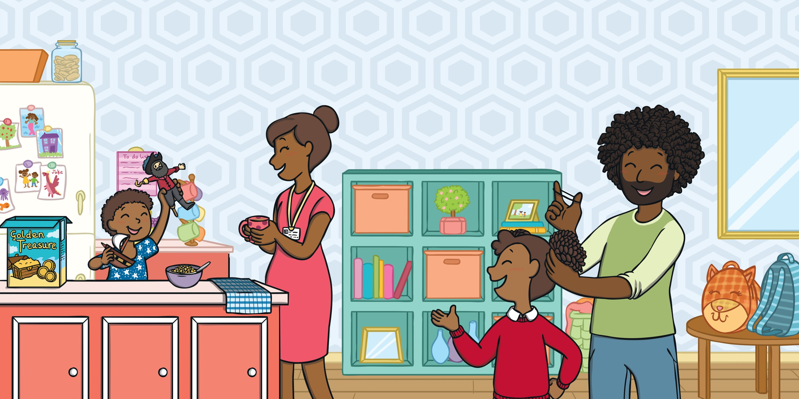
Jake was in his pyjamas, playing with his favourite toys.
“I don’t think I want to go,” said Jake. “I think I’ll just stay at home today and carry on playing.”
“Come on, Jake,” said Mum. “It’s your first day and you need to get ready.”
His sister, Holly, laughed. “You can’t stay here, Jake. You have to go to school.”

Slide 4
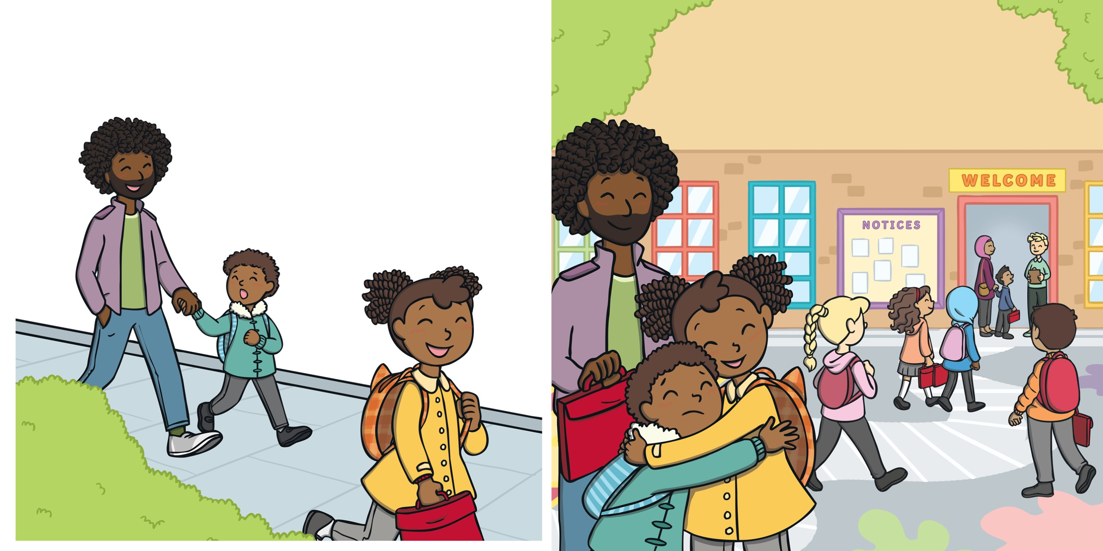
Holly, Jake and Dad made their way to school.
“Trust me,” said Holly. “It’s going to be a great first day.”
“But who will I play with?” asked Jake. “Who’s going to help me? What if I have to do really hard work? Will I have to go into the big playground? What about all of the big children in the dinner hall? What about–”
Holly hugged Jake and went off to her new classroom, excited to be back at school.

Slide 5
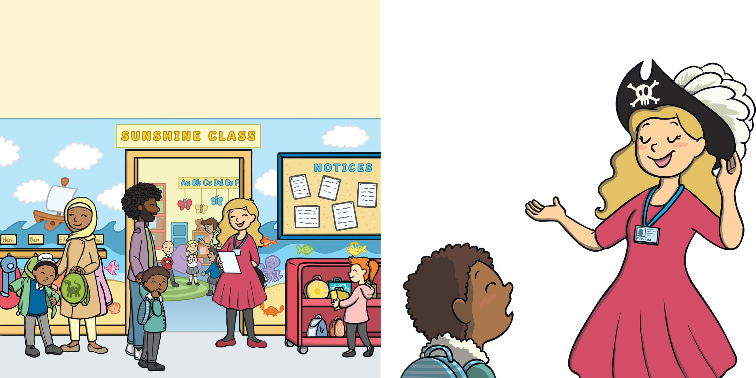
Dad took Jake to his new classroom. Jake was sure he’d rather be at home in his pyjamas.
Miss Fox gave Jake a big smile. “Ah. You must be Jake, our new shipmate.”
“Here we are,” said Dad. “Say hello to your new teacher.”
^{“New what?” asked Jake.}
^{Jake frowned.}
“We need another pirate like you on board,” she said. “Welcome. I’m Captain Fox.”

Slide 6
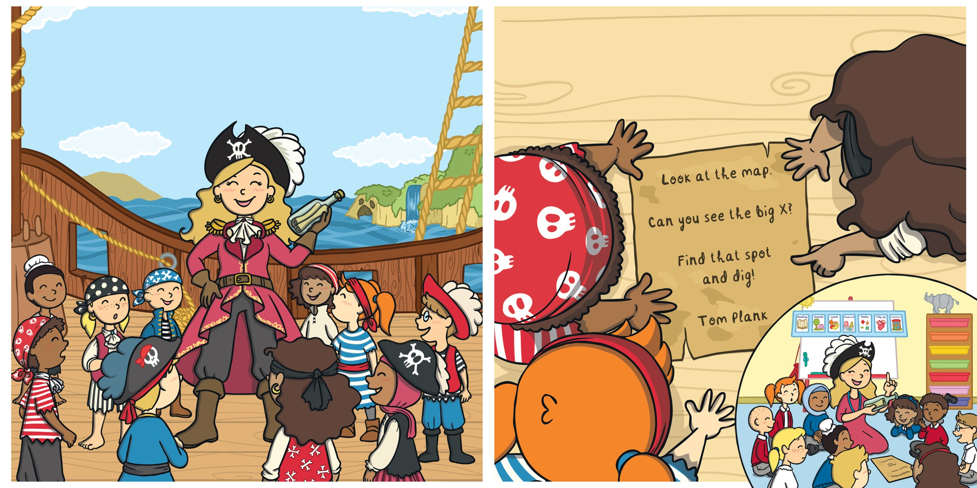
The pirates all gathered together to listen to their captain.
Captain Fox and the pirates worked as a team to read the letter together.
“We’ve received a message in a bottle,” said Captain Fox. “I need your help to read it and work out what it says.”

Slide 7
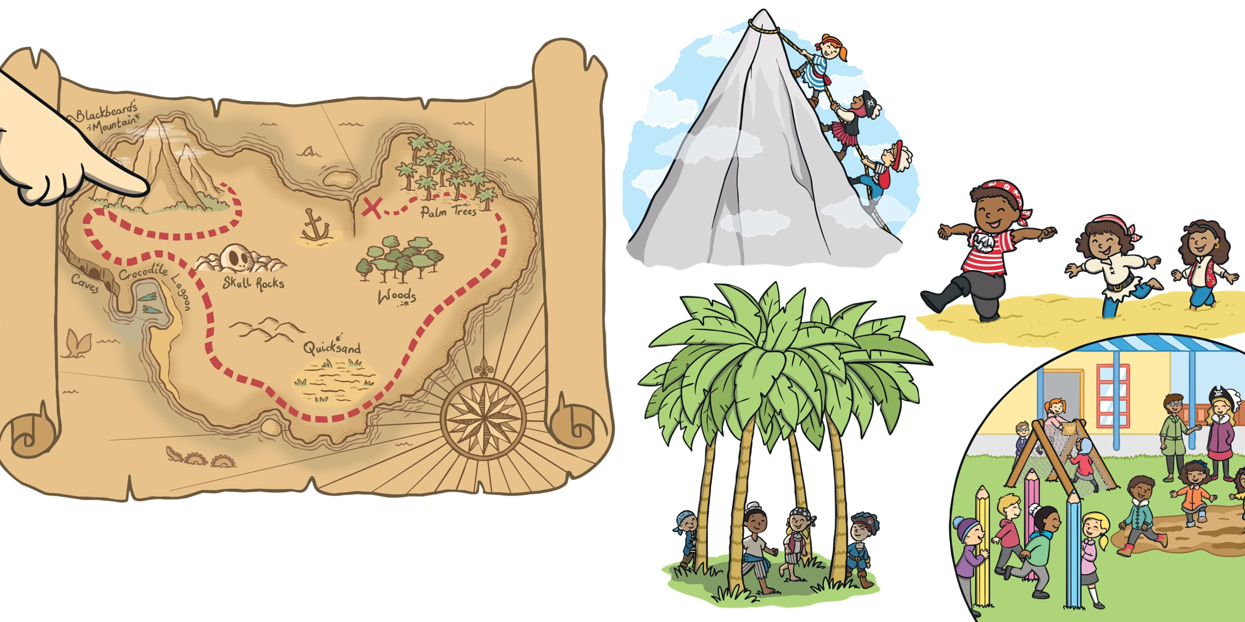
Captain Fox pulled the map from the bottle and showed the pirates.
Together, the pirates followed the path, over mountains, through quicksand and between the palm trees.
“I think we need to go over there first,” suggested Jaya.

Slide 8
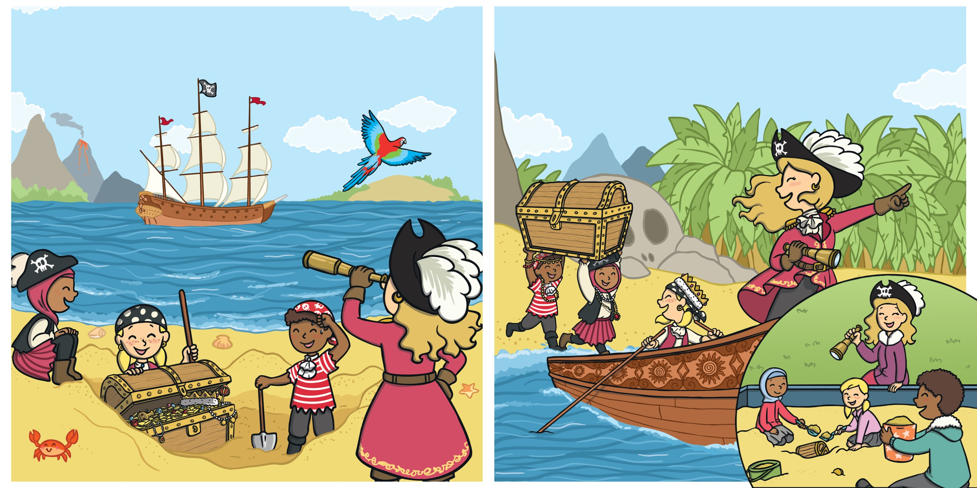
Finally, they found the spot marked on the map. So, they dug and dug until they found a wooden chest.
“Good work, mateys,” said Captain Fox. “Let’s get this loot back to the ship and then it’s time for a break. I think you’ve earned some fish and chips!”

Slide 9
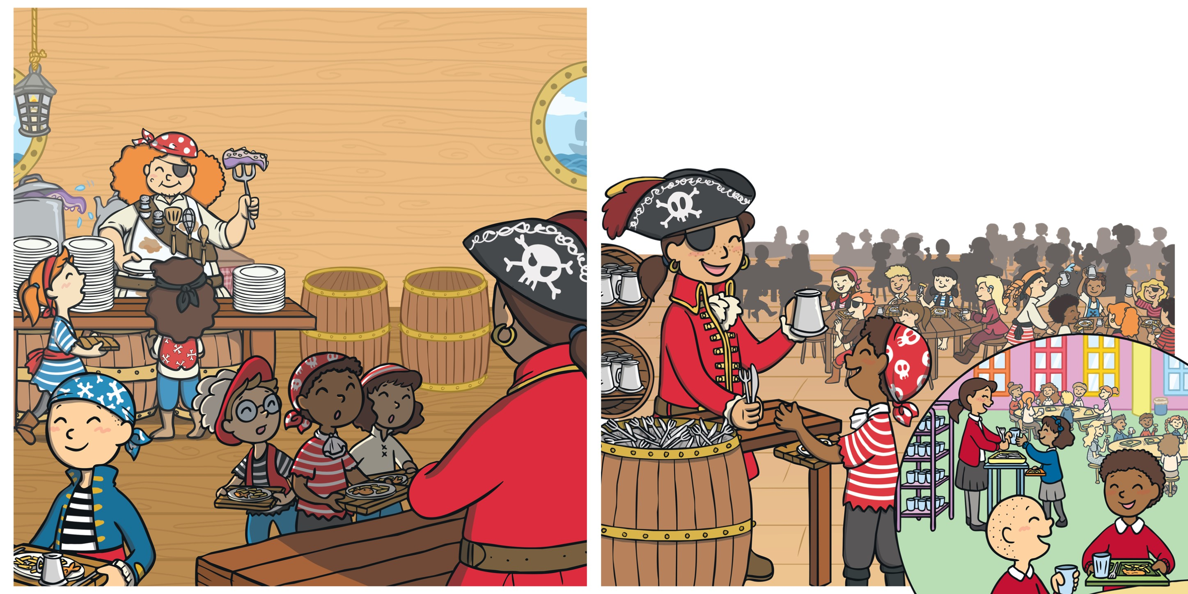
Together, the pirates made their way to the lower deck, where lots of other hungry pirates had gathered. After waiting in line, Jake was given a tray of hot food.
“Here’s your cutlery,” said the enormous pirate. “Make sure you get yourself a nice drink of water too.”
“Phew! I mean, thanks,” said Jake.
As he turned around, wondering where to sit, he found himself face to face with a huge stranger.

Slide 10
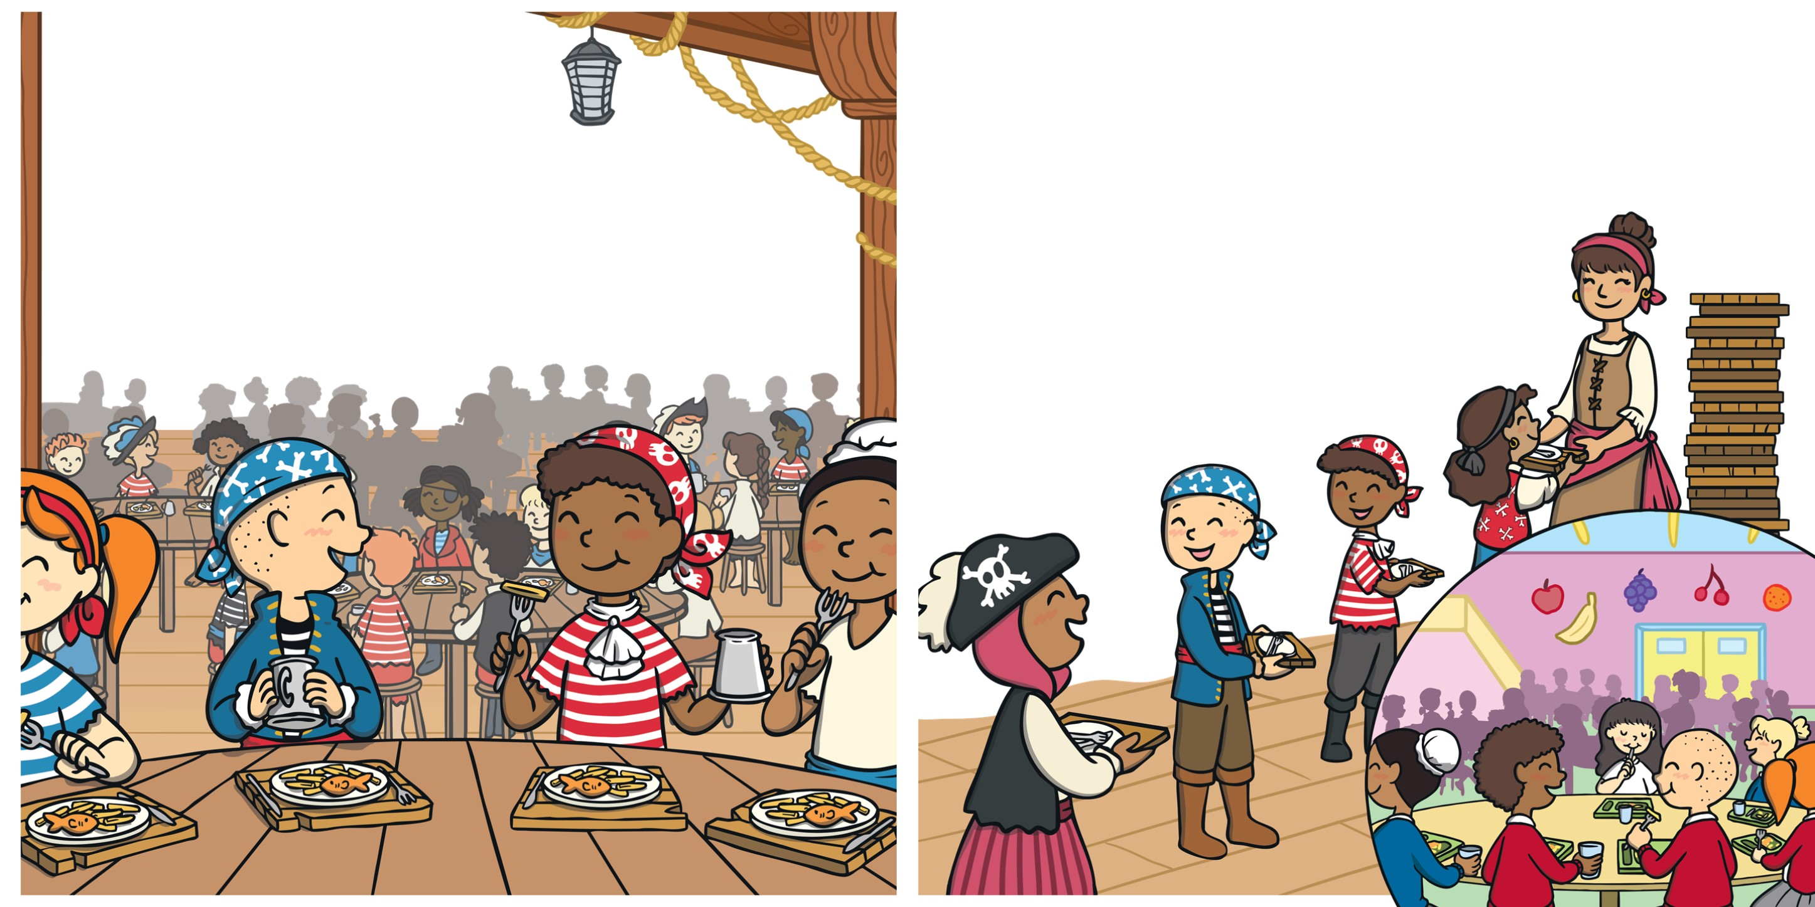
^{“Sit here!” called Darnell.}
Jake chewed his food, smiling and nodding as his new friend chatted away.
^{Jake smiled and joined him.}
Once they’d finished eating, Hani appeared. “I bet you can’t get across the sea without being eaten by crocodiles,” she said.
“Isn’t this the yummiest food ever?” said Darnell. “I love fish. And I love chips. But my favourite is fish and chips. Do you like fish? Or do you prefer chips? I think…”
“I bet we can!” replied Jake and Darnell.

Slide 11
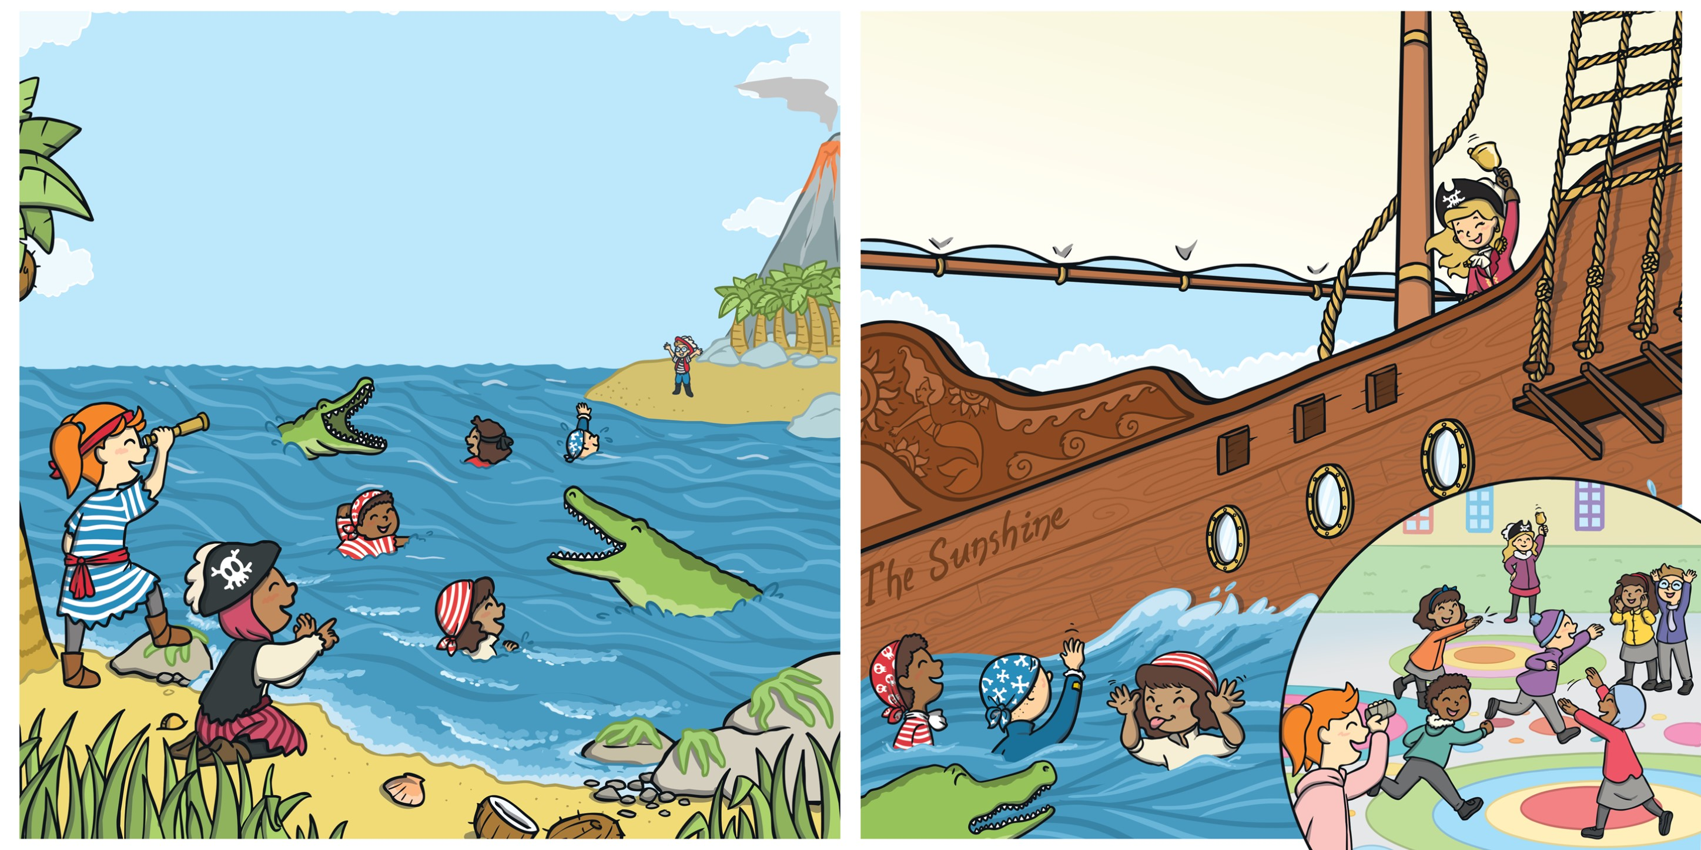
They made their way off their ship and outside.
Just then, Captain Fox appeared, ringing a loud bell. “All pirates back on board, please. We need to work out how much treasure we have!”
“You have to get from here, all the way across, without any crocodiles catching you,” said Hani. “Ready, steady, go!”
The pirates carefully raced across the sea, trying to avoid the crocodiles.

Slide 12
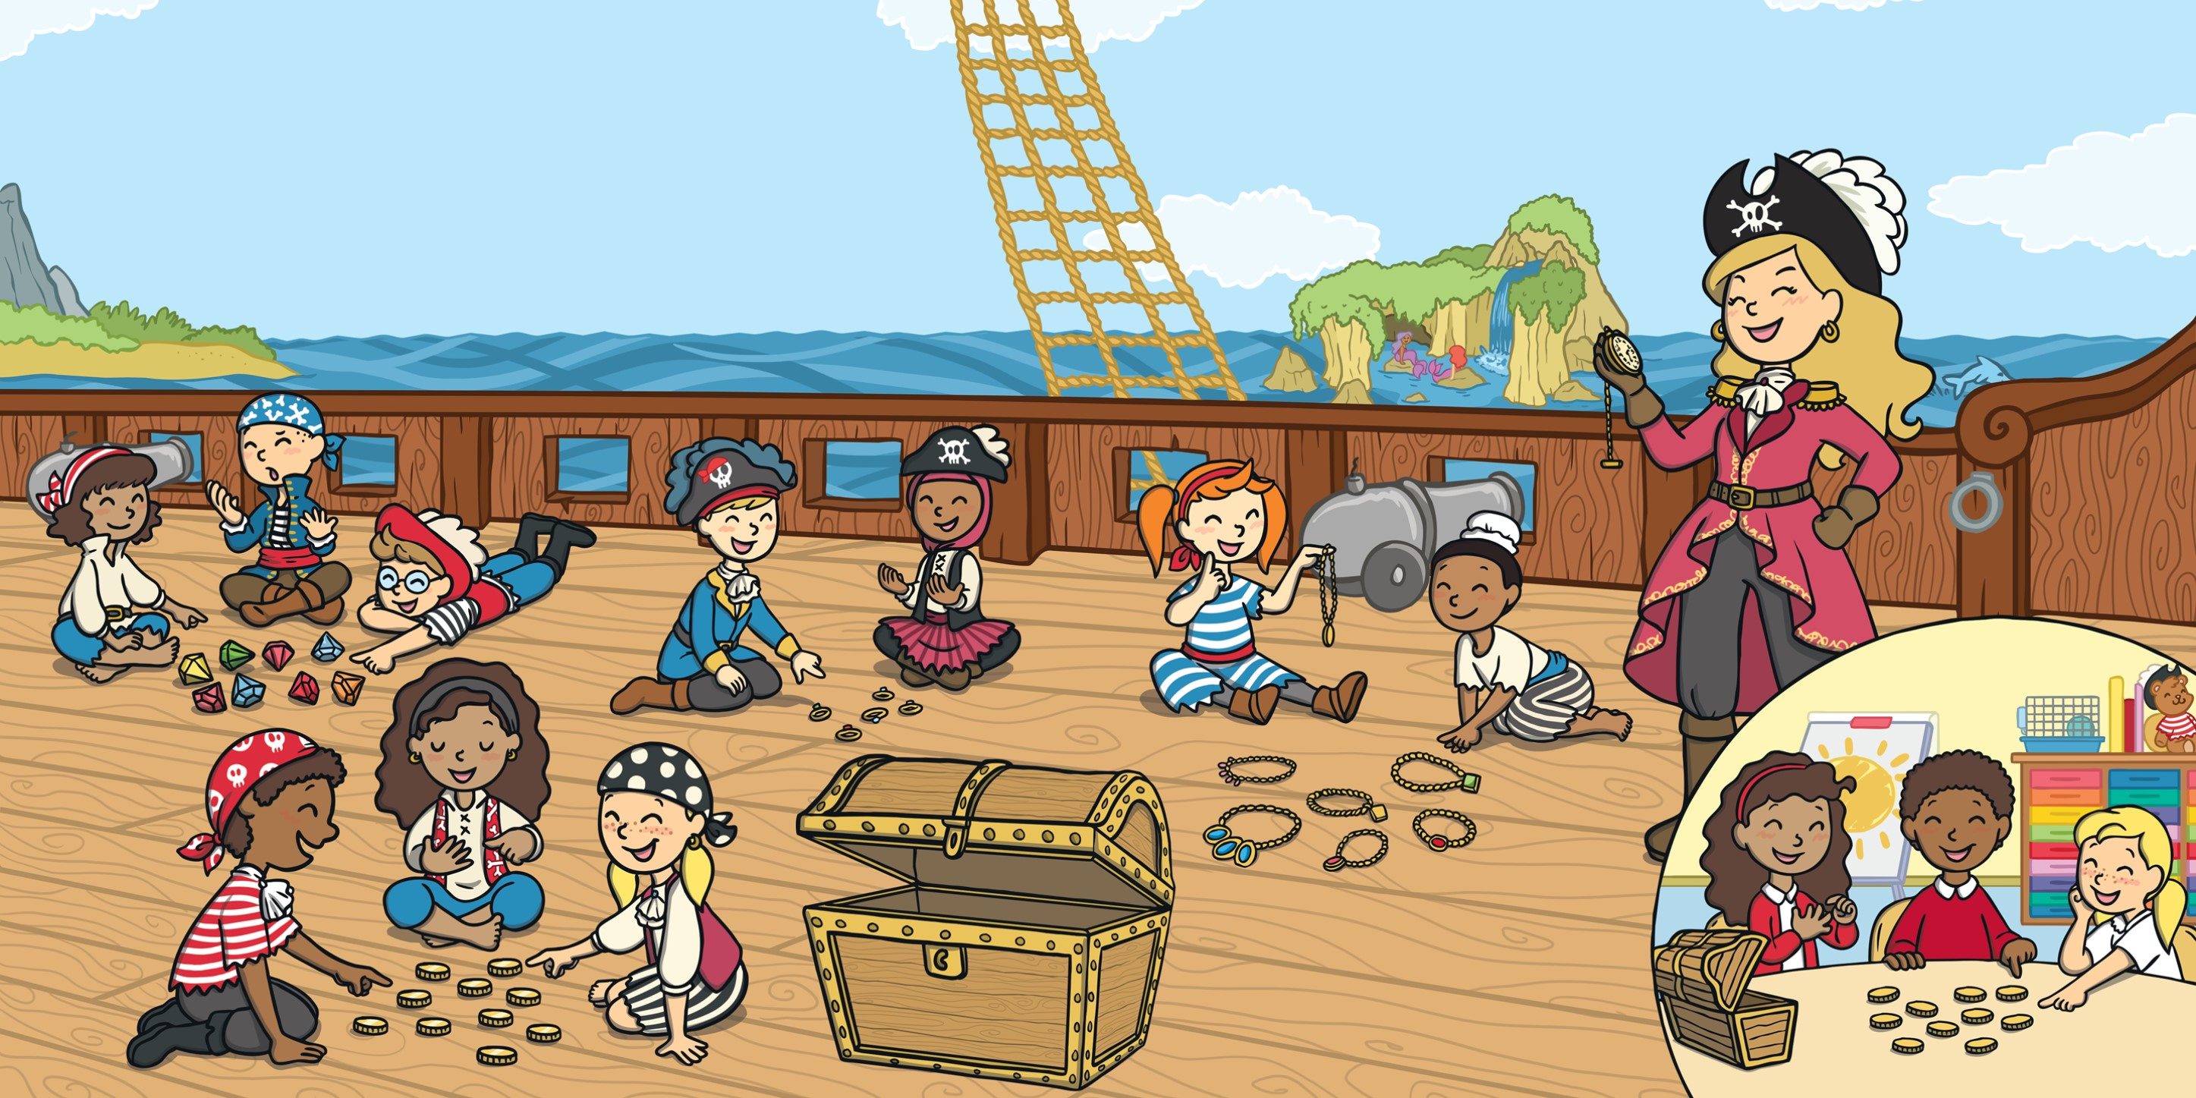
Each pirate helped to count the coins, the rings, the diamonds and the necklaces. They counted again to double-check.
“10 gold coins, 5 rings, 8 diamonds and 7 necklaces,” said Captain Fox.
“1, 2, 3, 4…” counted Jake, making sure he got it right.
“Amazing counting, everyone. Now, let’s get everything shipshape!”

Slide 13
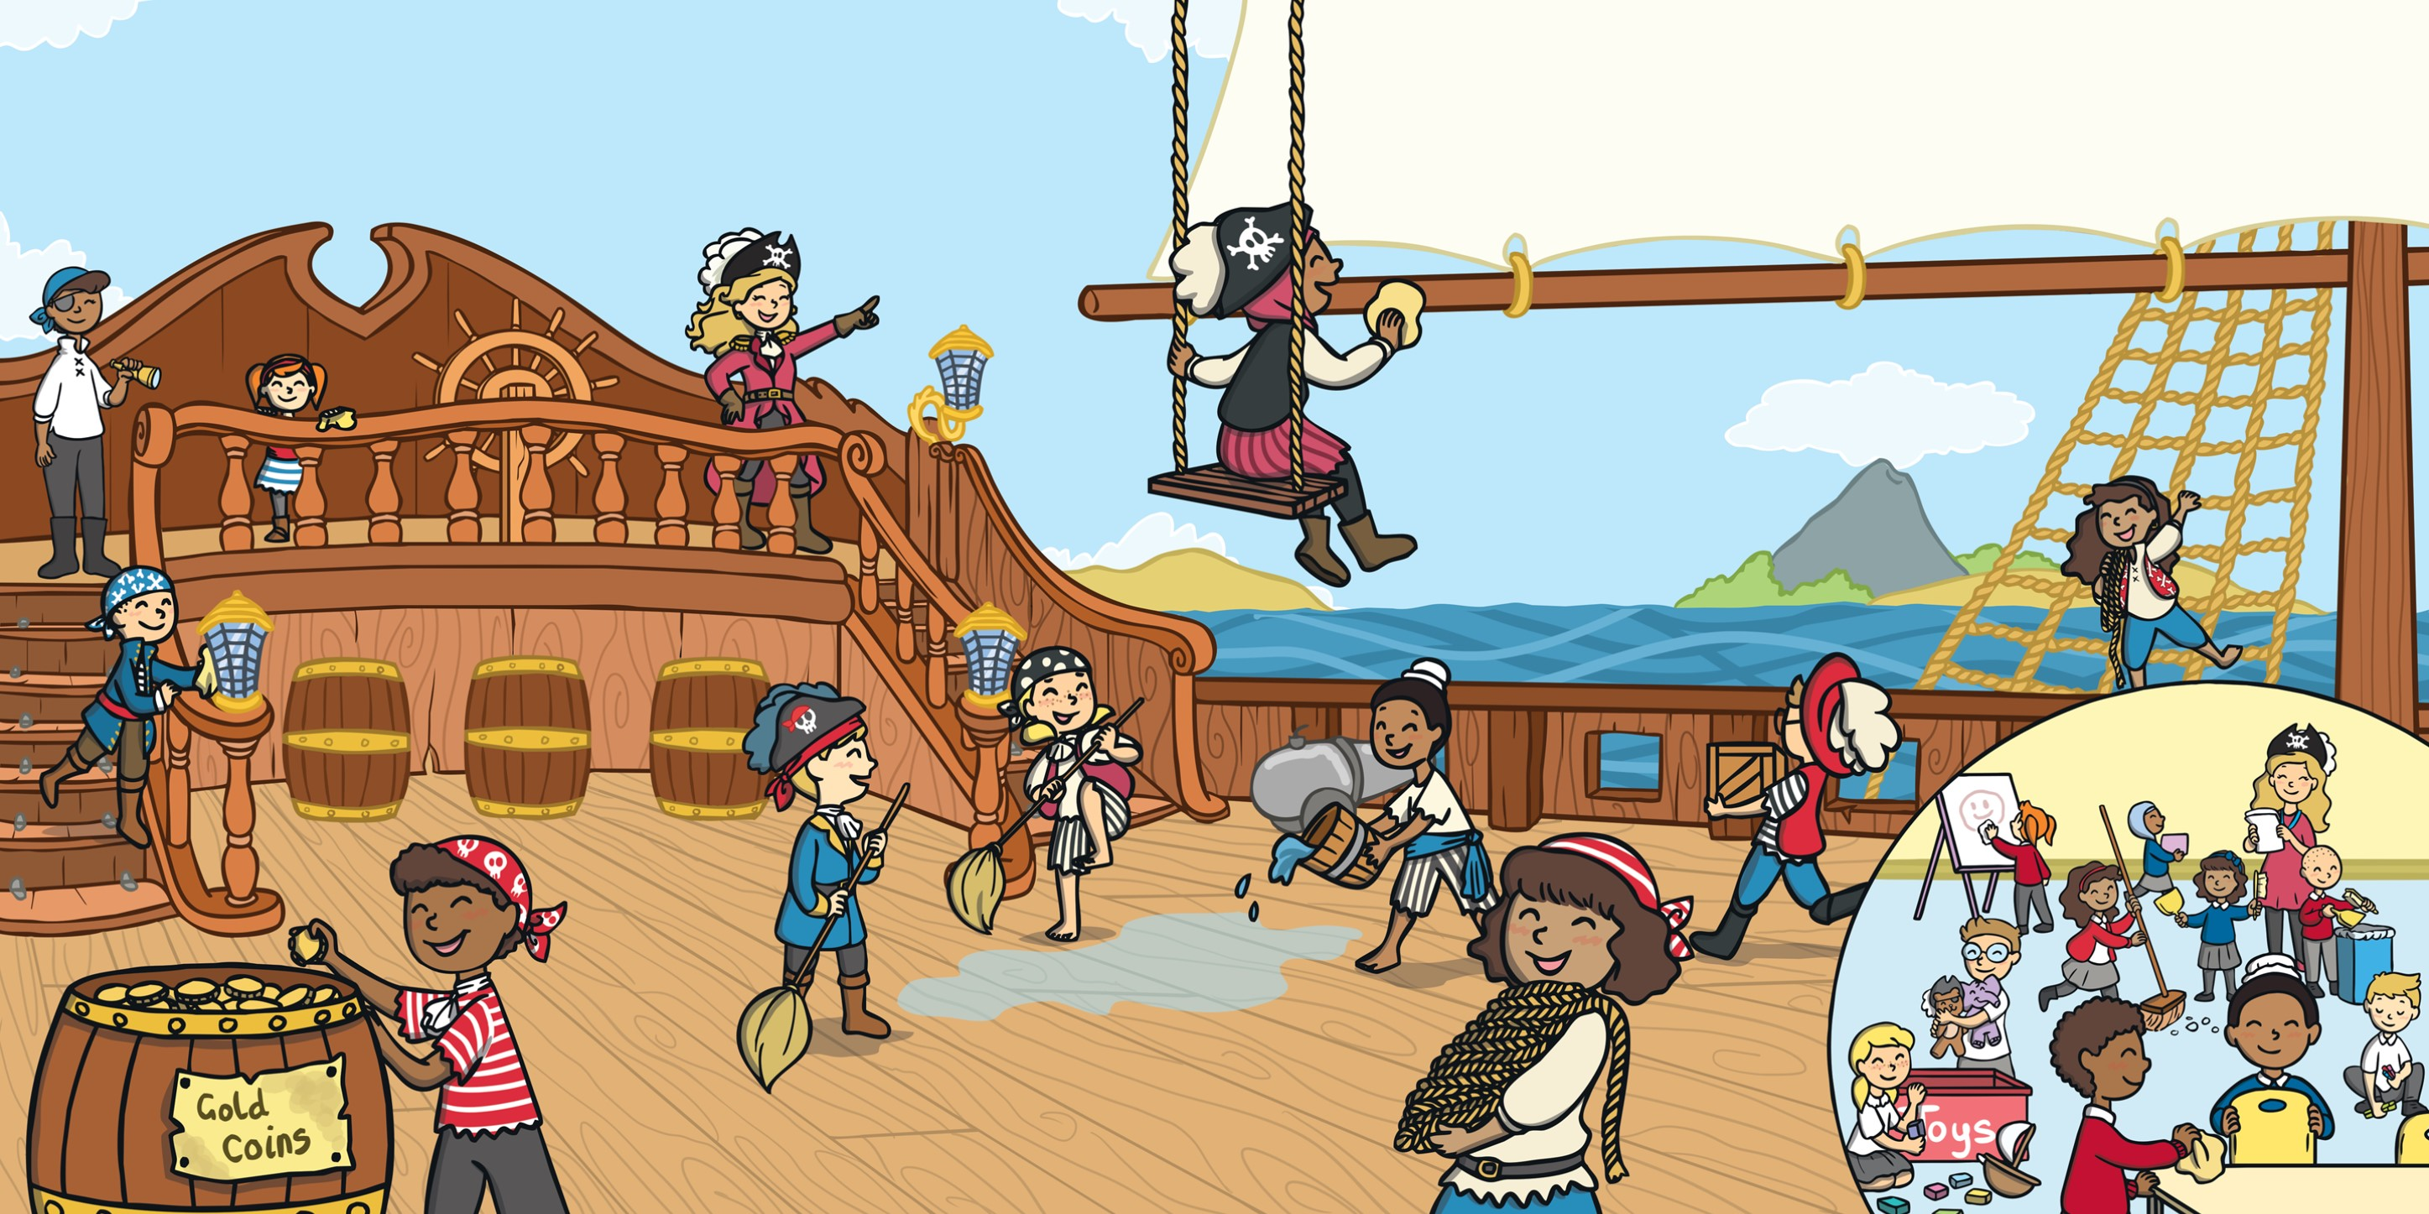
Everyone tidied and swept, scrubbed and cleaned, making sure everything was in the right place.
Once the ship was spick and span, Captain Fox told all of the pirates to collect their things and prepare for land.

Slide 14
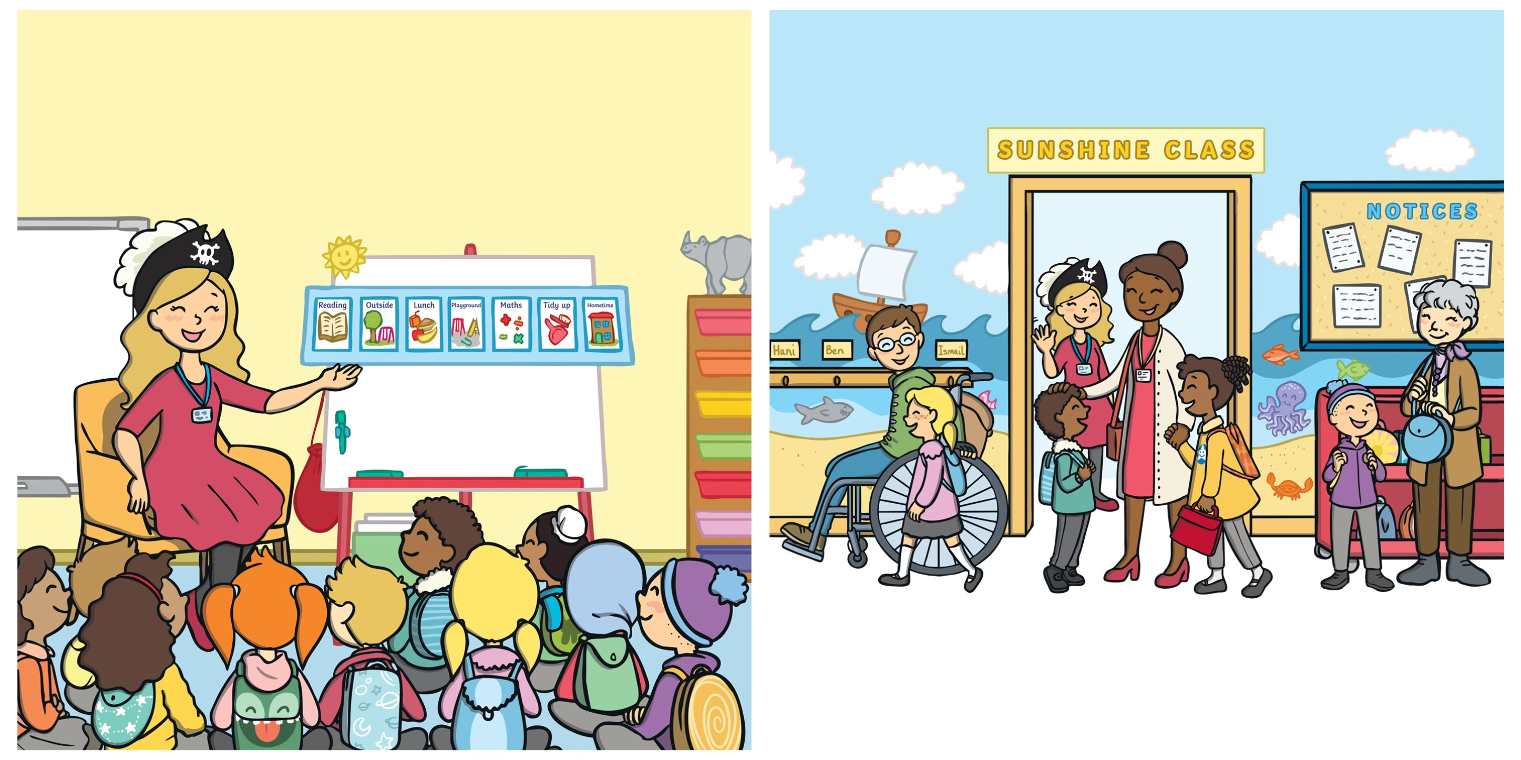
“What an amazing first day we’ve had!” said Miss Fox. “We’ve done some excellent reading, we’ve followed a map, we’ve been in the dinner hall and the big playground for the first time and we’ve even managed to find and count some treasure!”
Before Jake knew it, it was time to go home. Waiting at the door were Mum and Holly.
“So, how was your first day?” asked Mum.
“It was a real adventure!” said Jake. “I can’t wait for my second day.”

Slide 16


