Slide 1

We are learning some prepositions: in, on, under, over beside, in front of and behind

Slide 2

Rainbow colours story and song
https://www.youtube.com/watch?v=lY8eIqCEu04
https://www.youtube.com/watch?v=nRTdq0VsLGQ
You could go hunting for rainbow colours…
You could get creative and make rainbows…
Remember to say where you find objects
And colours… in the sky, on the ground…

Slide 3
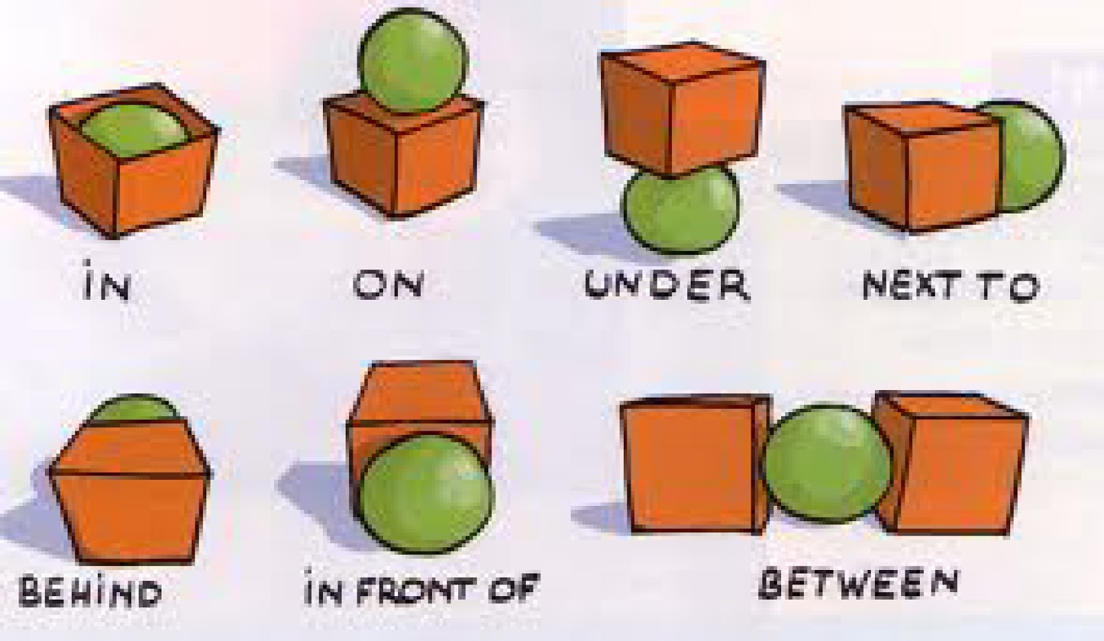

Prepositions – using any object and a plastic cup – show me …
in on under over beside in front of behind

Slide 4
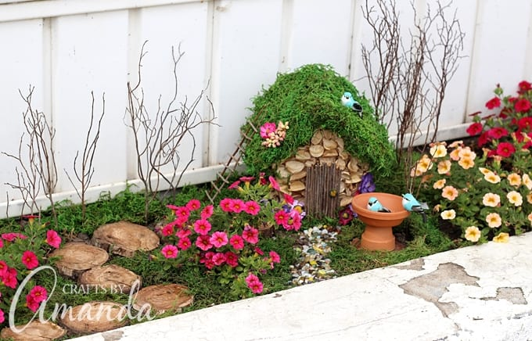
Lets make a fairy garden…
LO: To use prepositions in conversation.
To improve fine motor skills – cutting.
Practise your cutting skills
Laminate pictures of fairies
Glue to lolly sticks
Now lets go outside!

Slide 5
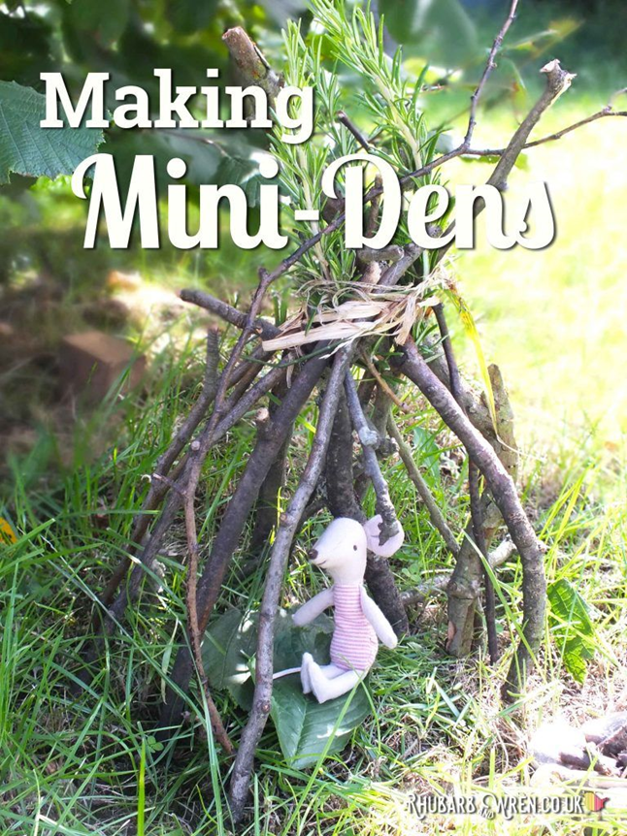
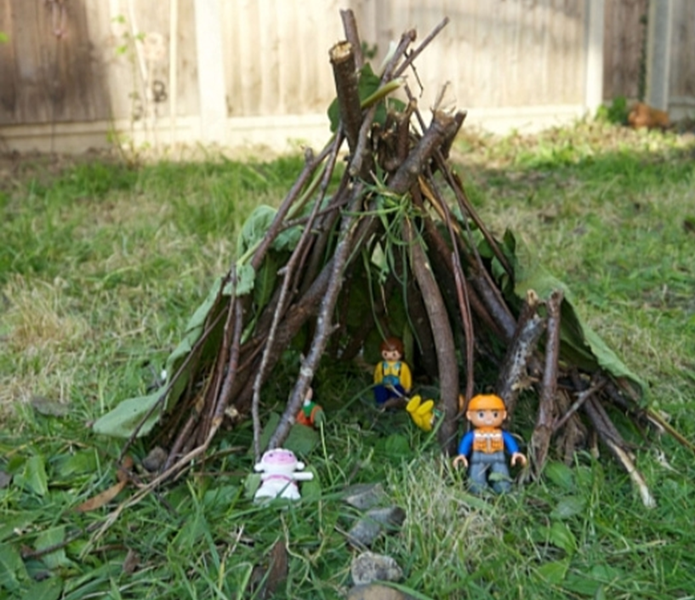
LO To develop communication (use those prepositions) and team work.
To find resources in the garden and use fine motor skills.

