Slide 1

We are learning about prepositions, peasants, princes, magic, rainbows and
Shakespeare’s
A Midsummer Nights
Dream

Slide 2
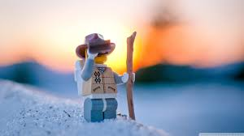

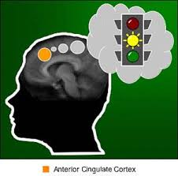

Rainbow stories – I will need an adult to help me with these activities
Learning intention: I will learn more prepositions (in, on, under, over, beside, in front of, behind) and identify colours
We are going to – explore, discover, anticipate and interact

Slide 3

Rainbow colours story and song
https://www.youtube.com/watch?v=lY8eIqCEu04
https://www.youtube.com/watch?v=nRTdq0VsLGQ
Now let’s go hunting for rainbow colours…
Let’s get creative and make rainbows…

Slide 4

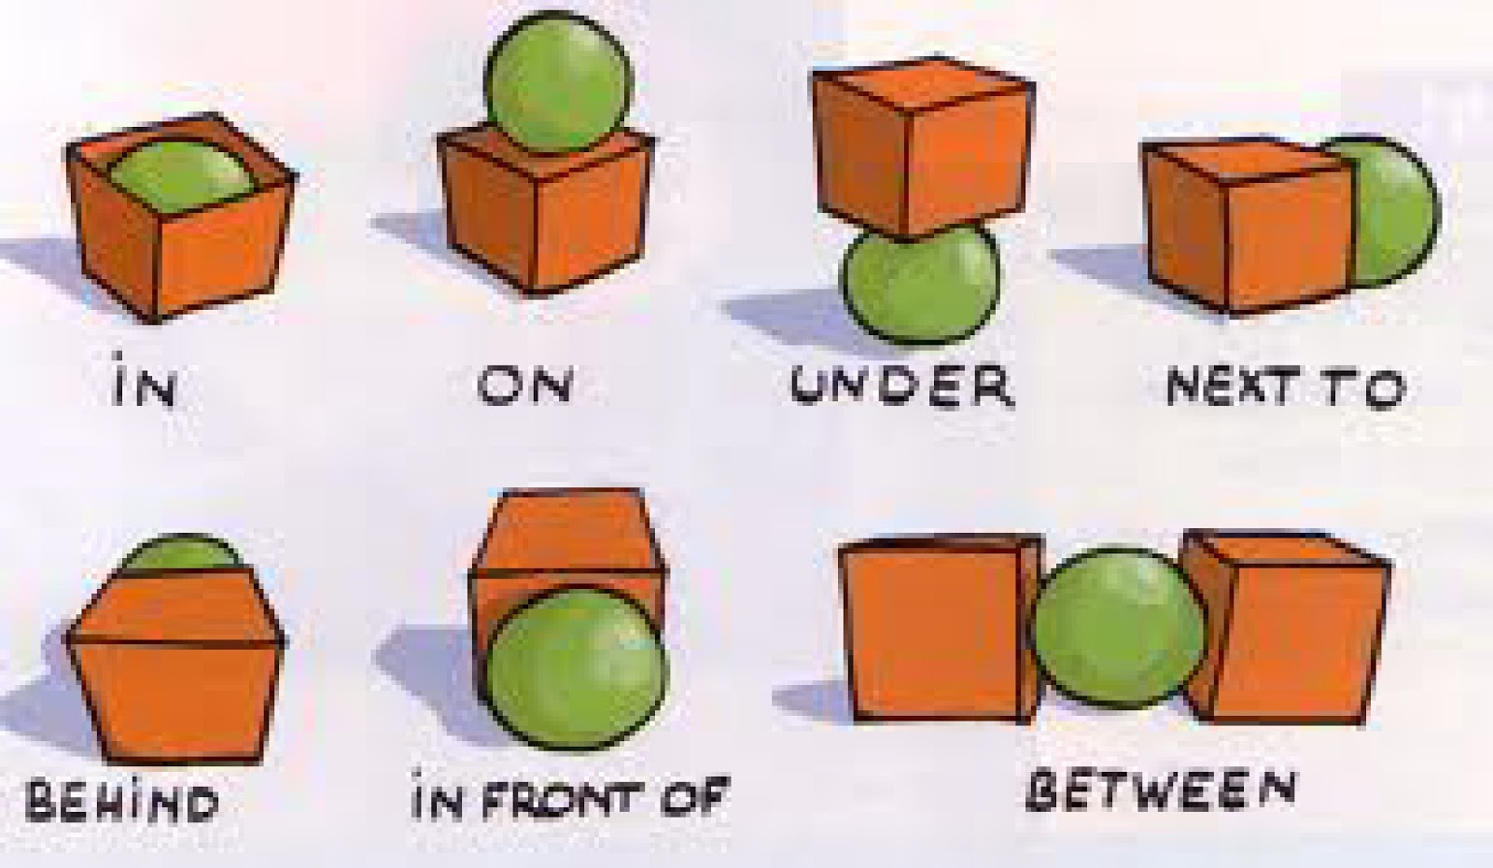
Prepositions – show me …
in on under over beside in front of behind

