Slide 2
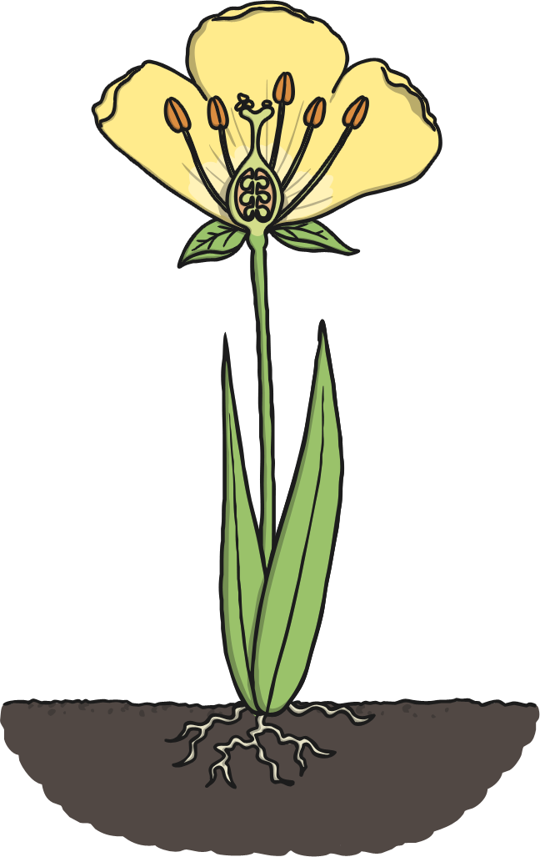
Parts and Functions of a Plant
Click on the labels to read about each part of the plant.
petal
anther
stem
leaf
roots

Slide 3


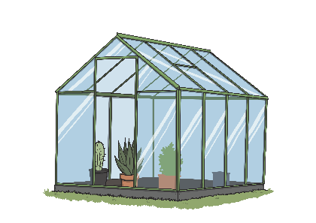
Leaf
Leaves make food for the plant from carbon dioxide in the air and sunlight.

Slide 4
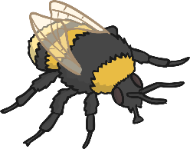

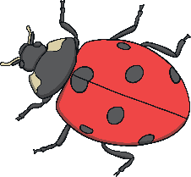
Petal
Petals attract insects to
the plant.
Plants need insects to bring pollen they have collected from other flowers so they can make seeds.
Petals are bright colours to attract the insects.

Slide 5
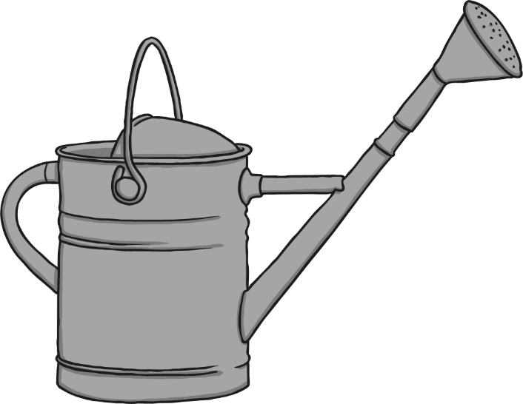
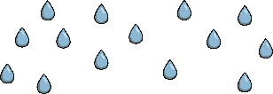

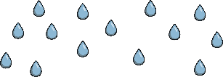
Roots
Roots absorb minerals and water from the soil.
The roots also help the plant anchor in the soil and stay upright.

Slide 6
Stem
The stem transports water around the plant.
It also holds the plant upright so it can get more sunlight.

Slide 7

Anther
The anther contains pollen which brushes onto insects when they land on the flower.
The pollen is moved by insects to other flowers.

