Slide 1
Rainforests

Slide 2
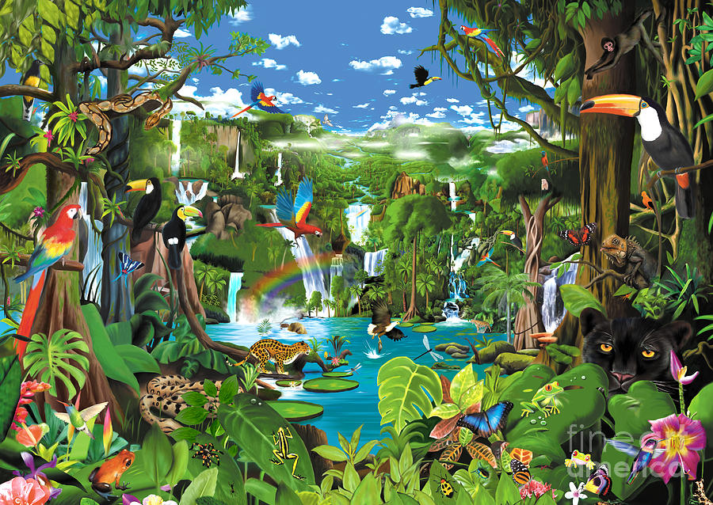

Slide 3


Slide 4
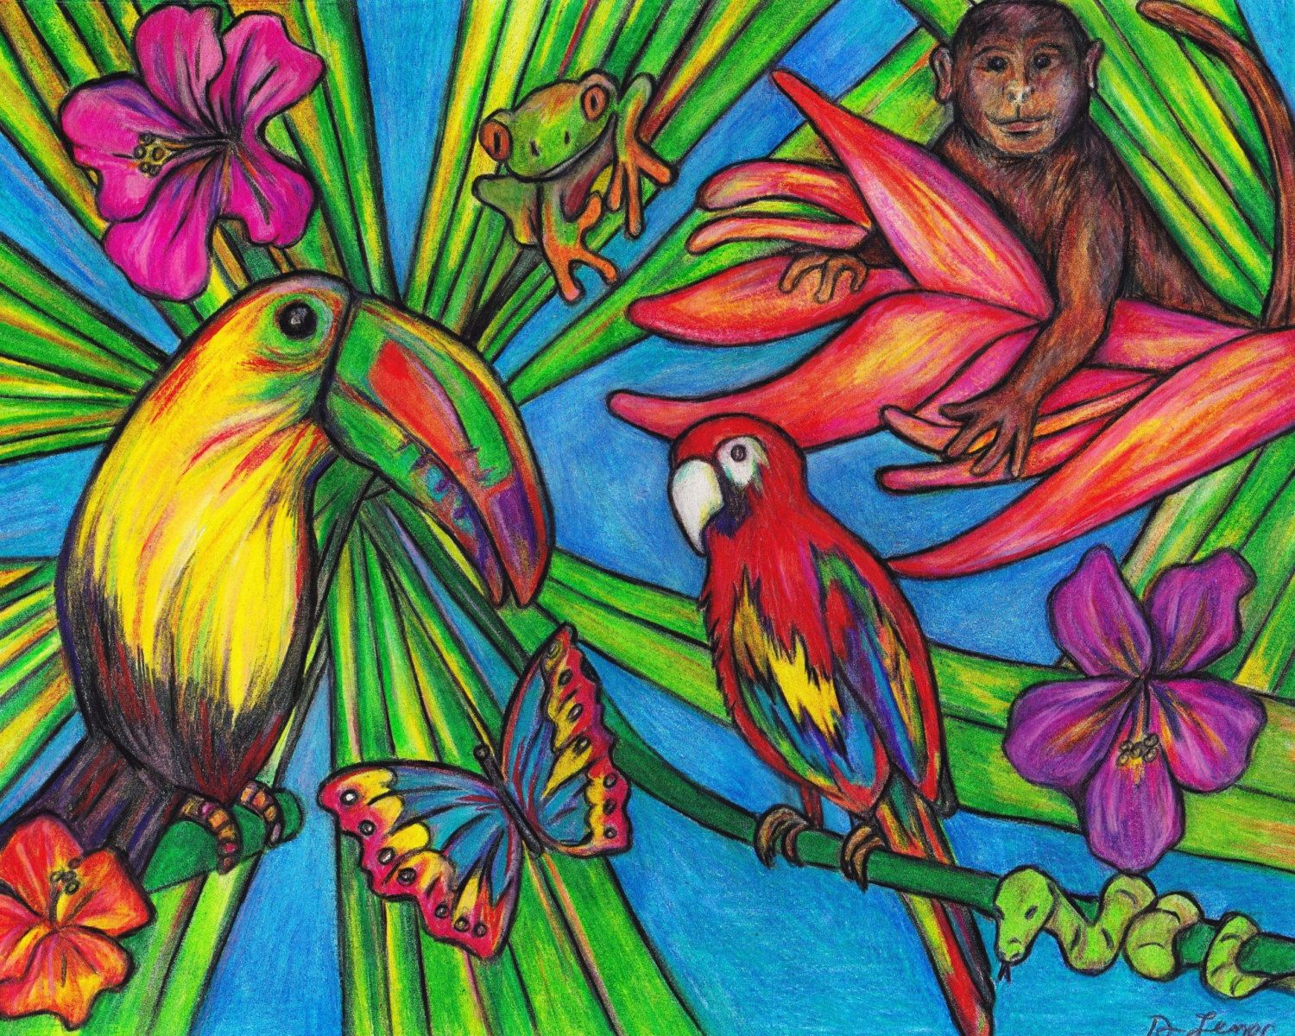

Slide 5


