Slide 2

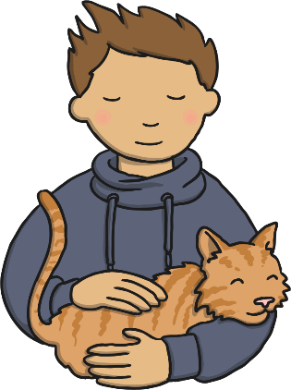



Senses
We have 5 senses. Today we are going to focus on smell.

Slide 3
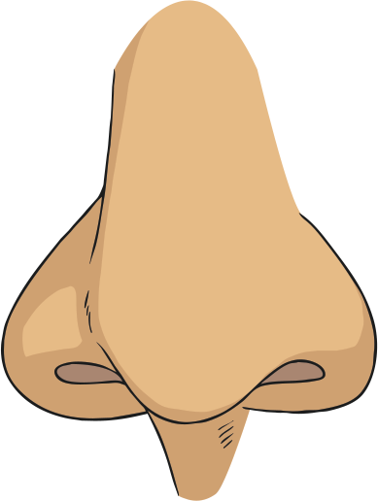
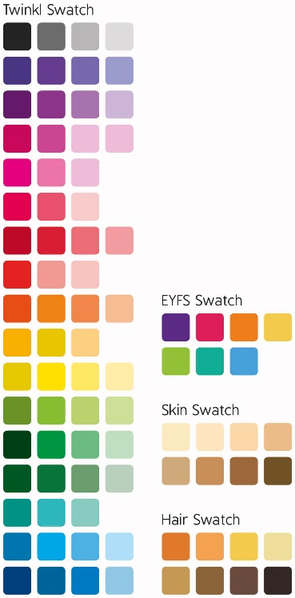
Learning Objective:
I can name the 5 senses.
I can name parts of the nose.
I can discuss what we can do
with this sense.

Slide 4

Where do you find these smells?
What is your favourite smell?
Where do you smell this smell?
What makes this smell?
When do you smell this smell?
What smells don’t you like?

Slide 5
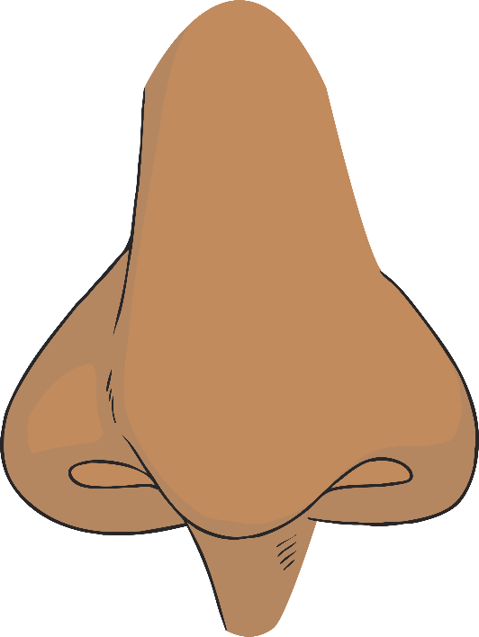
Nostril
The nostrils warm, moistens and filters air before it enters the lungs.
Septum
The septum is the small bone that separates the nostrils.
Olfactory: word for things to do with smelling.
Important Word

Slide 6

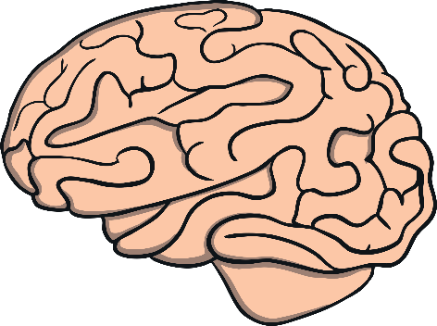

How does our sense of smell work?
Inside your nose are special, sensitive cells that can detect smells (also known as ‘odors’)
The things around us release tiny bits (called ‘molecules’) that the cells in your nose pick up.
The cells then send a signal to tell your brain what these molecules
smell like.

Slide 7

Task
At your tables.
Smell the pots at your table.
Match the pots to find one with the same smell.
What are the smells?
Are they nice or unpleasant?
Have you smelt this before?
Is it easy to match the pots?
Which smell was the easiest to recognise? Why?

Slide 8
Smelly Wordsearch
Find the words in the wordsearch.
Click on the first letters of each word to highlight them.
h | o | f | p | s | e | p | t | u | m
h | q | a | f | n | r | m | t | b | p
o | l | f | a | c | t | o | r | y | u
a | m | g | x | d | i | i | p | t | j
r | z | x | r | h | l | n | n | p | n
c | s | m | o | s | c | o | i | w | o
g | g | r | q | s | m | e | l | l | s
n | o | s | t | r | i | l | g | x | e
smells
olfactory
septum
nose
nostril

