Slide 2



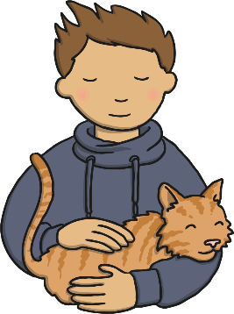

Our Senses
Your body is very clever – it is always working hard to help you learn about the things around you.
There are five main senses that your body uses everyday…
taste
smell
sight
hearing
touch
You are using your senses right now!
Click on a sense to find out more!
I know all five senses!

Slide 3


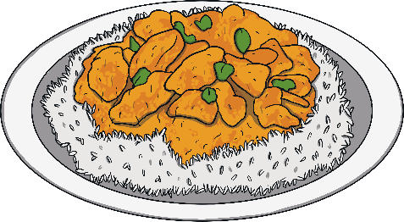


Taste
We use our mouths and tongues to taste food and drinks. We can tell if things taste bitter, salty, sweet or sour. Everyone has foods they like and foods they dislike!
Which foods do you like the taste of?
What tastes do you not like?
back

Slide 4
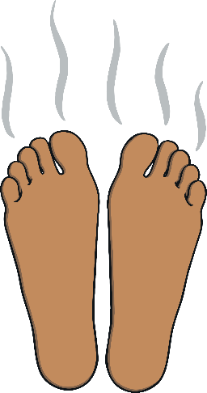


Smell
We use our noses to smell things. Noses can detect things that smell nice, such as flowers and cakes baking in the oven. However, noses can also detect nasty smells, such as a rubbish bin or old socks!
Which smells do you like?
Which smells are not nice?
back

Slide 5




Sight
We use our eyes to see things. We can see things that are near to us and things that are far away. Some people wear glasses to help them see things more clearly.
What things have you seen today?
Can you see your friends smiling at you?
back

Slide 6
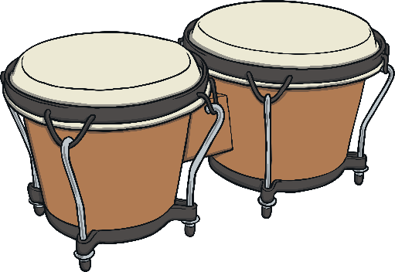
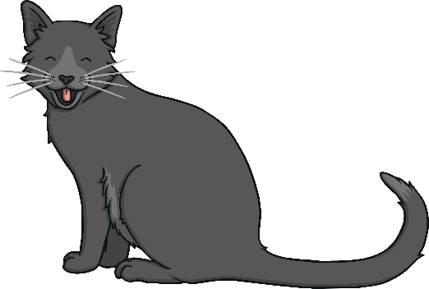
Hearing
We use our ears to hear sounds. Some sounds are loud and some are quiet. For example, fire alarms are loud, but someone whispering is quiet. Even when you are sleeping, your ears will be busy listening to hear what is going on around you. Some people use hearing aids to help them hear more clearly.
What sounds have you heard today?
Were they loud or quiet?
back

Slide 7
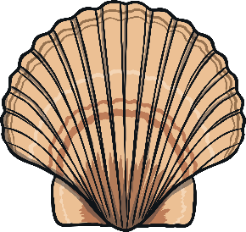
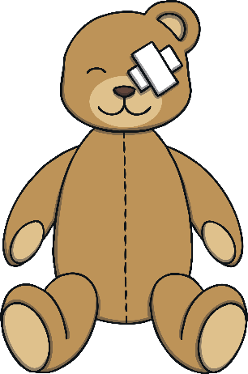
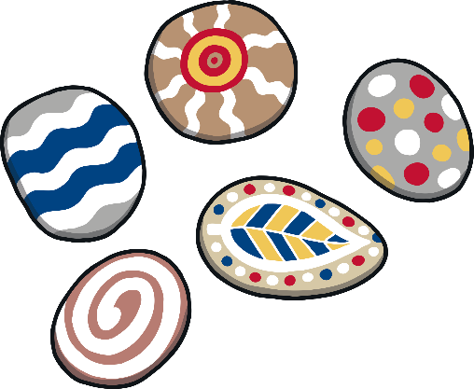

Touch
We mainly use our hands to touch and feel things. However, the skin all over your body can feel things too. We can tell if things are hot or cold, hard or soft, tickly or prickly and lots, lots more.
What would a teddy bear feel like?
What would a sea shell feel like?
back

Slide 8
Which senses have you used today?

