Slide 1
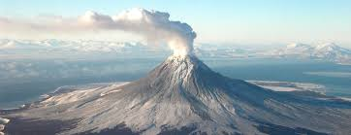
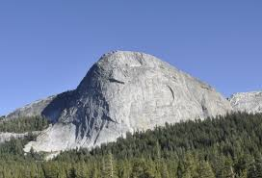
Different types of Mountains
-----------------------------------------------------
---------------------------------------------------

Slide 2
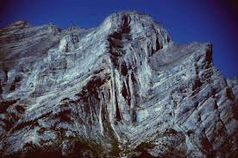
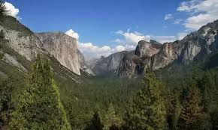
Word Bank:
Dome Mountain
Fold Mountain
Block Mountain
Volcano
------------------------------------------
---------------------------------------------

