Slide 1
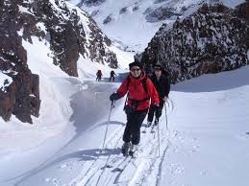
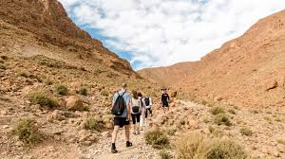
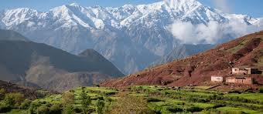
Hike and ski in the Atlas Mountains
Week 1 – choose a Mountain Range and locate it on a map. What do you already know about the mountain range? What would you like to find out? Decide how you would like to present your brochure.

Slide 2
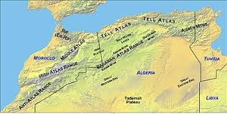
Week 2 – Describe the mountain range and what you will see when you look out from the top.
Description: The Atlas Mountains are located in North Africa. The Mountains are fold mountains created by the African Tectonic Plate moving against the Eurasian Plate pushing the land 4167m into the sky. Looking North you can see the Mediterranean sea and Europe and to the south you look towards the Sahara Desert. A very dry place which can be partly blamed by the mountain range. As the moist air rises from the Mediterranean Sea it falls on the West side of the mountain as rain and snow, the air that reaches the southern part of the mountains is dry and does not contain moisture.

Slide 3
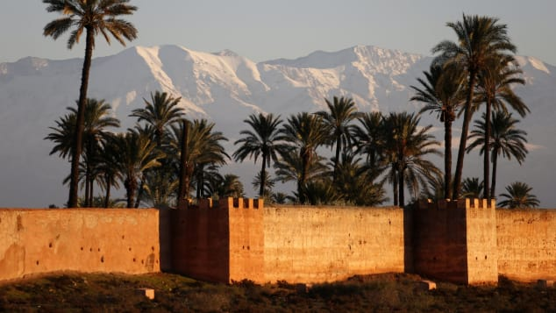
How to get there: Flights go daily form the UK and range between£75 and £150. From Marrakech there is just a short 50km drive to the mountains resort of Oukaimeden. You can drive or take a coach.
Week 3 – where is the resort and how can you get there?

Slide 4
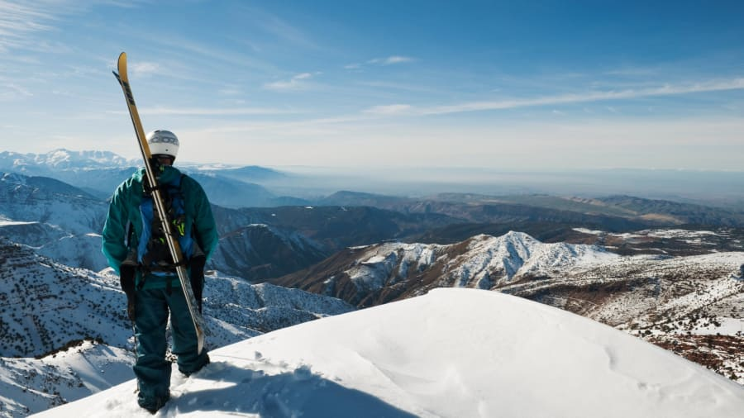
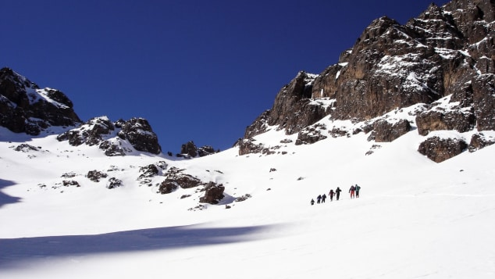
Week 4 – what can you do when you get there and are there any local communities you can support?
What you can do when you are there: Bring your own skis or higher some form the resort, as you can find 13km of ski slopes and an array of hiking areas. The area also boasts hiking high in the snowy peaks and work with the Berber people, the indigenous people to the area. They will guide you through mountain passes and valleys to witness some breath-taking scenery.

Slide 5
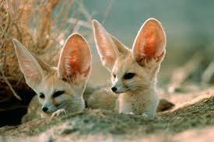
Eco friendly – walk to the resort, take rubbish home with you, follow specific paths, use local guides to support their culture, family and future.
Travel by train and ferry rather than flying. Visit local wildlife centres to support the conservation of the ecosystem.
Week 5 – how can you make your adventure eco friendly?

