Slide 1

Helping out around the house and increasing daily exercise!

Slide 2
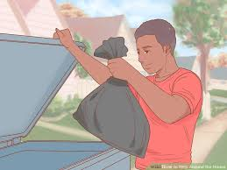
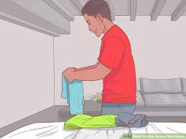
Take the rubbish out
Fold up and put your clothes away

Slide 3
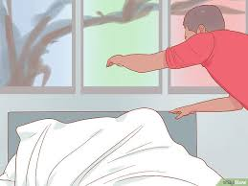
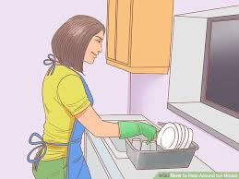
Make your bed
Do the washing up.

Slide 4


Vacuum, dust and sweep
Unload the washing machine

Slide 5

Walk the dog – with your parents or carers permission

