Slide 1
1st march 2019
R.S.E.
RELATIONSHIPS
EDUCATION
S.E.X.
Lesson 1 = Who am I ? What makes a good friend ?
Reflect on our own qualities
See if we have what it takes to be a friend
Reflect on what qualities we want our friends to have

Slide 2
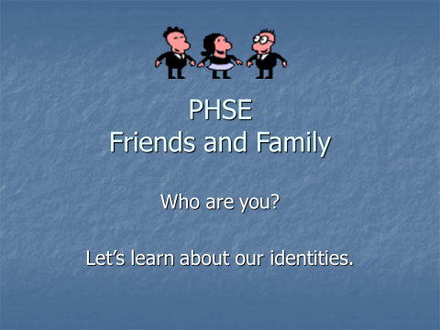
POWERPOINT = “WHO ARE YOU ?” (7 SLIDES)

Slide 3
READ AND COMPLETE GRID = TICK BOX

Slide 4
Colour in the best 10 qualities you think a good friend should have =
loyal | loving | kind | dependable
reliable | generous | considerate | helpful
unique | similar | likeable | sweet
thoughtful | courteous | forgiving | special
gentle | funny | welcoming | reliable
pleasant | mate | tolerant | supportive
caring | pal | chum | buddy

Slide 5
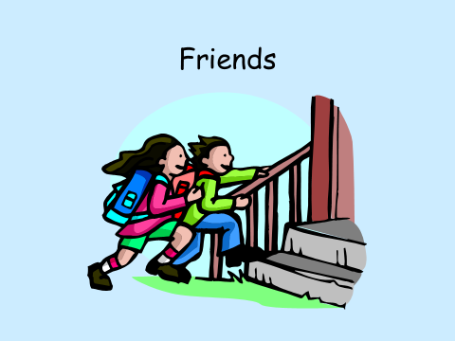
POWERPOINT = “FRIENDS?” (5 SLIDES) + WORKSHEET WITH 2 EXERCISES

Slide 6
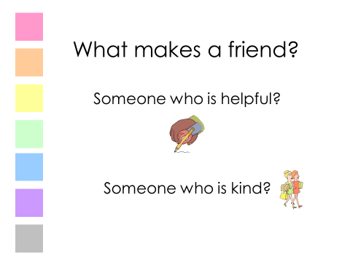
POWERPOINT = “MAKING FRIENDS?” (8 SLIDES) + WORKSHEET WITH 2 EXERCISES

Slide 7
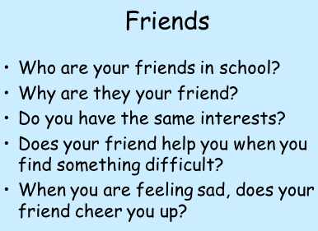
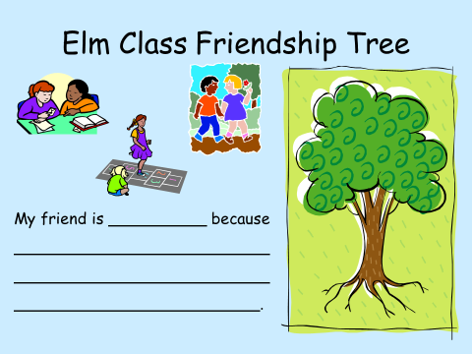

Slide 8
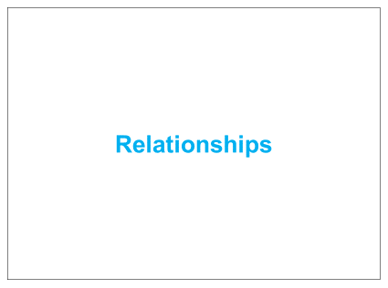
POWERPOINT = “6-1 “relationships?” (5 SLIDES) + WORKSHEET WITH 2 EXERCISES

