Slide 2

Strawberries Are the Best!
Many children say strawberries are their favorite fruit.
Strawberries are a great source of vitamin C.
Strawberries are low in calories.
There is a museum in Belgium dedicated only to strawberries!

Slide 3
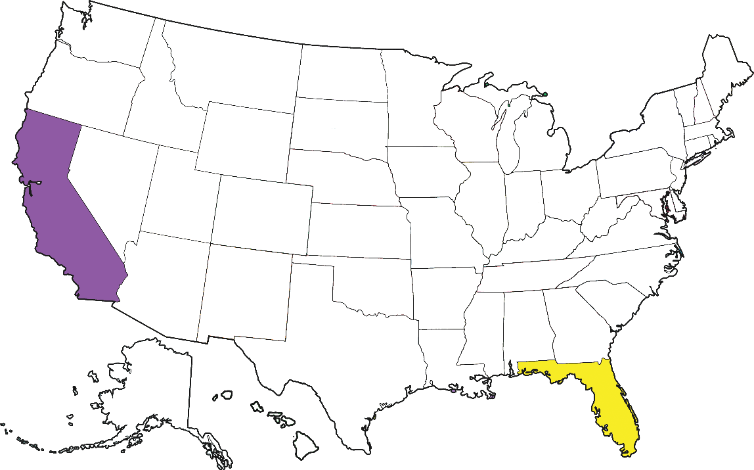
Where Do Strawberries Grow?
The United States grows more strawberries than any other country.
Strawberries grow in all 50 states, but most come from California
and Florida.

Slide 4
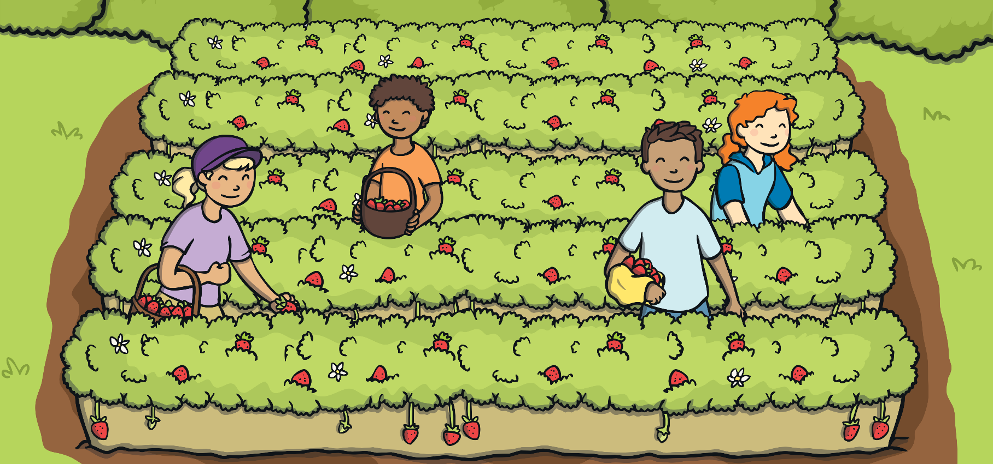
Strawberry Farms
Strawberries on farms are often grown in long rows.
Some people grow strawberries
from hanging baskets in their garden or house.

Slide 5
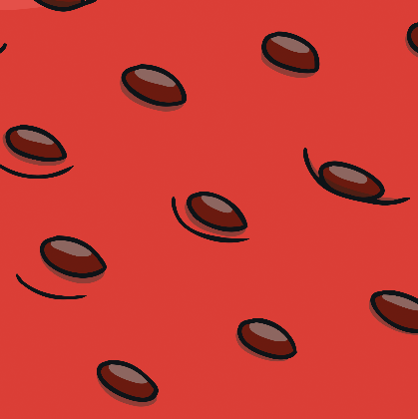

Strawberry Life Cycle
Strawberry seeds are on the outside of the strawberry fruit. The seeds are the small, dark spots on the outside.
When the fruit is eaten by an animal, the seeds pass through them, and are dropped in a new location to grow.

Slide 6
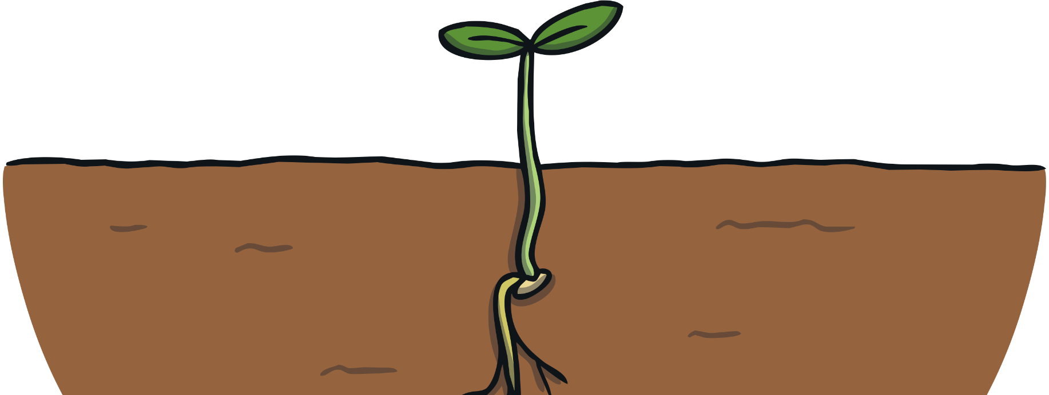
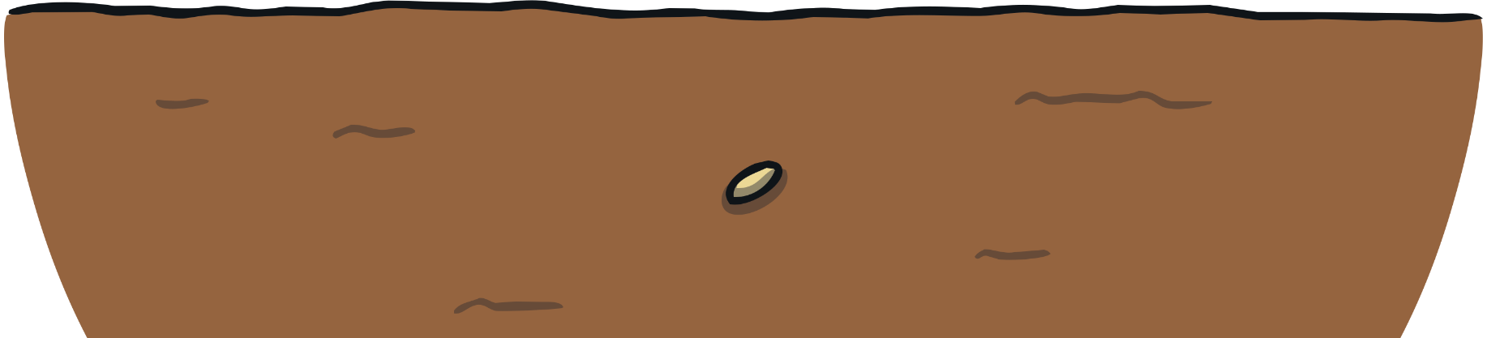
Strawberry Life Cycle
The strawberry seeds need about two weeks of freezing temperatures before they begin to sprout.
The soil around the seed needs to have plenty of water for the seed to soak up.

Slide 7

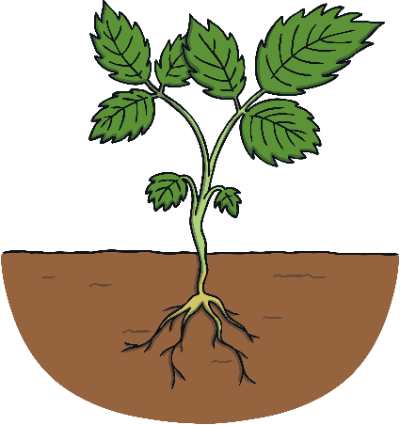


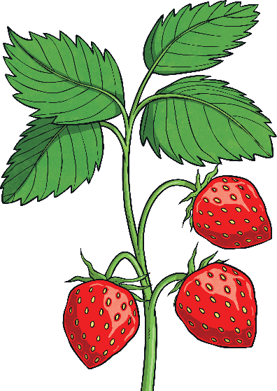
Strawberry Life Cycle
The roots and stems begin to come out from the seed shell.
The stem grows toward the sunlight and sprouts leaves.
The plant needs lots of water and sunshine to keep growing.

Slide 8

Strawberry Flowers
The strawberry plant then blossoms small white and yellow flowers.

Slide 9
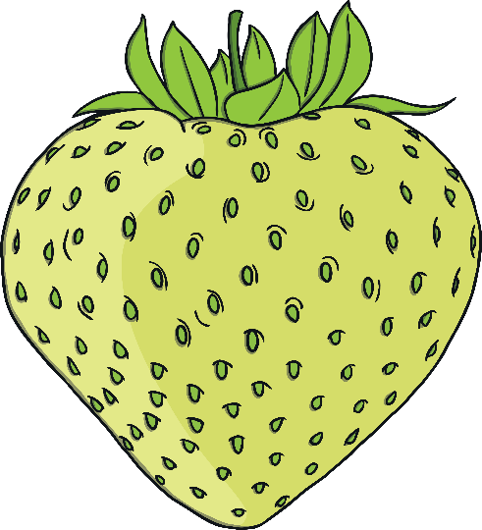
Strawberry Flowers
The flowers begin to grow small, unripe strawberries. These strawberries look green rather than red. Unripe strawberries taste sour.

Slide 10

Ripe Strawberries
After about a month, the strawberries will be ready to pick. The strawberries are ripe when they are bright red. Ripe strawberries are juicy and sweet!

Slide 11
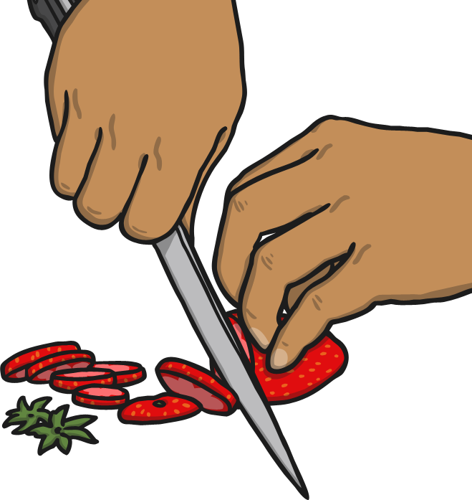
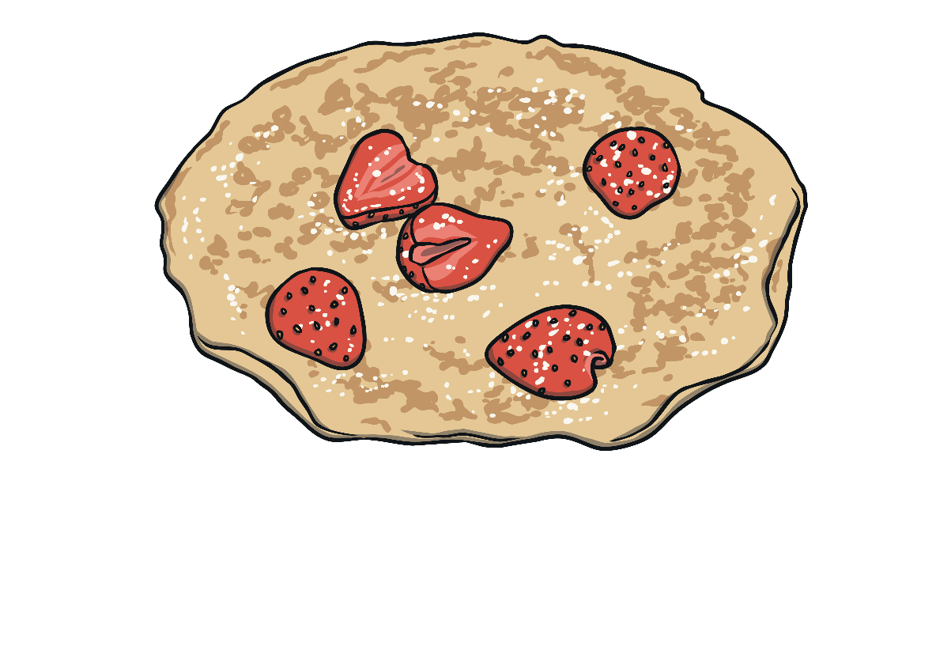
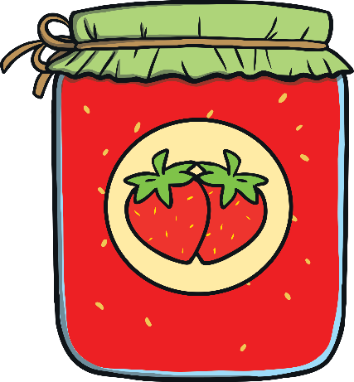
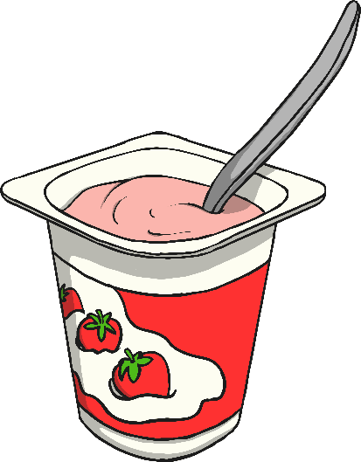
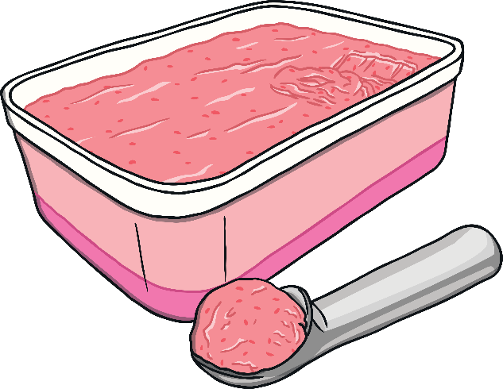
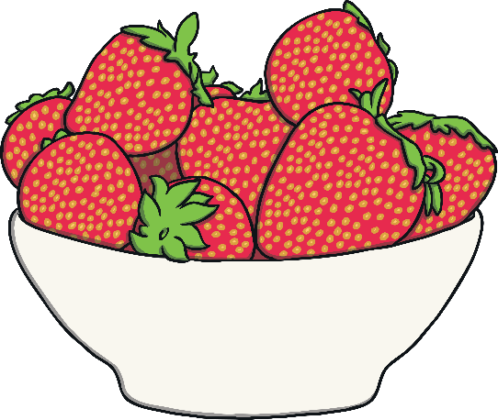
How do you like to eat your strawberries?

Slide 12


